Slide 1
Urban Green Spaces: Enhancing Cities through NBS
Lecture (online)
Trinity College Dublin
Content created in 2024
Notes:
Objective: Understand the role of local governments and public administration in implementing Nature-Based Solutions (NbS) in urban environments.
Explore how local communities and stakeholders can actively engage in NbS development to address climate change, water management, and urban resilience.

Slide 2
NBS Definition – EU
“Solutions that are inspired and supported by nature, which are cost-effective, simultaneously provide environmental, social and economic benefits and help build resilience.
Such solutions bring more, and more diverse, nature and natural features and processes into cities, landscapes and seascapes, through locally adapted, resource-efficient and systemic interventions.”
Reference: European Commission
Notes:
Think of an example

Slide 3
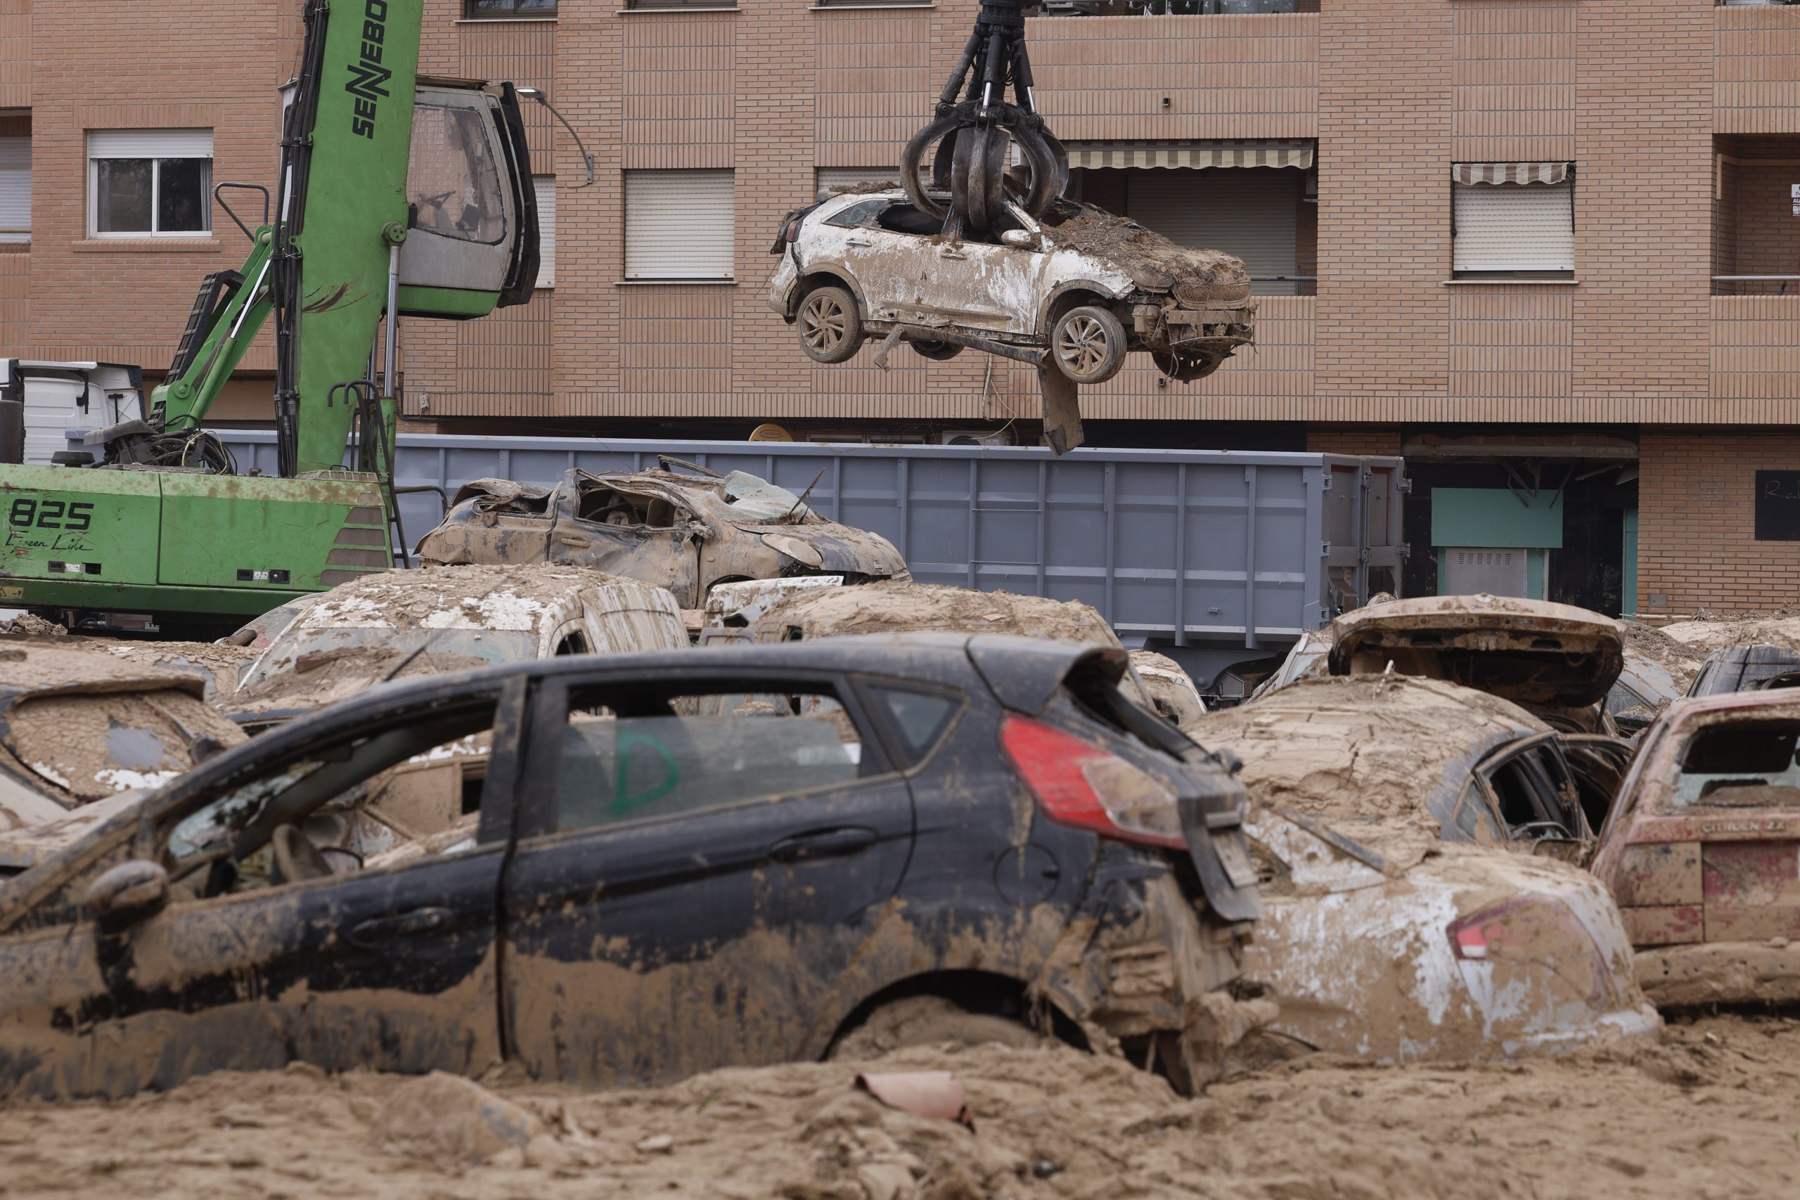
Why Urban Areas Need NBS
Urban Challenges:
Heat islands,
air pollution,
flooding,
biodiversity loss.
NBS Contributions:
Sustainable urban development.
Improved resilience and quality of life.
Flooding is a major threat for many EU cities
NBS are being used to alleviate the impacts
Notes:
Photo Credit: Euractive

Slide 4
Benefits for Urban Environments
Environmental
Carbon sequestration,
flood protection,
biodiversity enhancement.
Mitigating climate change impacts.
Economic
Increased property values near green spaces.
New job sectors in green infrastructure.
Social
Reduced stress, improved mental health.
Social cohesion through shared green spaces.
Notes:
Examples across triple bottom line

Slide 5
Local Government & NBS
Public Administration and NBS: Key Responsibilities
Policy Development: Local governments create and enforce policies that promote nature-based solutions (e.g., zoning laws, urban planning regulations).
Resource Allocation: Governments allocate funding and resources for the planning, implementation, and maintenance of NBS.
Community Engagement: Encouraging local participation and ensuring that the needs of residents are met through inclusive governance.

Slide 6
EU’s Role in Advancing NBS
A major driver of NBS innovation is EU funded research projects such as NBS EduWORLD
EU Research Exemplar Projects:
Connecting Nature: Managing urban infrastructure
URBAN GreenUP: Greening urban infrastructure.
CLEVER Cities: Inclusive and sustainable planning.
GrowGreen: Integrating NBS in urban strategies.
Notes:
Connecting Nature: https://connectingnature.eu/
Urban Green Up: https://www.urbangreenup.eu/

Slide 7
EU’s Role in Advancing NBS
Key EU and National Policies
EU Green Deal: Emphasizes climate neutrality by 2050, with a focus on urban sustainability.
European Biodiversity Strategy: Promotes green infrastructure and the restoration of ecosystems.
Local Zoning Regulations: Mandating the integration of green infrastructure in urban planning.
Notes:
Example projects

Slide 8
Green Roofs and Walls
How Local Communities Can Get Involved in NBS Implementation
Engagement through Workshops: Public workshops, consultations, and participatory processes to design NBS projects.
Volunteer Programs: Encouraging local residents to participate in tree planting, maintenance of public green spaces, and community-based monitoring of NBS projects.
Local Partnerships: Collaboration with NGOs, businesses, and schools to implement NBS solutions in urban spaces.
Notes:
Example projects

Slide 9
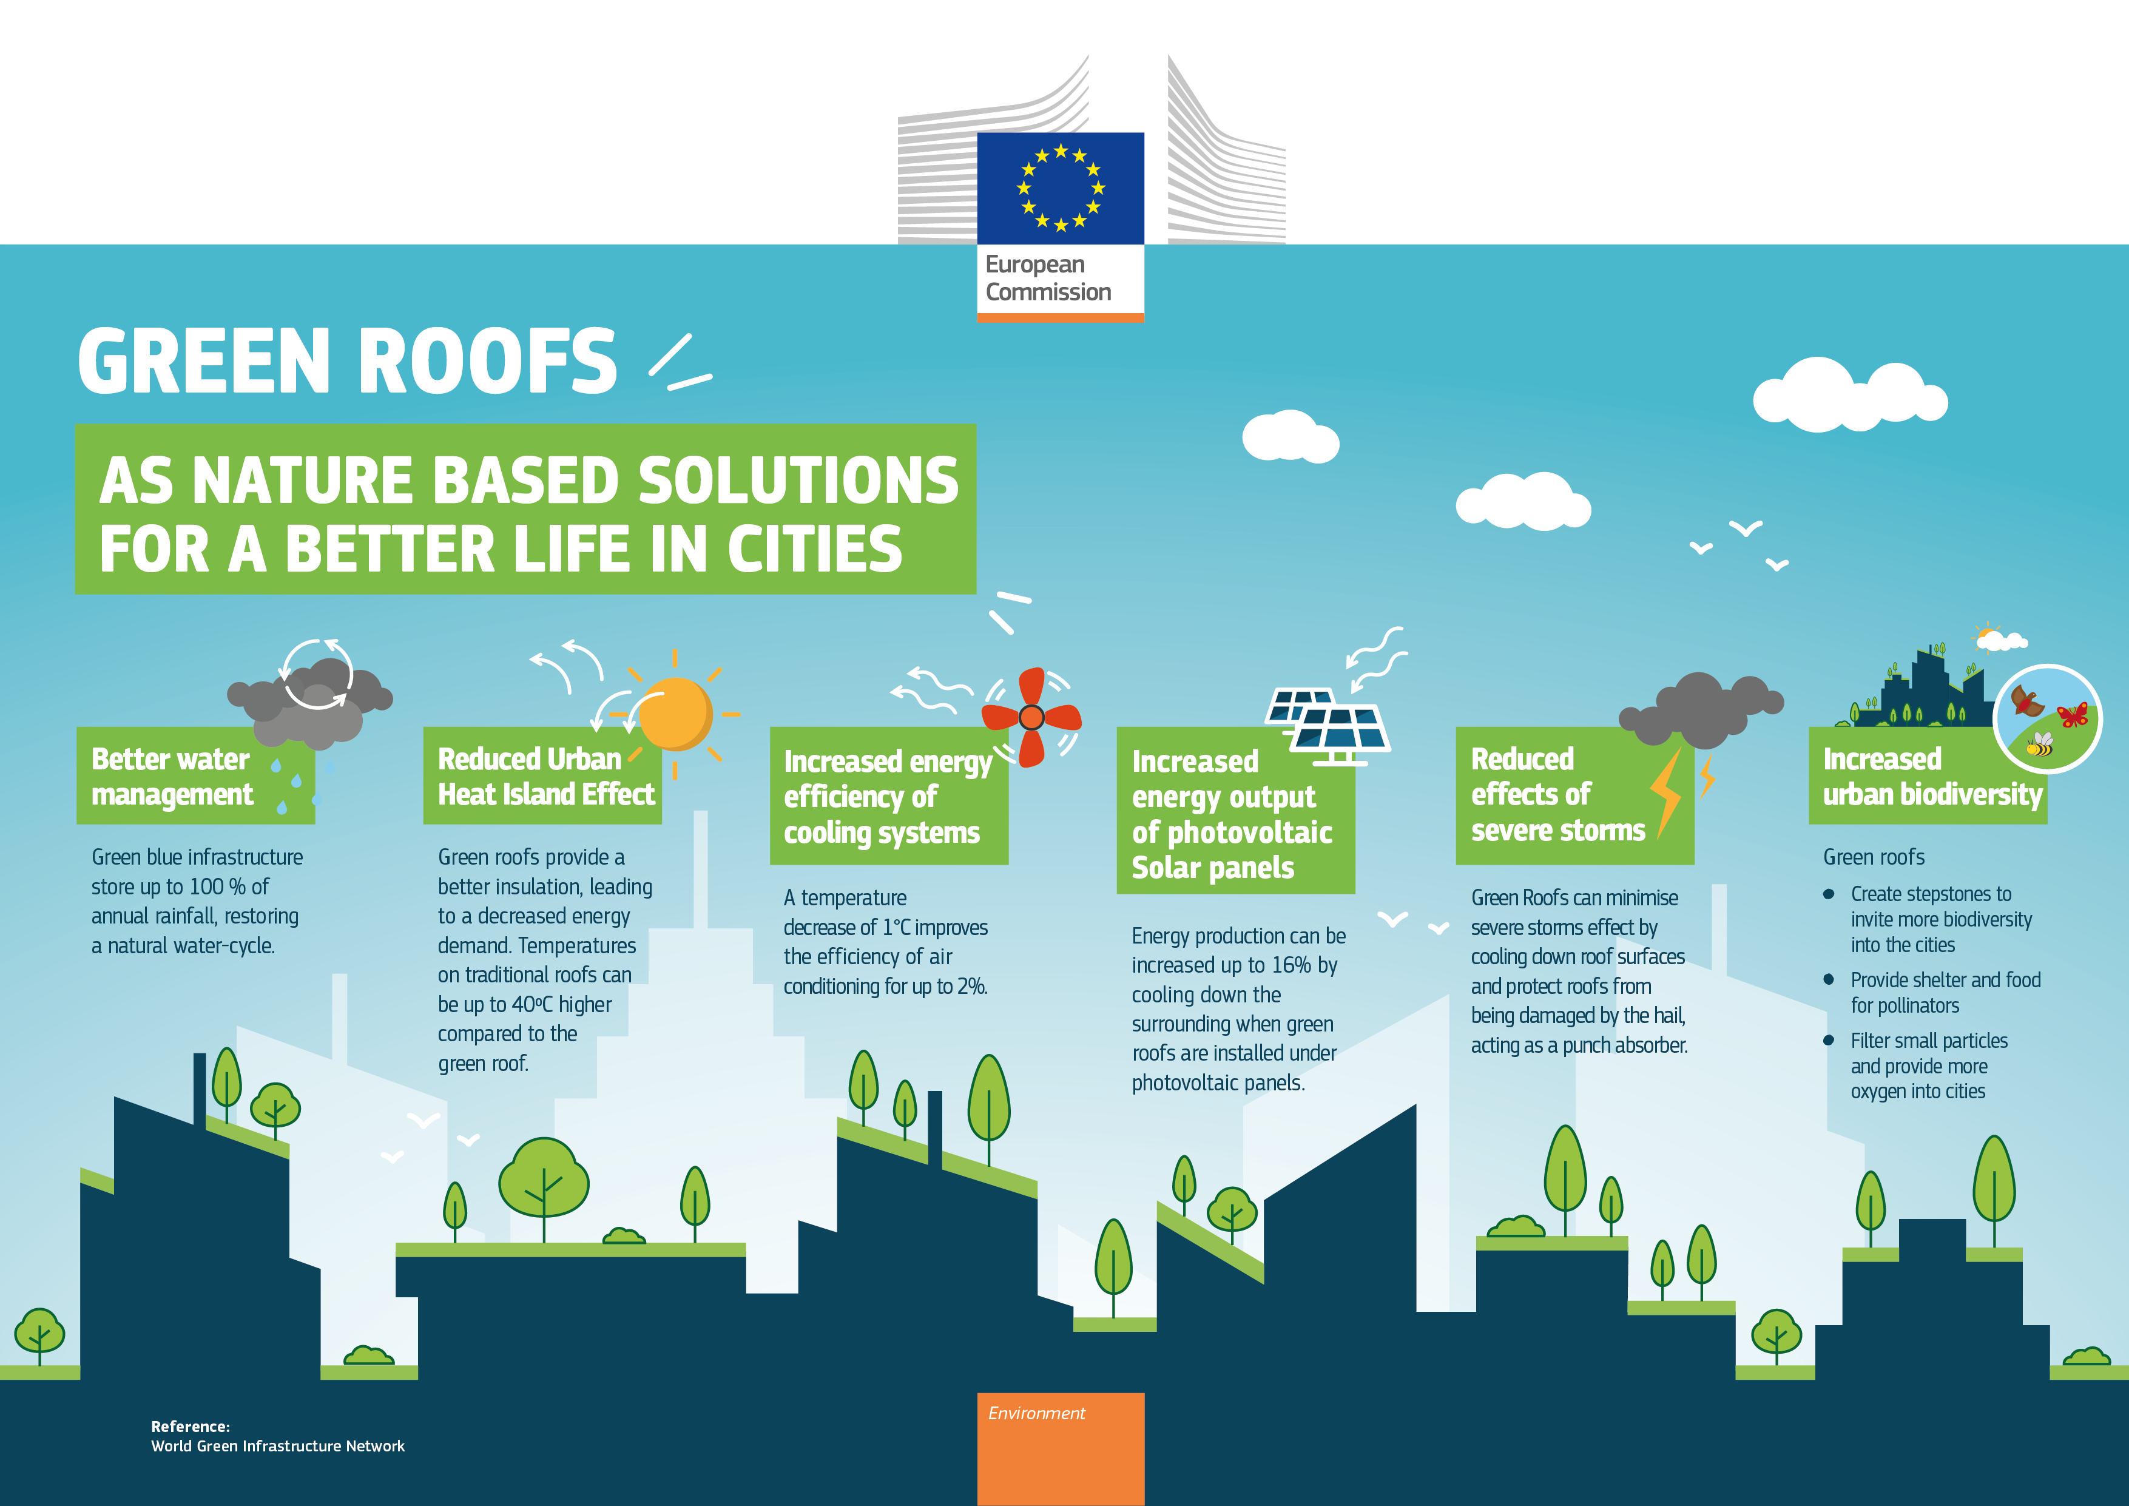
Green Roofs and Walls
Notes:
Example Green Roofs
Definition:
Green roofs are vegetated layers installed on rooftops, and green walls are vertical gardens attached to building exteriors.
Key Benefit:
Temperature regulation, air quality improvement, stormwater absorption.
Typical Scale:
Applicable for residential, commercial, and industrial buildings.
Cost: Approx. €120-300/m² depending on design and complexity.
Example:
Hamburg’s green roofs initiative for cooling urban spaces.

Slide 10
Urban NBS Example 1
Urban Parks and Public Green Spaces
Definition:
Large open spaces with vegetation designed for recreation, biodiversity, and aesthetic enhancement.
Key Benefit:
Providing community recreational areas and supporting biodiversity.
Typical Scale:
City-wide; can range from small neighbourhood parks to large urban landscapes.
Cost: Approx. €10-50/m² for establishment and maintenance.
Example:
London’s Olympic Park transformation.
Local Examples for the urban environment
Notes:
Example projects

Slide 11
Urban NBS Example 2
Rain Gardens and SUDS
Definition:
Rain gardens are shallow depressions planted with vegetation that absorb rainwater. Sustainable Drainage Systems (SUDS) manage stormwater sustainably.
Key Benefit:
Reducing urban flooding and improving water quality.
Typical Scale:
Neighborhood-level applications, integrated into urban landscapes.
Cost: Approx. €50-100/m² depending on design.
Example:
Sponge cities and rain gardens in Europe.
Local Examples for the urban environment
Notes:
Example projects

Slide 12
Urban NBS Example 3
Urban Forests and Tree Canopies
Definition:
Networks of trees planted in urban areas to form canopies and improve ecological balance.
Key Benefit:
Cooling urban heat islands and improving air quality.
Typical Scale:
City-wide implementation; significant impacts at block or district levels.
Cost: Approx. €500-1,500/tree including planting and maintenance.
Example:
Urban forestry initiatives in Amsterdam.
Local Examples for the urban environment
Notes:
Example projects

Slide 13
In-Class Exercise 1:
TAKE
FIVE
In-Class Group Exercise: Analysing the fit of a urban examples
Objective: Students will assess the socio-economic benefits of the given examples and reflect on a familiar urban setting
Tasks:
Reflect on examples of these NBS in your home
What impact are these having?
Who is responsible for them?
Notes:
Learning Outcome: Students will understand how to assess various applications and fit of NBS on urban environments, focusing on measuring socio-economic outcomes.
Materials: teacher can summarise answers and/or include a summary slide on the projector to capture the discussion

Slide 14
Role of Local Government
Case Study: ReGREEEN Project and Local Administration
The ReGREEEN project demonstrates how local governments work alongside communities to enhance urban resilience through green infrastructure.
Local authorities lead in the design and funding of green spaces, while community groups are involved in the maintenance and biodiversity monitoring.
Example: Rome, with the active participation of local citizens, implemented green corridors and urban parks to improve air quality and reduce flooding.
Notes:
Example projects

Slide 15
Integrate NBS Planning in local areas
Identify a local issue and match the relevant NBS
Find the fit
Step 1:
Identify Urban Challenges
Example: Cities facing frequent urban flooding could benefit from green roofs and rain gardens.
Step 2:
Develop or update urban policies to incorporate nature-based solutions in planning and zoning regulations.
Example: Mandate permeable surfaces in new developments to manage stormwater.
Step 3:
Example: Use community workshops to gather input on desired green spaces.
Step 4:
Funding and Resource Allocation
Example: Apply for Horizon Europe or LIFE Program funding to support NbS projects.
Step 5:
Implement and Monitor
Example: Use smart technologies to monitor stormwater systems or green spaces in real time.
Understand local urban issues (e.g., flooding, pollution, heat islands).
Policy Development and Integration
Community Engagement and Collaboration
Involve local communities, NGOs, and businesses in the decision-making process.
Secure funding through EU grants, local government budgets, and public-private partnerships.
Implement NBbS, ensuring that they are monitored for effectiveness and maintained properly.
Notes:
Example projects

Slide 16
Local Government Impact
Case Study: Sustainable Urban Drainage Systems (SUDS) in London
The London Borough of Islington integrated SUDS in urban planning to mitigate flooding and improve water quality.
Local Government Role:
Policy changes that mandate permeable pavements and rain gardens.
Active collaboration with local communities for ongoing maintenance of green spaces.
Notes:
Example projects

Slide 17
In-Class Exercise 2:
TAKE
FIVE
Objective: Students will work in groups to design a nature-based solution for a local community or urban area.
Instructions:
Choose an urban challenge (e.g., stormwater management, heat islands, or pollution).
Design a nature-based solution (e.g., rain gardens, green roofs, or swales) to address the chosen challenge.
Develop a step-by-step implementation plan that includes community engagement, budget considerations, and policy integration.
Notes:
Learning Outcome: Apply the theoretical knowledge of NbS to a real-world urban challenge and develop practical skills in planning and community engagement.
Materials: teacher can summarise answers and/or include a summary slide on the projector to capture the discussion

Slide 18
Scaling NBS
Challenges and Solutions in Implementing NBS at the Local Level
Challenges:
Lack of funding and resources.
Public resistance to change or disruption during implementation.
Space constraints in dense urban areas.
Solutions:
Leveraging EU funding (e.g., Horizon Europe, LIFE Program).
Engaging communities early in the planning process.
Implementing smaller-scale pilot projects to demonstrate success.
Notes:
Example projects

Slide 19
Vision for Nature-Integrated Cities
Trend | Future Focus
Integration of Smart Technologies | Use of smart sensors and IoT to monitor and optimize NBS performance.
Expanding Public-Private Partnerships | Increased collaboration to scale NBS projects through green bonds and EU funding.
NBS as Standard Practice | Make NBS a mandatory requirement in urban planning and zoning regulations.
Climate Change Adaptation & Mitigation | NBS for carbon sequestration, flood resilience, and biodiversity restoration.
Community-Led NBS Implementation | Empower local communities in the design, implementation, and maintenance of NBS.
Enhanced Policy Frameworks | Strengthen policies and incentives to make NBS integral to sustainable cities.
Notes:
The future direction of Nature-Based Solutions lies in scaling up their integration into urban development, smart technology, and community-led projects. As NBS become central to climate resilience, sustainability, and biodiversity conservation, cities will rely on both policy evolution and collaborative efforts to maximize their benefits for future generations.

Slide 20
Conclusion
NBS as a Pathway to Sustainable, Resilient Cities
Nature-Based Solutions (NBS) are crucial for creating sustainable, resilient, and healthy urban environments.
Local governments play a pivotal role in enabling the integration of NBS into urban planning, policymaking, and community engagement.
Collaboration between governments, local community groups, and private sectors is essential for ensuring the success and long-term impact of NBS.
Notes:
Example projects

Slide 21
Credit for this learning unit content: Trinity College Dublin

