Slide 1
Nature-Based Solutions (NBS) Review Lecture (online)
Trinity College Dublin
Content created in 2025
Notes:
Understanding Nature-Based Solutions: An Overview
NBS are strategies that use natural systems (e.g., forests, wetlands, green spaces) to address urban and environmental challenges.
Focus on climate adaptation, biodiversity, health benefits, and economic advantages.
Primary Source: Insights from EU research projects.

Slide 2
NBS Definition – EU
NBS are “Solutions that are inspired and supported by nature, which are cost-effective, simultaneously provide environmental, social and economic benefits and help build resilience.”
Such solutions bring more, and more diverse, nature and natural features and processes into cities, landscapes and seascapes, through locally adapted, resource-efficient and systemic interventions.
Reference: European Commission
Notes:
Think of an example

Slide 3
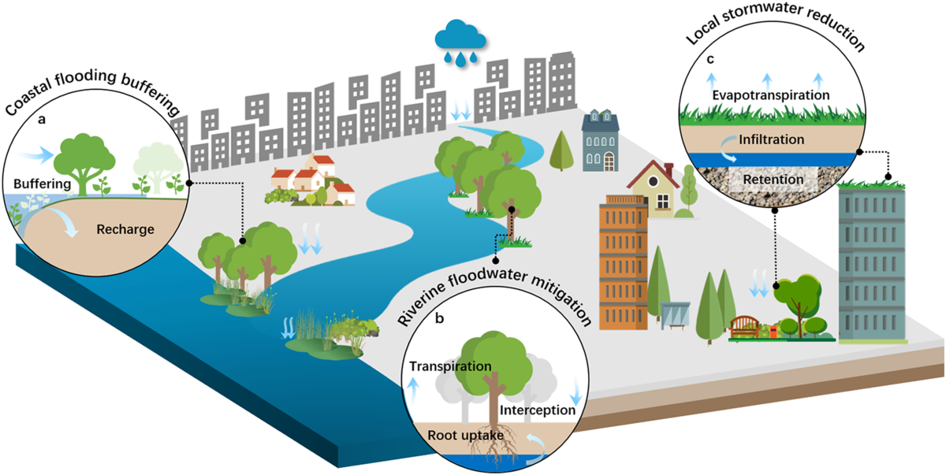
NBS as Tools for Climate Action
The Role of NBS in Climate Action
NBS help sequester carbon through forestation and wetland restoration.
Urban green spaces reduce urban heat islands and improve air quality.
NBS like green roofs and green corridors provide flood management and climate adaptation.
(Zhou et al., 2024)
Notes:
Zhou, K., Kong, F., Yin, H. et al. Urban flood risk management needs nature-based solutions: a coupled social-ecological system perspective. npj Urban Sustain 4, 25 (2024). https://doi.org/10.1038/s42949-024-00162-z

Slide 4
NBS and the SDGs
How NBS Contribute to Global Goals
NBS align with SDG 11 (Sustainable Cities) and SDG 13 (Climate Action), focusing on urban resilience and climate change mitigation.
They support SDG 6 (Clean Water and Sanitation) by improving water management and reducing stormwater runoff.
NBS contribute to SDG 15 (Life on Land) by enhancing biodiversity and promoting ecosystem restoration.
Notes:
https://sdgs.un.org/goals

Slide 5
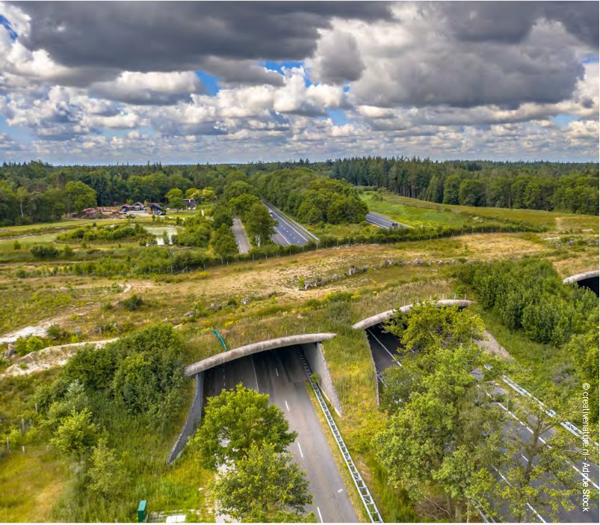
Nature’s Benefit
The Value of Ecosystem Services in NBS
NBS deliver ecosystem services such as carbon sequestration, water filtration, and flood regulation.
Green infrastructure solutions provide climate resilience by restoring ecosystem functions.
NBS enhance biodiversity, leading to healthier ecosystems that can better adapt to climate stress.
Notes:
https://sdgs.un.org/goals

Slide 6
Conservation Strategies
NBS for Protecting and Restoring Biodiversity
NBS contribute to biodiversity conservation by restoring wetlands, forests, and coastal ecosystems.
Strategies like rewilding and creating wildlife corridors help restore native species and habitats.
By promoting ecosystem services, NBS maintain ecological balance and support the natural habitat restoration process.
Notes:
https://sdgs.un.org/goals

Slide 7
Enhancing Cities
The Role of Green Spaces in Urban Areas
Green infrastructure like urban parks, green roofs, and vegetated swales provide urban cooling and reduce the heat island effect.
Green spaces increase public health, offering places for recreation and improving mental well-being.
Urban greening initiatives reduce flooding risks by improving stormwater management and increasing water retention.
Notes:
https://sdgs.un.org/goals

Slide 8
Healing Landscapes
Restoration Approaches through NBS
Restoration ecology focuses on repairing ecosystems that have been degraded or damaged, often using NBS like wetland restoration and agroforestry.
Reforestation helps restore biodiversity, sequester carbon, and enhance soil fertility.
NBS projects like forest restoration and river rehabilitation provide long-term ecological benefits for both communities and the environment.
Notes:
Photo Credit: Waterlands Eu Project: https://waterlands.eu/news-and-events/ambitous-new-eu-green-deal-project-waterlands-now-up-and-running/

Slide 9
In-Class Exercise 1:
TAKE
FIVE
Objective: Design a futuristic nature-based solution incorporating emerging technologies.
Instructions:
Choose an urban challenge (e.g., flooding, urban heat islands).
Propose an innovative NBS solution that uses new technologies like AI, IoT sensors, or smart infrastructure.
Identify community engagement strategies and the expected impacts.

Slide 10
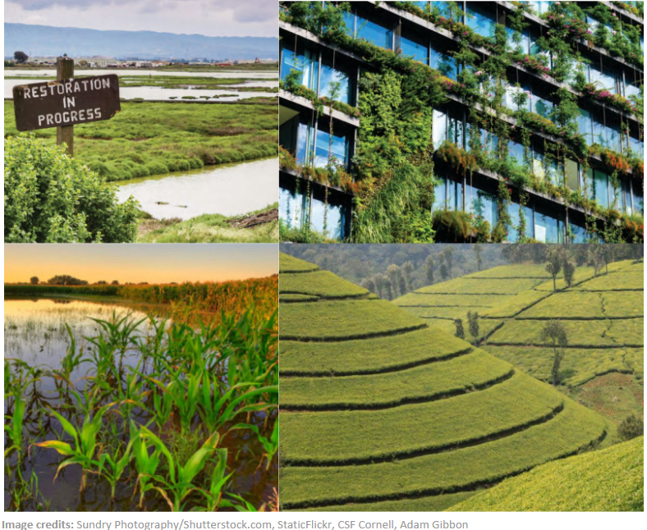
Upscaling NbS – How can it be done?
“Instead of piloting and implementing site specific projects, this approach involves thinking about how you might work within the system to operate at a higher and more leveraged scale. For example, instead of doing wetland restoration yourself, you might work to implement a national policy that will incentivise key landowners to restore wetlands in watersheds that they manage. Or you could develop a market-based strategy and partner with major seafood companies to implement sustainable seafood production.
Activities needed to go to scale under this approach include developing higher level strategies as well as raising the necessary resources and building the program team needed to implement these strategies.” (Salafsky et al., 2021)
Notes:
Key Considerations for Successful NBS Projects
Implementation requires integrating NBS into urban planning frameworks and regulatory processes.
Securing funding through EU programs (e.g., Horizon Europe, LIFE Program) is essential for project scale-up.
Stakeholder collaboration, including governments, businesses, and communities, ensures effective implementation and maintenance of NBS.

Slide 11
1. Tools for Scaling NBS
Evaluating and Measuring NBS Impact
Tools like GIS, remote sensing, and data analytics help assess the effectiveness of NBS in urban environments.
Real-time monitoring tools, such as IoT sensors, provide insights into the performance of green infrastructure.
The Ecosystem Services Toolkit and NBS Impact Assessment frameworks help cities quantify the social, environmental, and economic benefits of NBS.
DEMONSTRATE IMPACT

Slide 12
2. Tools for Scaling NBS
European Union Funds & Grants
Horizon Europe (2021-2027) – Supports NBS research & innovation
LIFE Programme – Funds environmental and climate action projects
European Green Deal – Directs funding towards sustainable infrastructure
EU Mission on Climate Adaptation – Invests in resilient cities & landscapes
Just Transition Fund (JTF) – Supports green investments in transitioning regions
Public Finance & Policy-Driven Funds
National Government Grants – Climate adaptation & environmental funding
Municipal Green Bonds – Cities issuing bonds for NBS projects
Development Banks (EIB, World Bank, ADB) – Large-scale NBS financing
Private Sector & Market-Based Mechanisms
Impact Investment & ESG Funds – Sustainable finance supporting green projects
Public-Private Partnerships (PPPs) – Collaborative funding models
Carbon Credits & Biodiversity Offsets – Monetizing ecosystem services
Innovative & Circular Economy Financing
Payments for Ecosystem Services (PES) – Rewarding conservation efforts
Crowdfunding & Green Philanthropy – Community-driven NBS funding
Nature-Based Enterprises – Business models integrating sustainable land use
FUNDING

Slide 13
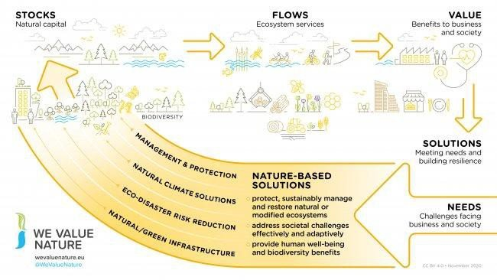
Nature-based Solutions and Natural Capital
Notes:
Demonstrable financial returns can help fast track NBS deployment

Slide 14
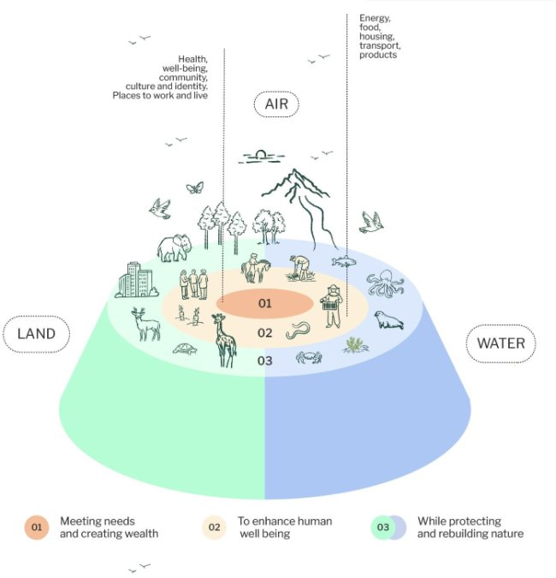
Benefits
Economic Transformation
Everyone and everything in society depends on nature: all humans and all businesses need a healthy planet to survive and prosper.​
55% of global GDP is moderately or highly dependent on nature (PwC 2023). Construction, agriculture, and food and beverages are the largest highly nature-dependent industries. China, the EU and the US have the highest absolute economic value in nature-dependent industries (WEF 2020)
Transforming our businesses and economic systems towards a Nature-Positive Economy that works with, and for, nature will help to reverse these negative trends. A whole-of-society approach is needed.
Notes:
Nature-based solutions (NBS) and Nature-based Enterprises (NBEs) play an important role in a Nature-Positive Economy
However, nature is in freefall – combined and intertwined with the climate and pollution crisis, our planet is in a perilous condition right now with increased frequency and severity of natural disasters resulting in increasingly devastating impacts.​

Slide 15
3. Tools for Scaling NBS
Incorporating Communities in NBS Design
Community involvement is critical for the success of NBS, especially in co-designing solutions that meet local needs.
Engaging citizens in planning and maintaining urban green spaces ensures long-term success and stewardship.
Successful community engagement boosts social cohesion, fosters ownership, and empowers local populations to contribute to sustainability efforts.
COMMUNITY COLLABORATION

Slide 16
4. Tools for Scaling NBS
EU Policies Driving NBS Adoption
The EU Green Deal promotes the integration of green infrastructure and nature-based solutions into urban planning for climate resilience.
Biodiversity Strategy for 2030 encourages the use of NBS for ecosystem restoration and the preservation of natural habitats.
Local and national governments are encouraged to adopt policies that support climate adaptation and the scaling of NBS in urban spaces.
POLICY

Slide 17
Key challenges within NBS governance
1. Vertical and horizontal dispersion
Eco-system services beneficiaries and providers are dispersed vertically and at multiple governance levels and across sectors
2. Diverse actors and values
Governance efforts often face challenges in aligning policy instruments across different scales and sectors. Policies that work well for one group (e.g., local communities) may conflict with those designed for others (e.g., national economic goals).
There are certain institutional cultural characteristics and logistics that can act as barriers to smooth collaboration and communication
The governance framework must accommodate participatory, adaptive, and transparent processes to address power imbalances and ensure legitimacy.
Need to balance the interests of stakeholders with differing values, from local communities to global beneficiaries. Differing cultural and ideological perceptions of nature (e.g., intrinsic versus utilitarian values) add complexity to governance negotiations.
Lasse Loft, Carsten Mann, Bernd Hansjürgens (2015) Challenges in ecosystem services governance: Multi-levels, multi-actors, multi-rationalities, Ecosystem Services, Volume 16, Pages 150-157, ISSN 2212-0416, https://doi.org/10.1016/j.ecoser.2015.11.002.
Notes:
Working with, and changing policy is needed to address these issues

Slide 18
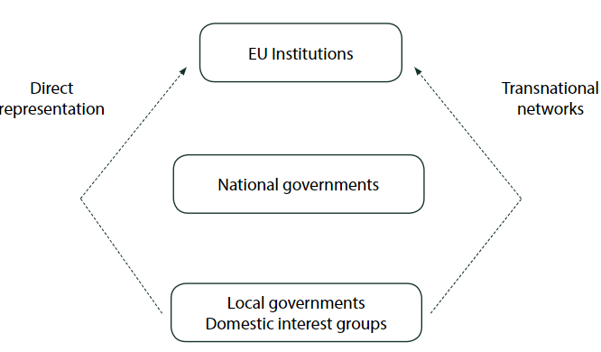
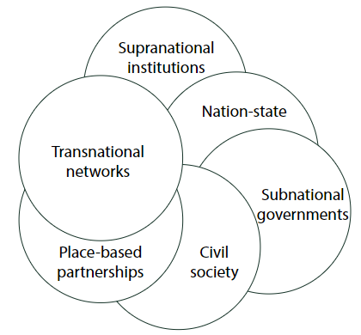
Multi Level Governance: nested versus polycentric
Source: Bulkeley, Harriet, Davies, Anna, Evans, Bob, Gibbs, David, Kern Kristine and Kate Theobald (24 June 2010) Environmental Governance and Transnational Municipal Networks in Europe, Journal of Environmental Policy & Planning, 5:3, 235-254, DOI: 10.1080/1523908032000154179
Notes:
MLG can be understood in different ways. Either with the state still being the centre of defining collective goals or with more clear hierarchical structure (‘nested’ – figure on the left) or a more polycentric view (figure on the right).
In the former, local levels governments and domestic interest groups still have some abilities for influence and can create powerful alliances at the global level. Yet, they still primarily depend on national level governance since the national level provides opportunities for going local or global.
In the polycentric view, there are no clear structures and hierarchies, only ‘spheres of authority’ (Rosenau 1997) or ‘complex overlapping networks’ (Bache and Flinders 2004), and state and non-state actors can also have interrelated and simultaneous influence.
These two views are not necessarily mutually exclusive.

Slide 19
5. Tools for Scaling NBS
How to Measure NBS Effectiveness
Key metrics include environmental benefits (e.g., carbon sequestration, biodiversity improvement) and social outcomes (e.g., public health and community engagement).
IoT and data analytics tools help monitor the performance of NBS in real-time, optimizing their impact.
Measuring cost-benefit analysis and long-term sustainability ensures successful scaling of NBS projects.
IMPACT

Slide 20
Benefits
NBS for Rewilding and Ecological Restoration
Rewilding is a key strategy for restoring ecosystems by reintroducing native species and rebuilding natural processes.
NBS like wildlife corridors, wetland restoration, and forest expansion help enhance biodiversity and ecosystem services.
Rewilding efforts contribute to carbon sequestration, biodiversity preservation, and climate resilience.

Slide 21
Benefits
Health Benefits of NBS
NBS improve mental health by providing accessible, natural spaces for recreation, social interaction, and stress reduction.
Urban green spaces contribute to physical well-being by encouraging outdoor activities like walking, cycling, and sports.
NBS reduce air pollution and mitigate heat island effects, leading to healthier, more sustainable urban environments.

Slide 22
Benefits
Urban Transformation Through NBS
NBS contribute to making cities sustainable and climate-resilient by integrating green infrastructure into city planning.
Smart cities use data-driven solutions to optimize green spaces, energy use, and water management through technology and NBS.
NBS integration transforms urban spaces into more livable, inclusive, and environmentally responsible areas.

Slide 23
Conclusion
NBS as a Solution for Sustainable Urban Futures
The future of NBS lies in their ability to address complex urban challenges while contributing to climate action, health, and economic growth.
EU research and policy frameworks will continue to shape the role of NBS in urban environments.
The growth of green industries, entrepreneurship, and innovation will drive the next wave of NBS adoption globally.

Slide 24
Credit for this learning unit content: Trinity College Dublin

