Slide 1
Future of Nature-Based Solutions (NBS) Lecture (online)
Trinity College Dublin
Content created in 2024
Notes:
Objective: Explore the future of Nature-Based Solutions (NBS) and how cutting-edge innovations are shaping the way we use natural systems to tackle urban challenges.
Primary Source: Insights from EU research projects.

Slide 2
NBS Definition – EU
NBS are “Solutions that are inspired and supported by nature, which are cost-effective, simultaneously provide environmental, social and economic benefits and help build resilience.”
Such solutions bring more, and more diverse, nature and natural features and processes into cities, landscapes and seascapes, through locally adapted, resource-efficient and systemic interventions.
Reference: European Commission
Notes:
Think of an example

Slide 3
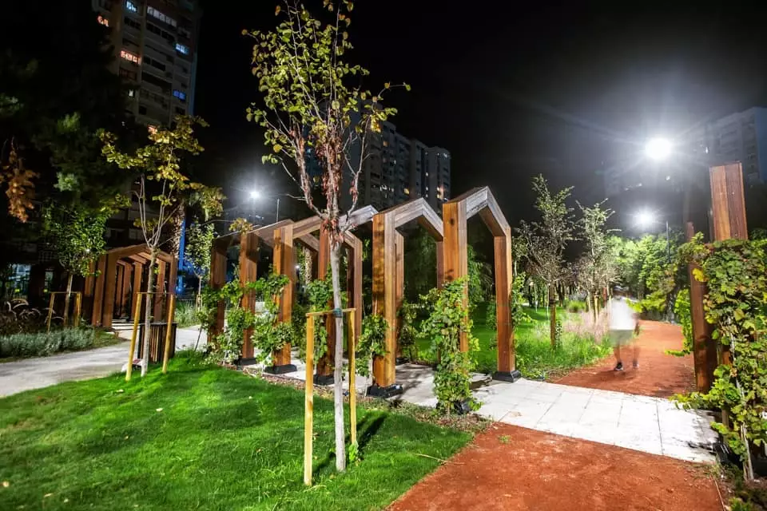
Innovating NBS
Why Innovation is Key for NBS
Urban Growth: Increasing urbanization requires innovative ways to incorporate nature into cities.
Climate Change: NBS play a crucial role in adapting to climate change, improving resilience, and reducing environmental impacts.
Technology Integration: Innovations in smart technology, data collection, and monitoring are enhancing the effectiveness of NBS.
Notes:
Photo Credit: Urban Green Up

Slide 4
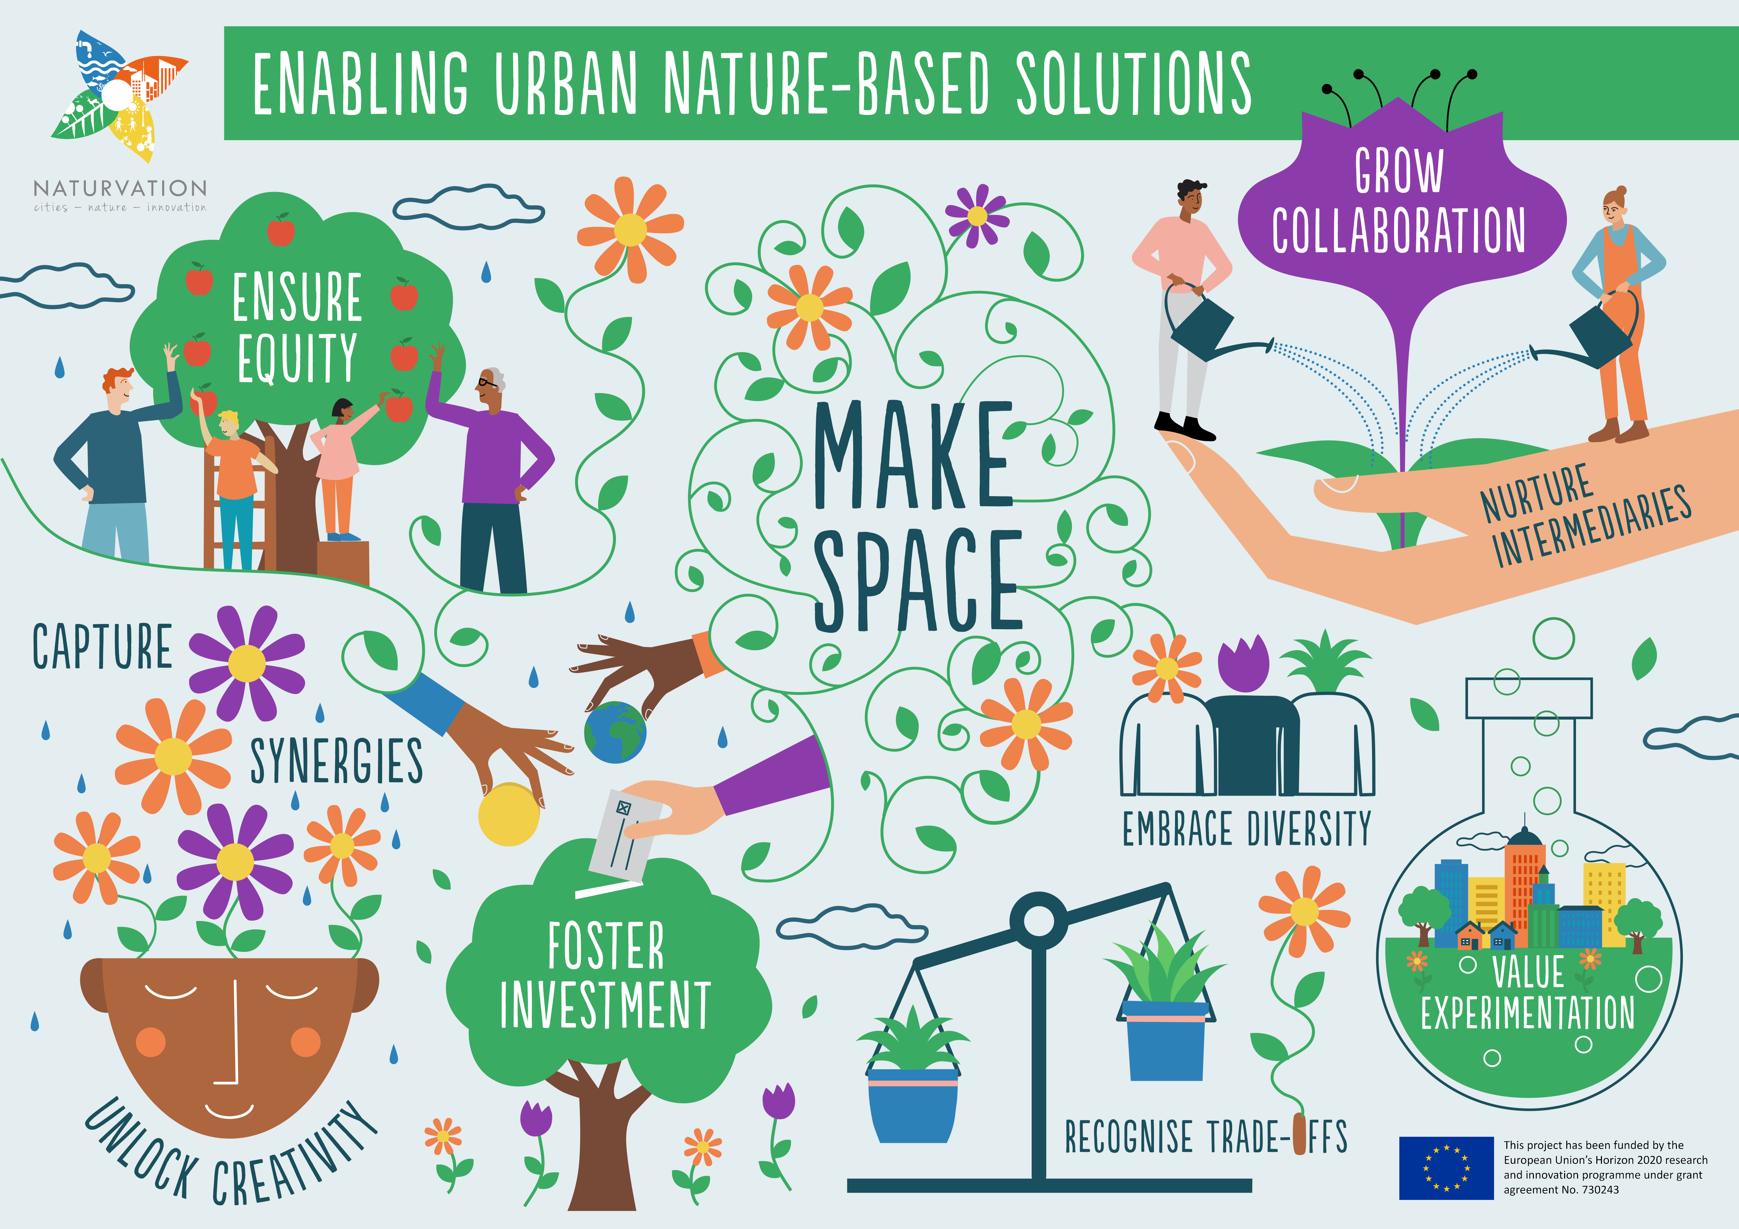
Innovating NBS
Emerging Technologies for NBS
Smart Sensors: IoT devices to monitor green infrastructure (e.g., real-time monitoring of rain gardens, green roofs).
Artificial Intelligence (AI): Using AI to optimize the design and management of NBS based on predictive analytics.
Data Analytics: Leveraging big data to assess the effectiveness of NBS projects in real-time.
Notes:
Note that while innovation and technology can improve NBS, it is important to focus on the core components, see image. Credit Naturvation

Slide 5
Carbon Sequestration:
Heat Mitigation:
Flood Resilience:
Advanced reforestation and wetland restoration projects to sequester carbon.
Green roofs, urban trees, and vegetated walls to combat urban heat islands.
Sustainable drainage systems (SuDS) and floodplain restoration to manage flood risks.
Innovating NBS
NBS for Climate Mitigation and Adaptation

Slide 6
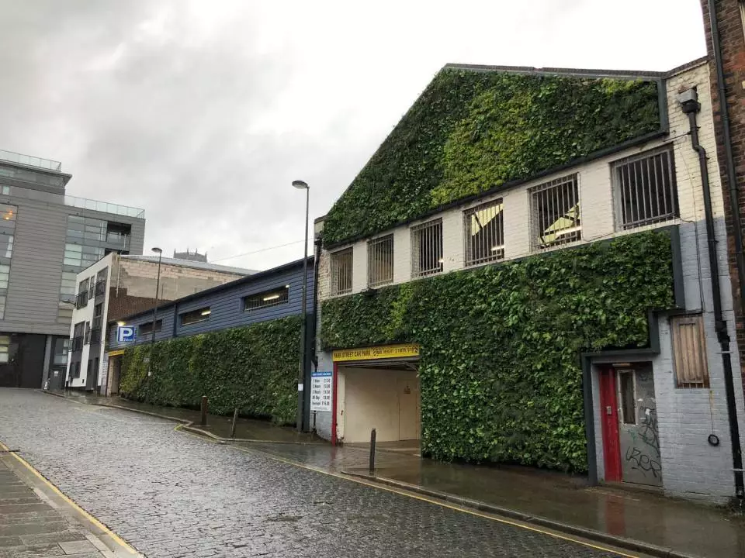
Future Innovations
Exploring Future Green Infrastructure Solutions
Living Walls: Vertical gardens that use hydroponics and solar-powered systems for energy efficiency and air purification.
Eco-Friendly Building Materials: Bio-based materials and permeable surfaces to promote water retention and reduce urban heat islands.
Modular Green Infrastructure: Modular systems that can be scaled up or down based on the needs of cities and communities.
Green wall Liverpool
Notes:
Photo credit Urban Green Up

Slide 7
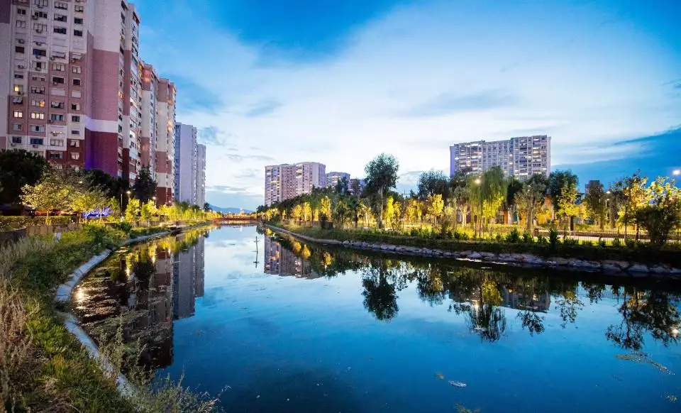
Future Innovations
The Future of Ecosystem Restoration with NBS
Urban Wetlands: The future of urban wetland restoration to manage water quality and provide recreational spaces.
Coastal Restoration: Restoration of mangroves and seagrass meadows to protect coastal communities from rising sea levels.
Reforestation and Agroforestry: Advanced methods for restoring degraded land and enhancing carbon sequestration.
Urban Wetland Izmir
Notes:
Photo credit Urban Green Up

Slide 8
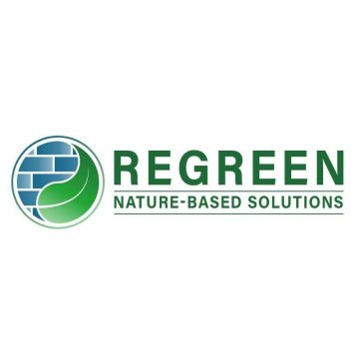
Regreen Exemplar
ReGREEN Project: Cutting-Edge Technology in NBS Implementation
Technology Integration: The ReGREEN project integrates smart sensors and real-time monitoring to track the success of urban green spaces in managing flood risk and improving air quality.
Outcome: this demonstrates how smart city technologies can enhance community engagement and optimize the effectiveness of green infrastructure.
Notes:
This may be used to help stimulate discussion on the next slide

Slide 9
In-Class Exercise 1:
TAKE
FIVE
Objective: Design a futuristic nature-based solution incorporating emerging technologies.
Instructions:
Choose an urban challenge (e.g., flooding, urban heat islands).
Propose an innovative NBS solution that uses new technologies like AI, IoT sensors, or smart infrastructure.
Identify community engagement strategies and the expected impacts.

Slide 10
Innovation Drivers 1
Understanding Social Drivers Behind NBS Adoption
Public Health Benefits: Increasing awareness of the health benefits of green spaces (e.g., stress reduction, improved mental health, physical activity)
Community Engagement: Communities are demanding inclusive, co-designed solutions that improve quality of life, including access to green spaces, biodiversity, and cleaner air.
Social Equity: Growing recognition that NBS can address social inequalities by improving public spaces and environmental quality in under-served communities.
Climate Justice: Advocacy for equitable climate solutions that use NBS to reduce vulnerabilities in low-income and high-risk communities, especially those disproportionately affected by climate change.
SOCIAL

Slide 11
Innovation Drivers 2
How Customer Demand is Shaping the Future of NBS
Consumer Awareness and Sustainability: Increasing demand from consumers and businesses for sustainable solutions is pushing the adoption of NBS, including green building certifications and eco-friendly infrastructure.
Corporate Responsibility: Companies are responding to market pressure by implementing NBS for carbon reduction, energy efficiency, and improving employee well-being.
Urban Development and Real Estate: Developers and investors are recognizing the financial value of NBS in urban environments, including higher property values, healthier communities, and attracting residents and businesses.
ECONOMIC

Slide 12
Innovation Drivers 3
EU-Funded Projects Driving NBS Innovation
Horizon Europe: Funds cutting-edge research on urban resilience, climate adaptation, and nature-based solutions.
Connecting Nature: Supports cities in scaling up NBS and integrating green infrastructure into urban planning.
LIFE Program: Focuses on ecosystem restoration, urban greening, and integrating NBS in flood-prone and high-density urban areas.
RESEARCH

Slide 13
Innovation Drivers 4
How Customer Demand is Shaping the Future of NBS
Consumer Awareness and Sustainability: Increasing demand from consumers and businesses for sustainable solutions is pushing the adoption of NBS, including green building certifications and eco-friendly infrastructure.
Corporate Responsibility: Companies are responding to market pressure by implementing NBS for carbon reduction, energy efficiency, and improving employee well-being.
Urban Development and Real Estate: Developers and investors are recognizing the financial value of NBS in urban environments, including higher property values, healthier communities, and attracting residents and businesses.
POLICY

Slide 14
Increasing Employment
Emerging Job Roles in NBS
Urban Sustainability Manager: Overseeing the integration of green infrastructure in city planning.
Green Infrastructure Engineer: Designing and implementing nature-based solutions like green roofs and SUDS.
Community Engagement Specialist: Facilitating public participation and co-design of NBS projects.

Slide 15
Increasing Employment
Key Skills for Emerging NBS Roles
Technical Skills: Knowledge of GIS, IoT, and data analytics for monitoring NBS.
Environmental Science: Expertise in ecology, climate change, and biodiversity.
Urban Planning: Experience in sustainable urban development and green infrastructure design.
Community Engagement: Facilitating public participation in designing and managing NBS projects.

Slide 16
Scaling
Innovative Ways to Scale Up NBS in Cities
Modular Green Infrastructure: Easily scalable green solutions like green walls and bio-swales.
Smart Cities: Integration of IoT, AI, and smart grids to monitor and manage NBS at scale.
Collaborative Platforms: Online platforms for cities to share knowledge and collaborate on NBS implementation.

Slide 17
Future of NBS
Advances in Biodiversity Restoration through NBS
Urban Biodiversity: Implementing wildlife corridors, green roofs, and pocket parks to improve urban biodiversity.
Ecosystem Restoration: Large-scale restoration of mangroves, wetlands, and forests using advanced methods and technologies.
Smart Conservation: Using data analytics and sensors to monitor and enhance biodiversity in urban areas.

Slide 18
Conclusion
Innovating for the Future: NBS and Cutting-Edge Technologies
Nature-Based Solutions (NBS) are at the forefront of creating sustainable, resilient cities.
Technology integration, community engagement, and innovative policy will shape the future of NBS.
Career opportunities in the NBS sector will grow with increasing demand for professionals in urban planning, technology, environmental science, and community management.

Slide 19
Credit for this learning unit content: Trinity College Dublin

