Slide 1
Sustainable Urban Drainage Systems Exemplar
Lecture (online)
Learning Unit 41
Credit: Trinity College Dublin
Content created in 2024
Notes:
Sustainable Urban Drainage Systems (SuDS): An Integrated Approach to Stormwater Management
Objective: Understand the role of SuDS in urban environments for effective stormwater management, flood prevention, and water quality improvement.
Goal: Provide students with a clear understanding of the development, design principles, and real-world applications of SuDS in urban areas.

Slide 2
What are SUDS?
Definition: Sustainable Urban Drainage Systems (SUDS) are designed to manage surface water runoff sustainably, mimicking natural water cycles.
Key Features:
Slow water flow
Filter pollutants
Enhance biodiversity
(Zannat Et al., 2024)
Notes:
Esraz-Ul-Zannat, Md & Dedekorkut-Howes, Aysin & Morgan, Edward. (2024). A review of nature‐based infrastructures and their effectiveness for urban flood risk mitigation. Wiley Interdisciplinary Reviews: Climate Change. 15. 10.1002/wcc.889.

Slide 3
Defining SUDS
SUDS are engineered systems designed to manage surface water runoff in a sustainable manner, reducing the negative environmental impacts of traditional drainage methods.
Key Goals of SUDS:
Manage stormwater.
Improve water quality.
Prevent flooding.
Integrate green infrastructure into urban spaces.
Components of SUDS:
Permeable pavements
Rainwater harvesting
Green roofs
Swales and wetlands
Retention ponds

Slide 4
NBS Definition – EU
“Solutions that are inspired and supported by nature, which are cost-effective, simultaneously provide environmental, social and economic benefits and help build resilience.
Such solutions bring more, and more diverse, nature and natural features and processes into cities, landscapes and seascapes, through locally adapted, resource-efficient and systemic interventions.”
Reference: European Commission
Notes:
Think of an example

Slide 5
Why are SUDS important?
Drivers:
Urbanization and increased impermeable surfaces
Climate change impacts: flooding, droughts
Water quality improvement
(Zannat Et al., 2024)
Notes:
Esraz-Ul-Zannat, Md & Dedekorkut-Howes, Aysin & Morgan, Edward. (2024). A review of nature‐based infrastructures and their effectiveness for urban flood risk mitigation. Wiley Interdisciplinary Reviews: Climate Change. 15. 10.1002/wcc.889.

Slide 6
Key Elements
Principles of SUDS Design and Operation
SUDS mimic natural hydrological processes, aiming to slow, store, and infiltrate stormwater into the ground.
Key elements in SUDS systems:
Infiltration: Allowing water to soak into the soil.
Storage: Temporary storage to delay peak runoff.
Treatment: Removing contaminants from runoff.
Discharge: Ensuring controlled discharge of clean water to drainage systems or watercourses.

Slide 7
Policy Context
1. The European Green Deal (2019): Achieve carbon neutrality by 2050 and enhance climate resilience.
2. EU Biodiversity Strategy for 2030: Halt biodiversity loss and restore ecosystems by 2030.
3. The EU Climate Adaptation Strategy: Enhance Europe’s resilience to climate change impacts.
4. EU Water Framework Directive (2000): Protect and improve the quality of water resources across the EU.
5. Horizon Europe (2021-2027): Provide funding for research and innovation in climate change, energy, and biodiversity.
6. The EU Floods Directive: Promotes the use of NBS, such as wetlands and floodplains, as natural flood management solutions that help prevent or mitigate flood risks.
Notes:
1 Promotes the integration of nature-based solutions into urban planning, energy systems, and agriculture to reduce emissions, enhance biodiversity, and promote sustainable development.
2. NBS, such as urban forests, wetlands, and green corridors, are essential for biodiversity restoration and the creation of nature-based habitats within cities.
3. Supports the use of NBS for climate change adaptation, such as green roofs and rain gardens, to mitigate urban heat islands, manage stormwater, and improve water quality.
4. Encourages the use of sustainable drainage systems (SUDS) and other nature-based approaches to manage water quality and reduce the risk of flooding.
5. Supports projects that develop and implement nature-based solutions, including those focusing on urban resilience, water management, and green infrastructure.
6. Promotes the use of NBS, such as wetlands and floodplains, as natural flood management solutions that help prevent or mitigate flood risks.

Slide 8
Case Example - CityLoops
SUDS Integration in Circular Urban Water Management
CityLoops is an EU-funded project focused on enhancing circularity in urban water systems. It uses SUDS to reduce runoff and improve water quality by integrating green infrastructure into the urban fabric.
Application of SUDS: Includes rain gardens, green roofs, and permeable pavements to manage water locally and reduce pressure on traditional drainage systems.
Benefits:
Reduced runoff and flooding.
Improved water quality through filtration.
Increased urban greenery and biodiversity.
Notes:
CityLoops Project - https://cityloops.eu/

Slide 9
Key Design Principles of SUDS
Managing water quantity
Improving water quality
Enhancing amenity and biodiversity
Adaptability to local conditions

Slide 10
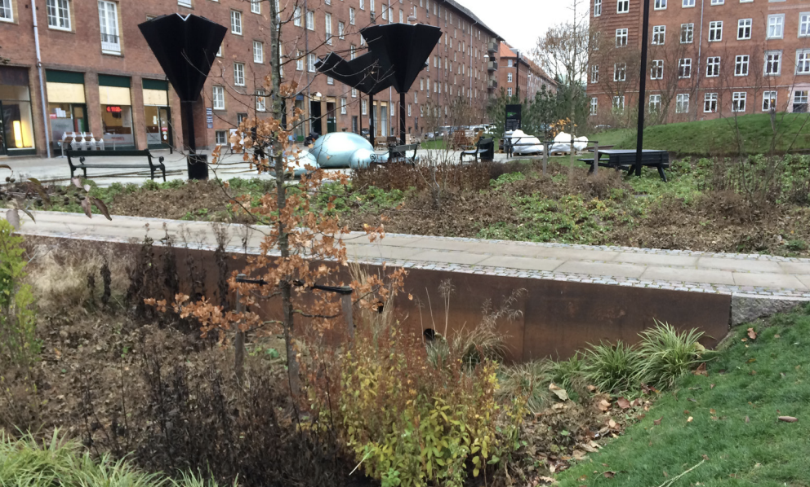
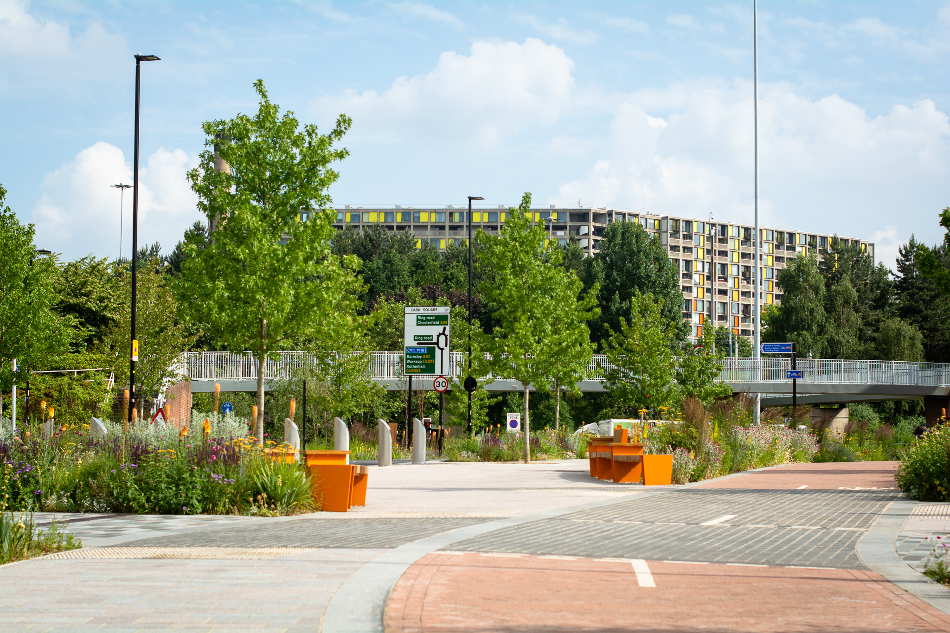
Exemplar Cases
Example 1: Copenhagen, Denmark
Cloudburst Management Plan
Integrating SUDS with public spaces
Example 2: Sheffield, UK
Grey to green project
Flood resilience and urban greening
Notes:
Photo Credit: Aalto University
Photo Credit: The Architects Journal

Slide 11
Benefits
Environmental:
Reduced flooding
Improved water quality
Increased green spaces
Social:
Enhanced urban aesthetics
Improved mental health
Community engagement
Economic:
Cost-effective water management
Increased property values

Slide 12
Implementation Challenges
Land availability
Limited space for large-scale SUDS in highly urbanized areas.
Costs and funding
Installation and upfront costs can be high.
Maintenance responsibilities
SUDS require ongoing maintenance and monitoring to ensure optimal performance
Public and stakeholder buy-in
Stakeholders may be more comfortable with status quo approaches
Business as Usual

Slide 13
Class Exercise 1: SUDS Design Challenge
TAKE
FIVE
Guiding Questions:
What type of SUDS components will be most effective in managing stormwater in this area?
How will you address maintenance and ensure long-term functionality?
What are the social, environmental, and economic benefits of the proposed SUDS?
Notes:
Group Exercise: Designing a SUDS System for an Urban Area
Objective: Students will be divided into groups and tasked with designing a SUDS system for a specific urban area (e.g., a neighborhood, park, or school campus).
Learning Outcome: Students will learn to design and assess the suitability of different SUDS components for real-world urban contexts.
Materials: Use design tools, markers, and city maps for drawing solutions.

Slide 14
Design Considerations
2
1
3
4
Urban Context
Climate resilience
Community needs
Site conditions (soil type, slope)
Notes:
How to Develop a SUDS System
Site Assessment:
Topography: Assessing the landscape to identify suitable areas for SUDS integration.
Soil Permeability: Determines the type of SUDS best suited for the site (e.g., swales, infiltration basins).
Hydrology: Analyzing rainfall data and runoff patterns.
Choosing SUDS Components:
Decide on a combination of green roofs, permeable pavements, rain gardens, and detention basins based on the site’s needs.
Example: Use of swales in areas with high runoff, or rainwater harvesting in residential areas.
Designing for Maintenance:
Ensure easy access for ongoing maintenance and cleaning of SUDS components.
Design systems that are resilient to changing weather conditions and increased storm events due to climate change.
Installation and Monitoring:
Installation: Professional installation of SUDS components, ensuring they meet local regulations and environmental standards.
Monitoring: Use of smart sensors to track the performance of SUDS systems, ensuring they function as designed over time.

Slide 15
Regulatory and Policy Support
Alignment with urban planning policies
Clear guidelines and standards
Incentives for developers
Notes:
The EU's policy framework encourages the integration of NBS across sectors such as climate adaptation, biodiversity, and water management. These policies recognize NBS as essential for building sustainable, resilient cities that mitigate climate change and enhance ecosystem services

Slide 16
Maintenance (Stewardship)
Best Practices:
Regular inspections
Debris removal
Vegetation management
Case Example:
Wetland maintenance in the Netherlands

Slide 17
Class Exercise 2: Public Engagement & SUDS
TAKE
FIVE
Guiding Questions:
What concerns might the public have about SUDS implementation (e.g., loss of parking spaces, aesthetics)?How can local governments and project teams engage communities and increase awareness of the benefits of SUDS?
What strategies can be used to overcome resistance and increase support for these green solutions?
Notes:
Group Exercise: Designing a SUDS System for an Urban Area
Objective: Discuss how public perception and community engagement can affect the adoption of SUDS projects in cities.
Learning Outcome: Develop communication strategies for engaging the public and fostering support for SUDS projects.

Slide 18
Monitoring and Evaluation
Maintenance: Regular monitoring and maintenance of SUDS components are essential for ensuring long-term success.
Green roofs require vegetation upkeep, irrigation, and cleaning.
Rain gardens need regular removal of debris and management of plant health.
Smart Technology: Integrating IoT sensors and smart meters to monitor SUDS performance, allowing real-time adjustments and data collection.
Why It Matters:
Assess effectiveness
Inform future projects
Meet compliance standards
Tools and Techniques:
Water quality sensors
Remote sensing
Citizen science initiatives
Notes:
Example:
The Green4CITIES project employs smart sensors to monitor the health and performance of green spaces and stormwater systems in real-time.

Slide 19
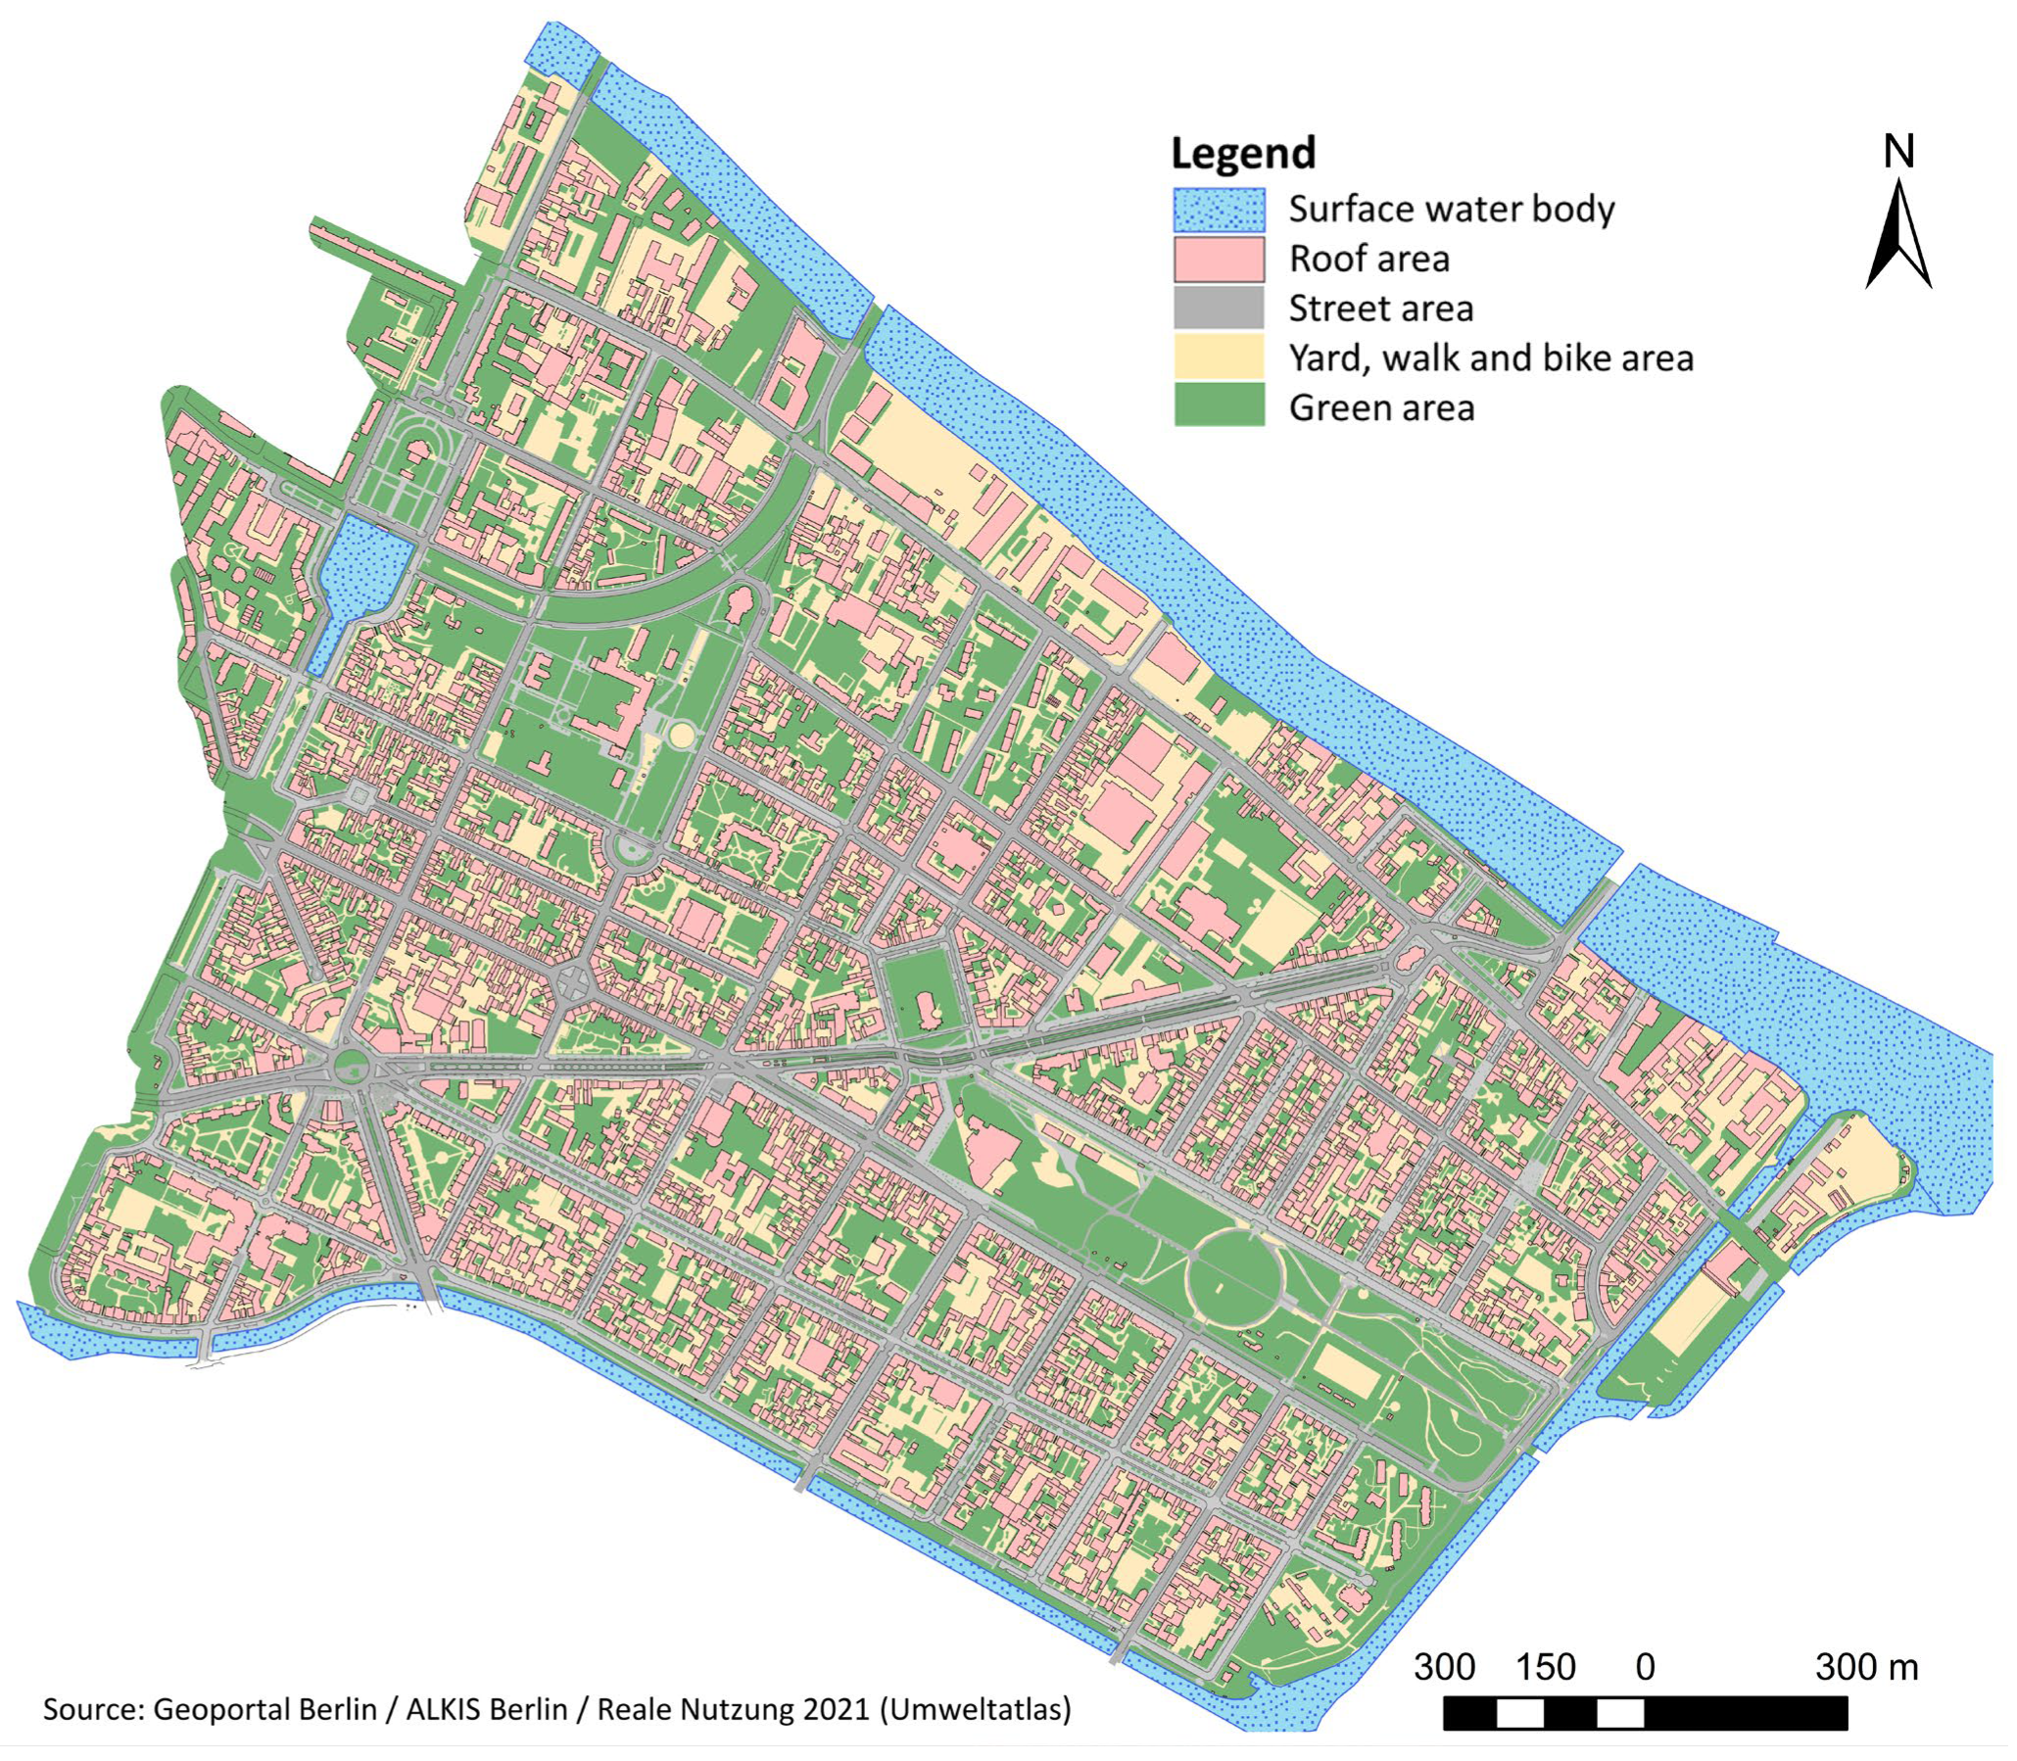
Integration with NBS
Synergies:
Combining SUDS with urban greening
Biodiversity corridors
Multi-functional landscapes
Neumann et al., 2024
Notes:
Neumann, J., Scheid, C. and Dittmer, U., 2024. Potential of Decentral Nature-Based Solutions for Mitigation of Pluvial Floods in Urban Areas—A Simulation Study Based on 1D/2D Coupled Modeling. Water, 16(6), p.811.

Slide 20
EU Research Insights
CityLoops Focus: Enhancing circularity in urban water systems using nature-based solutions to reduce runoff and improve water quality.
NATURE4CITIES Focus: Integrating nature-based solutions into city planning to improve resilience to climate change, with a focus on green infrastructure, urban cooling, and stormwater management.
Green4CITIES Focus: Promoting green urban infrastructure for biodiversity, public health, and economic development, focusing on NBS like green roofs, rain gardens, and sustainable drainage systems.
LIFE-IP UrbanGreening Focus: Implementing nature-based solutions in cities to improve climate resilience and biodiversity, with emphasis on urban wetlands and green infrastructure for water management.
CIVITAS Focus: Integrating smart transport systems with green infrastructure, aiming to improve urban mobility, air quality, and sustainability.
Notes:
Reference: CityLoops - NetworkNature
Reference: NATURE4CITIES - NetworkNature
Reference: Green4CITIES – NetworkNature
Reference: LIFE-IP UrbanGreening - NetworkNature
Reference: CIVITAS - NetworkNature

Slide 21
Future Trends
1. Integration of Smart Technologies
Trend: Increasing use of IoT sensors, AI, and data analytics to monitor and manage SUDS in real-time.
Impact: Enhanced performance of SUDS, with better tracking of stormwater management, water quality, and system efficiency.
2. Climate Change Resilience
Trend: Greater emphasis on designing SUDS systems that can handle the increasing frequency of extreme weather events (e.g., heavy rainfall, droughts).
Impact: SUDS will play a crucial role in climate change adaptation, managing flood risks and reducing urban heat islands.
3. Multifunctional and Green Infrastructure
Trend: SUDS will be integrated more deeply into urban spaces as multifunctional green infrastructure.
Impact: These systems will not only manage stormwater but also improve air quality, provide public green spaces, and enhance biodiversity.

Slide 22
Conclusion
SUDS are essential for building climate-resilient cities, improving urban sustainability, and providing socio-economic benefits.
Through effective design, implementation, and community engagement, SUDS can offer practical solutions to stormwater management, urban heat reduction, and biodiversity conservation.
With the support of EU-funded projects and smart technology integration, SUDS are key to creating sustainable urban landscapes.

Slide 23
Credit for this learning unit content: Centre for Social Innovation, Trinity College Dublin

