Slide 1
Seaweed Farming Case
Lecture (online)
Learning Unit 40
Credit: Trinity College Dublin
Content created in 2024
Notes:
This presentation highlights the significance of seaweed farming as a nature-based solution, showcasing EU-funded research projects, the development process, funding models, and real-world applications. It provides a comprehensive overview of the potential of seaweed farming for climate change mitigation, sustainable coastal management, and economic opportunities.

Slide 2
Introduction
Nature-Based Solutions for Coastal Resilience: Seaweed Farming
Overview of nature-based solutions (NBS) for coastal and marine environments.
Seaweed farming as a promising NBS for carbon sequestration, coastal protection, and sustainable food production.
Focus on EU research projects exploring seaweed farming for environmental benefits and economic sustainability.
Notes:
5 minutes discussion

Slide 3
NBS Definition – EU
“Solutions that are inspired and supported by nature, which are cost-effective, simultaneously provide environmental, social and economic benefits and help build resilience.”
Such solutions bring more, and more diverse, nature and natural features and processes into cities, landscapes and seascapes, through locally adapted, resource-efficient and systemic interventions.
Reference: European Commission
Notes:
Think of an example

Slide 4
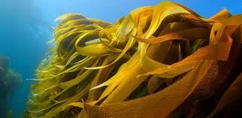
What is seaweed farming?
Understanding Seaweed Farming as a Nature-Based Solution
Seaweed farming involves cultivating edible and non-edible seaweed species in coastal waters.
Seaweeds help absorb excess carbon dioxide (CO2), improve water quality, and provide habitat for marine biodiversity.
Key Benefits: Carbon sequestration, coastal protection, sustainable resource production.
Notes:
Photo Credit: KELP-EU

Slide 5
EU Research Projects on Seaweed Farming
SEAMARK: uses ground-breaking selective breeding technologies within EU seaweed crop genetics to increase biomass yield.
KELP-EU: aims to jump-start the European sustainable seaweed industry
C-FAARER: supporting the transition towards the use of community-driven sustainable business models
Notes:
https://seamark.eu/
https://oceanium.world/kelp-eu/
https://www.c-faarer.eu/

Slide 6
Why Seaweed?
Benefits of Seaweed Farming for Coastal and Marine Environments
Climate Change Mitigation: Seaweed absorbs CO2 during growth, contributing to carbon sequestration.
Coastal Protection: Seaweed farms reduce wave energy, acting as natural barriers against coastal erosion and storm surges.
Biodiversity: Creates habitats for marine life and helps improve water quality by absorbing excess nutrients.
Economic Value: Seaweed farming supports sustainable industries, such as biofuel, food, and pharmaceuticals.
Notes:
5 minutes discussion

Slide 7
Climate Mitigation
Carbon Sequestration Potential of Seaweed Farms
Seaweed absorbs CO2 from seawater, storing carbon in its biomass.
Carbon sequestration in seaweed can offset carbon emissions in other sectors.
Seaweed farms act as a natural solution for mitigating greenhouse gas emissions.
Example: Ross et al 2023
Notes:
Ross, F.W., Boyd, P.W., Filbee-Dexter, K., Watanabe, K., Ortega, A., Krause-Jensen, D., Lovelock, C., Sondak, C.F., Bach, L.T., Duarte, C.M. and Serrano, O., 2023. Potential role of seaweeds in climate change mitigation. Science of the Total Environment, 885, p.163699.

Slide 8
1. Site Selection
Identify Suitable coastal areas with favorable conditions:
5-20 degrees Celsius
10-30meters deep
Moderate currents
30-35 PSU (practical salinity units)
Moderate Wave Action
2. Permit and regulatory approval
secure the necessary permits and approvals from local and national authorities
3. Species Selection
Choose the appropriate seaweed species (kelp or algae etc.) based on local conditions
4. Farm Design
Design the farm layout eg floating or anchored systems, cultivation lines etc
5. Harvesting and processing
Develop methods for harvesting, processing and marketing the seaweed products

Slide 9
Highlight: Site Selection and Planning
Choosing the Right Location for a Seaweed Farm
Environmental Considerations: Ensure minimal disruption to local ecosystems, navigation routes, and fisheries.
Water Conditions: Select areas with optimal temperature, salinity, and current for the chosen seaweed species.
Accessibility: Location must be accessible for farm maintenance, harvesting, and transport.
Regulatory Compliance: Ensure compliance with maritime and environmental regulations. Check with the relevant maritime regulatory body in your county.
Notes:
5 minutes discussion

Slide 10
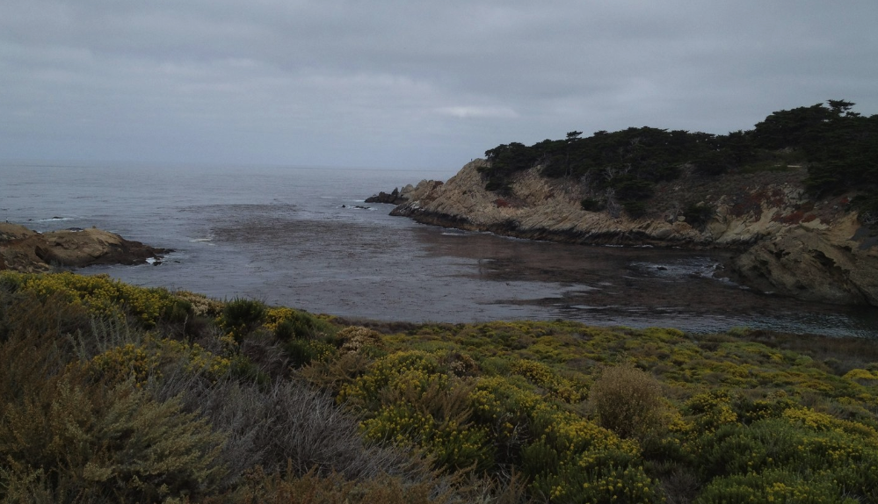
Highlight: Site Selection and Planning
Designing a Sustainable Seaweed Farm
Floating Systems: Using floating platforms or rafts to suspend seaweed in the water column.
Anchored Systems: Lines anchored to the seafloor for larger-scale operations.
Sustainability Considerations: Design systems that minimize environmental impact and ensure ease of maintenance and harvesting.
Notes:
Photo Credit: C-FAARER Project

Slide 11
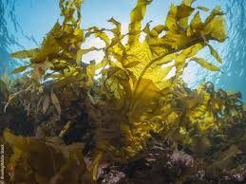
Seaweed Species for Farming
Choosing the Right Seaweed Species for Farming
Edible Seaweeds: Kelp, nori, wakame, and other edible algae used in food, medicine, and cosmetics.
Industrial Seaweeds: Seaweeds used for biofuels, bioplastics, and pharmaceuticals.
Eco-Engineering: Use of native species for coastal protection and restoration.
Notes:
Photo Credit: C-FAARER Project

Slide 12
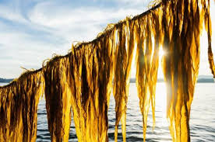
Farming Techniques
Best Practices for Seaweed Cultivation
Seeding: Attach seaweed spores to ropes or other substrates to allow growth.
Growth Monitoring: Regularly monitor growth rates and environmental conditions (e.g., water quality, temperature).
Harvesting: Once seaweed reaches maturity, harvest using manual or mechanical methods.
Sustainability: Employ environmentally friendly methods to minimize damage to ecosystems and ensure farm sustainability.
Notes:
Photo Credit: C-FAARER Project

Slide 13
Funding Models for Seaweed Farming
Financial Support and Investment in Seaweed Farming
EU Funding: EU provides funding through various programs like Horizon 2020, Interreg, and Blue Growth to support sustainable marine projects.
Public-Private Partnerships: Collaborative funding models between governments, research institutions, and private investors.
Grants and Subsidies: Local and international funding sources dedicated to green, sustainable agriculture.
Social Enterprises: Community-based funding for seaweed farms that emphasize local economic benefits and environmental sustainability.

Slide 14
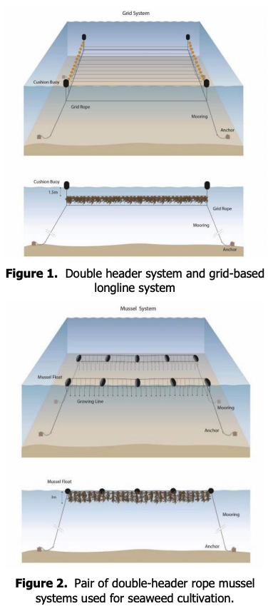
Examples
Notes:
Economic Feasibility Study on Seaweed Report
https://maritime-forum.ec.europa.eu/document/download/f32da738-0395-4e5e-85c3-18b8f0b7a594_en?filename=Scotland%20-%20economic-feasibility-study-on-seaweed.pdf

Slide 15
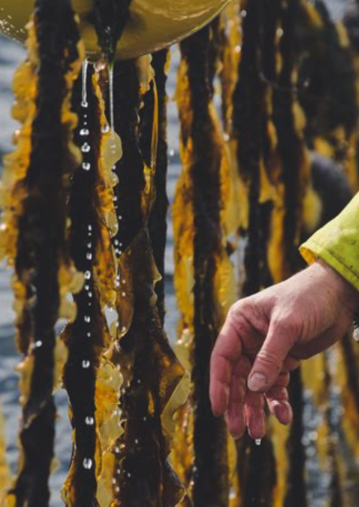
Market Opportunities
Economic Potential of Seaweed Farming
Food Industry: Seaweed as a sustainable food source for human consumption (e.g., snacks, salads, and health supplements).
Bioenergy: Seaweed can be used to produce biofuels, reducing reliance on fossil fuels.
Pharmaceuticals and Cosmetics: Seaweed extracts are used in skincare and medicinal products.
Carbon Credits: Seaweed farms could earn carbon credits for their sequestration efforts, adding to economic viability.
Notes:
5 minutes discussion

Slide 16
Challenges in Seaweed Farming
Obstacles to Scaling Up Seaweed Farming
Regulatory Hurdles: Navigating legal and regulatory frameworks for marine farming.
Environmental Conditions: Variability in water temperature, salinity, and currents that can impact seaweed growth.
Market Demand: Establishing stable and diverse markets for seaweed products.
Technical Expertise: Need for skilled labour and advanced technology for farming and harvesting.
Notes:
5 minutes discussion

Slide 17
Monitoring and Maintenance
Best Practices for Seaweed Farm Monitoring
Regular Environmental Monitoring: Measure water quality (e.g., temperature, salinity) and farm conditions to optimize growth.
Harvesting Schedules: Monitor growth rates to ensure timely and efficient harvesting.
Post-Harvest Handling: Proper handling and processing of harvested seaweed to prevent degradation and ensure quality.
Notes:
5 minutes discussion

Slide 18
Long Term Sustainability
Ensuring Long-Term Success of Seaweed Farms
Adaptive Management: Regularly adapt farm practices based on environmental changes and market trends.
Eco-friendly Practices: Use non-invasive species, and reduce waste during processing to protect marine environments.
Monitoring Carbon Sequestration: Measure the amount of CO2 sequestered by seaweed farms for continuous improvement and verification.
Notes:
5 minutes discussion

Slide 19
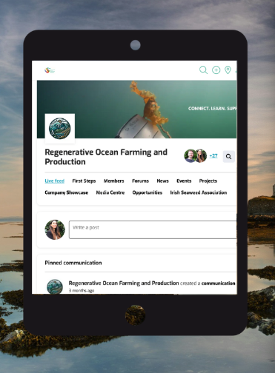
Conclusion
Seaweed Farming: A Promising Solution for a Sustainable Future
Seaweed farming offers numerous environmental and economic benefits as a nature-based solution.
EU projects demonstrate the potential of seaweed farming for climate change mitigation, coastal protection, and sustainable economies.
Proper implementation, monitoring, and collaboration can ensure seaweed farming's success in combating climate change.
Notes:
For more contact reach to the projects and check out the seaweed film:
https://www.c-faarer.eu/videos/v/jdbz2jxwps4j4x5fbmn8ytw92xjssh

Slide 20
Credit for this content:
Centre for Social Innovation, Trinity College Dublin

