Slide 1

Introduction to NBS:
Nature’s Benefits and Ecosystem Services
Lecture (online)
Credit: Trinity Business School – Centre for Social Innovation – Trinity College Dublin
Content created in 2024

Slide 2
(Part 1)
Learning Outcomes for this Learning Unit
Introduce and interrogate the definitions and elements of NBS as it connects to the broader ecosystem.
Highlight the benefits of NBS for ecosystem services, focused on the environment, economy and society.
Reflect on elements of NBS in the learner's own personal experiences.
Consider how NBS can offer benefits from the perspective of the learner's own academic discipline of study.

Slide 3
Exploring NBS
What comes to mind when hearing 'Nature-Based Solutions’?
answer in the chat (or Miro Board)

Slide 4
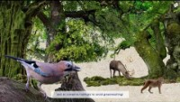
What is NBS?
(video 2 min)
Elements of NBS:
Biodiversity
Resilience and mitigation of climate change effects
Environmental, societal and economic benefits
Cost-efficiency
Co-creation
Beyond technical solutions for climate change, consider nature solutions
Reference: NetworkNature

Slide 5
NBS Definition – EU
“Solutions that are inspired and supported by nature, which are cost-effective, simultaneously provide environmental, social and economic benefits and help build resilience.
Such solutions bring more, and more diverse, nature and natural features and processes into cities, landscapes and seascapes, through locally adapted, resource-efficient and systemic interventions.”
Reference: European Commission

Slide 6
NBS Definition
“… actions to protect, sustainably manage, and restore natural or modified ecosystems, that address societal challenges effectively and adaptively, simultaneously providing human well-being and biodiversity benefits.”
Reference: International Union for the Conservation of Nature

Slide 7
NBS Definition – extended: what it is and what it is not
“Nature-Based Solutions…provide multiple benefits for biodiversity. Any approaches that do not improve biodiversity, are not based or delivering on a range of ecosystem services, are not Nature-Based Solutions.”
“Nature-based solutions protect, sustainably manage and restore natural or modified ecosystems, which address challenges facing humanity (e.g. climate change, food and water security or natural disasters). At the same time nature-based solutions bestow wider benefits to human well-being and biodiversity.”
Reference: Connecting Nature

Slide 8
Terms that sound like NBS – but are not
Nature derived solutions:
Wind, wave, and solar energy derived from nature
  replace our carbon energy needs and benefit society.
  In isolation, not based on functioning natural ecosystems or not direct ecosystem benefits
Nature inspired solutions:
Innovative design, production of materials/structures/systems modelled on biological processes
sticky gloves that mimic geckos
Not based on direct use of ecosystem services and do not provide benefits for nature.
Reference: Network Nature (2023) NBS Made Easy Brochure

Slide 9
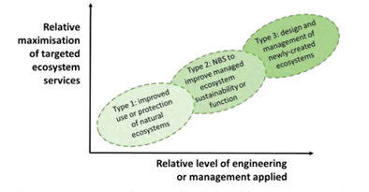
NBS Classification
TYPE 1 - Protection and conservation strategies
(some examples)
Protected areas, conservation zones
Limit or prevent land use
Maintenance or enhancement of natural wetlands
“PRESERVE”
UniLab – Urban Nature Labs adapted from Eggermont et al., 2015 (p.12)

Slide 10
NBS Classification
TYPE 2 - Sustainable management protocols
(some examples)
Pest/weed management
Habitats/shelters to support biodiversity (e.g., insect hotels)
Sustainable fertiliser use
“IMPROVE”
UniLab – Urban Nature Labs adapted from Eggermont et al., 2015 (p.12)

Slide 11
NBS Classification
TYPE 3 – Highly intensive ecosystem management
(some examples)
Green spaces (e.g. Botanical garden)
Trees and shrubs (e.g. orchard)
Soil conservation (e.g. slope revegetation)
Blue-green space (e.g. dune structures)
Green build environment (e.g. green roof)
“CREATE”
UniLab – Urban Nature Labs adapted from Eggermont et al., 2015 (p.12)

Slide 12

Types of NBS - Examples
(video 2 min)
NBS can be found in:
Urban
Rural
Coastal
communities
Reference: NetworkNature

Slide 13
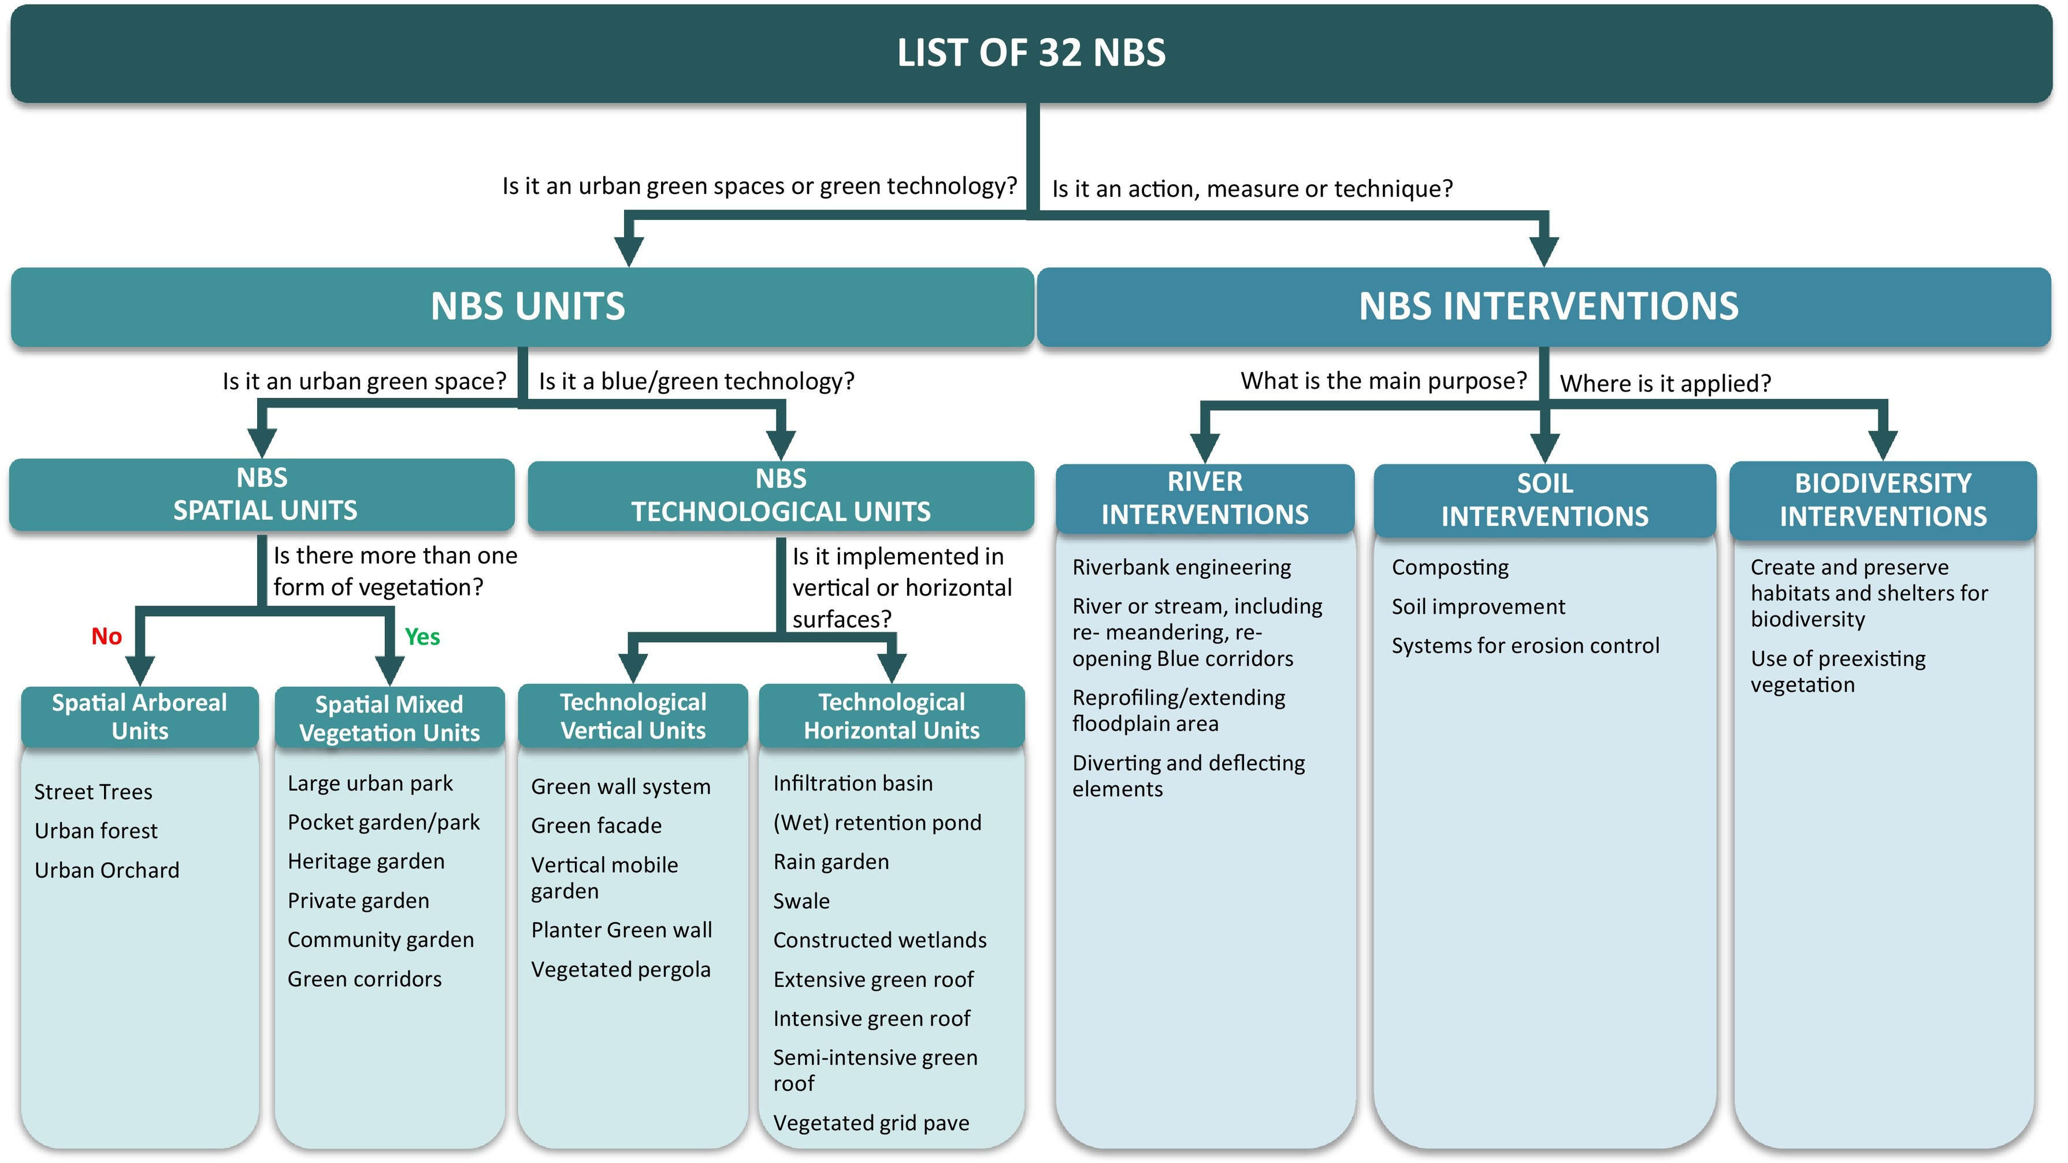
NBS Examples – A Hierarchical Classification
Reference: Castellar et al 2021

Slide 14
Exploring NBS – Revisited
What comes to mind when hearing 'Nature-Based Solutions’?
Is NBS what you thought?
What is different? The same?
Discuss in the group or respond in group chat

Slide 15
NBS 5 Principles
Does it use nature/natural processes?
Does it provide/improve social benefits?
Does it provide/improve economic benefits?
Does it provide/improve environmental benefits?
Does it have a net-benefit on biodiversity?
Connop, S. “Nature-Based Solutions Explained.” Connecting Nature.

Slide 16
(Part 2)
NBS
Benefits:
A Reflection point
Based on what you learned so far and your own knowledge:
What Nature-Based Solutions are you familiar with?
What do you see are the benefits of NBS?

Slide 17
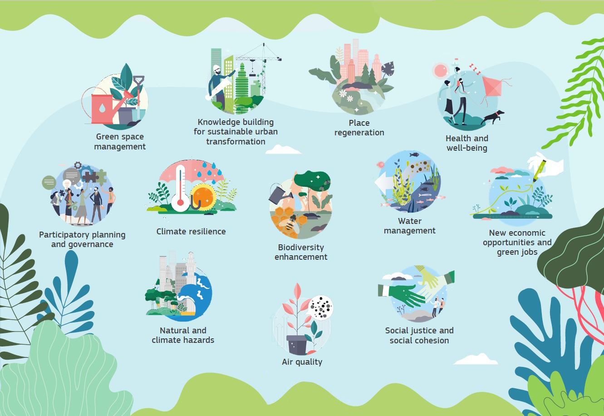
Summary of the Benefits of NBS: tackling the climate and biodiversity crisis
Reference: European Commission. 2021 Evaluating the impact of nature-based solutions

Slide 18
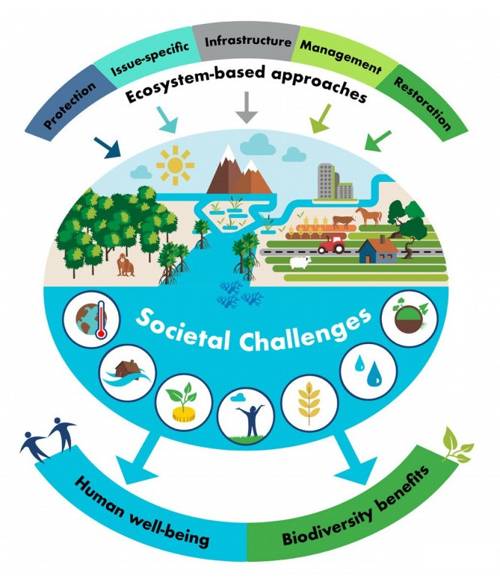
NBS: Social Benefits
  Human well-being
    Air quality
    Health and well-being
  Societal well-being
    Social cohesion and social justice
    Participatory planning and governance
Reference: International Union for the Conservation of Nature

Slide 19

NBS: Economic Benefits
  Fostering a nature positive economy
    Green jobs
    Nature-based enterprises and entrepreneurship
    Partnership with private sector for nature-positive initiatives
The Vital Role of NBS for a nature positive society (video 3 min)
Reference: NetworkNature
Union for the Conservation of Nature

Slide 20
NBS: Environmental Benefits
Ecosystem-based approaches to societal challenges for:
  Biodiversity benefits
  Urban regeneration
  Coastal resilience
  Climate mitigation and adaptation
Reference: International Union for the Conservation of Nature

Slide 21
Example of NBS: Benefits of Green Roofs
Cross-cutting ecosystem approach to this NBS solution
  Varying benefits some higher impact than others
  What benefits resonate with you most about this Nature-Based Solution?
Reference: Faivre et al (2017) “Nature-Based Solutions in the EU” Env Res p.510

Slide 22
NBS Definition – EU
“Solutions that are inspired and supported by nature, which are cost-effective, simultaneously provide environmental, social and economic benefits and help build resilience.
Such solutions bring more, and more diverse, nature and natural features and processes into cities, landscapes and seascapes, through locally adapted, resource-efficient and systemic interventions.”
Reference: European Commission

Slide 23
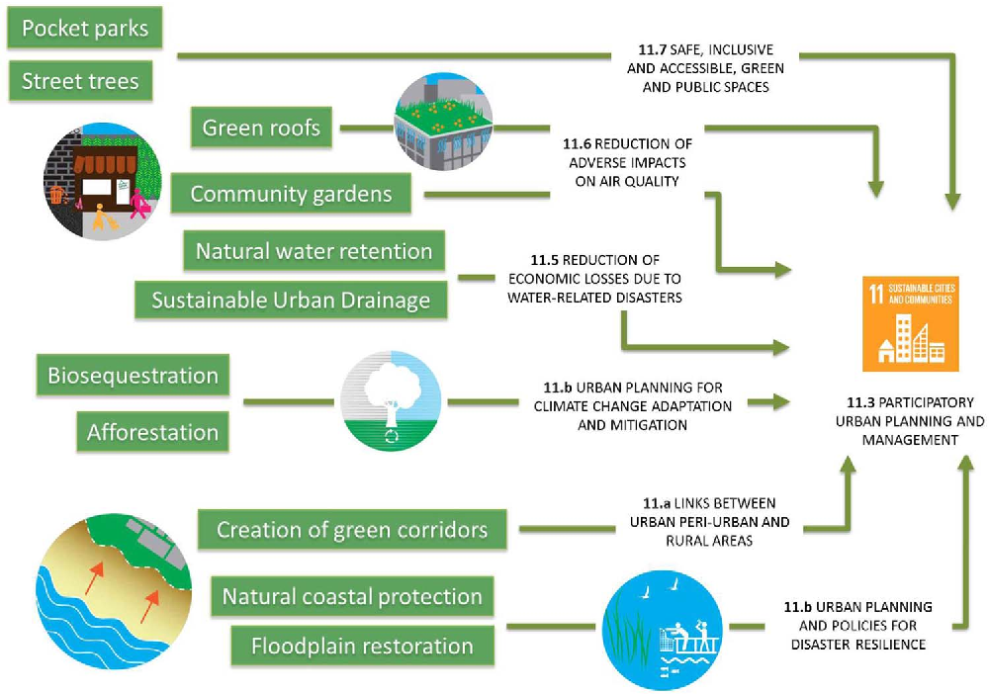
NBS Benefits and the SDGs
Addressing the Sustainable Development Goal targets
  Follow one NBS (in green) and see the link to SDG 11 targets: SDG 11: Sustainable Cities and Communities
  THINK GLOBAL, ACT LOCAL
Reference: Faivre et al (2017) “Nature-Based Solutions in the EU” Env Res p.510

Slide 24
(Part 3)
NBS: A multidisciplinary reflection
Given the learning on the benefits and elements of NBS
What do you see as the links to your academic discipline?
How can you link NBS ideas and benefits in your area of study?
Pair and Share (breakout groups – 2 people) – 5 minutes
Share with the whole group – 5 minutes

Slide 25
(Part 4) Final Summary: Benefits of NBS
Reflect on your NBS learning:
What NBS benefits resonate with you the most?
  Why?
  What's the potential and possible challenges to implementation?

Slide 26
Final Summary: Benefits of NBS
Reflect on your NBS learning:
What is your key takeaway item?
What new information on the benefits of NBS will you share with others?

Slide 27
Credit for this learning unit content: Centre for Social Innovation
Trinity Business School – Trinity College Dublin

