Slide 1
UrbanByNature: Going through Step 7 UPSCALE
Online presentation + discussions
Credit: ICLEI Europe
Content created in 2024

Slide 2
Learning Outcomes for this Learning Unit
The 3 Scaling approaches for NbS: Scaling out, scaling deep and scaling up
Understand the importance of Upscaling NbS to reverse ecosystem degradation and support nature restoration
Learn about the IUCN Standards – NbS Principles and the importance of standards for applying NbS at wider scale
Learn about the challenges and think of solutions for upscaling NbS

Slide 3
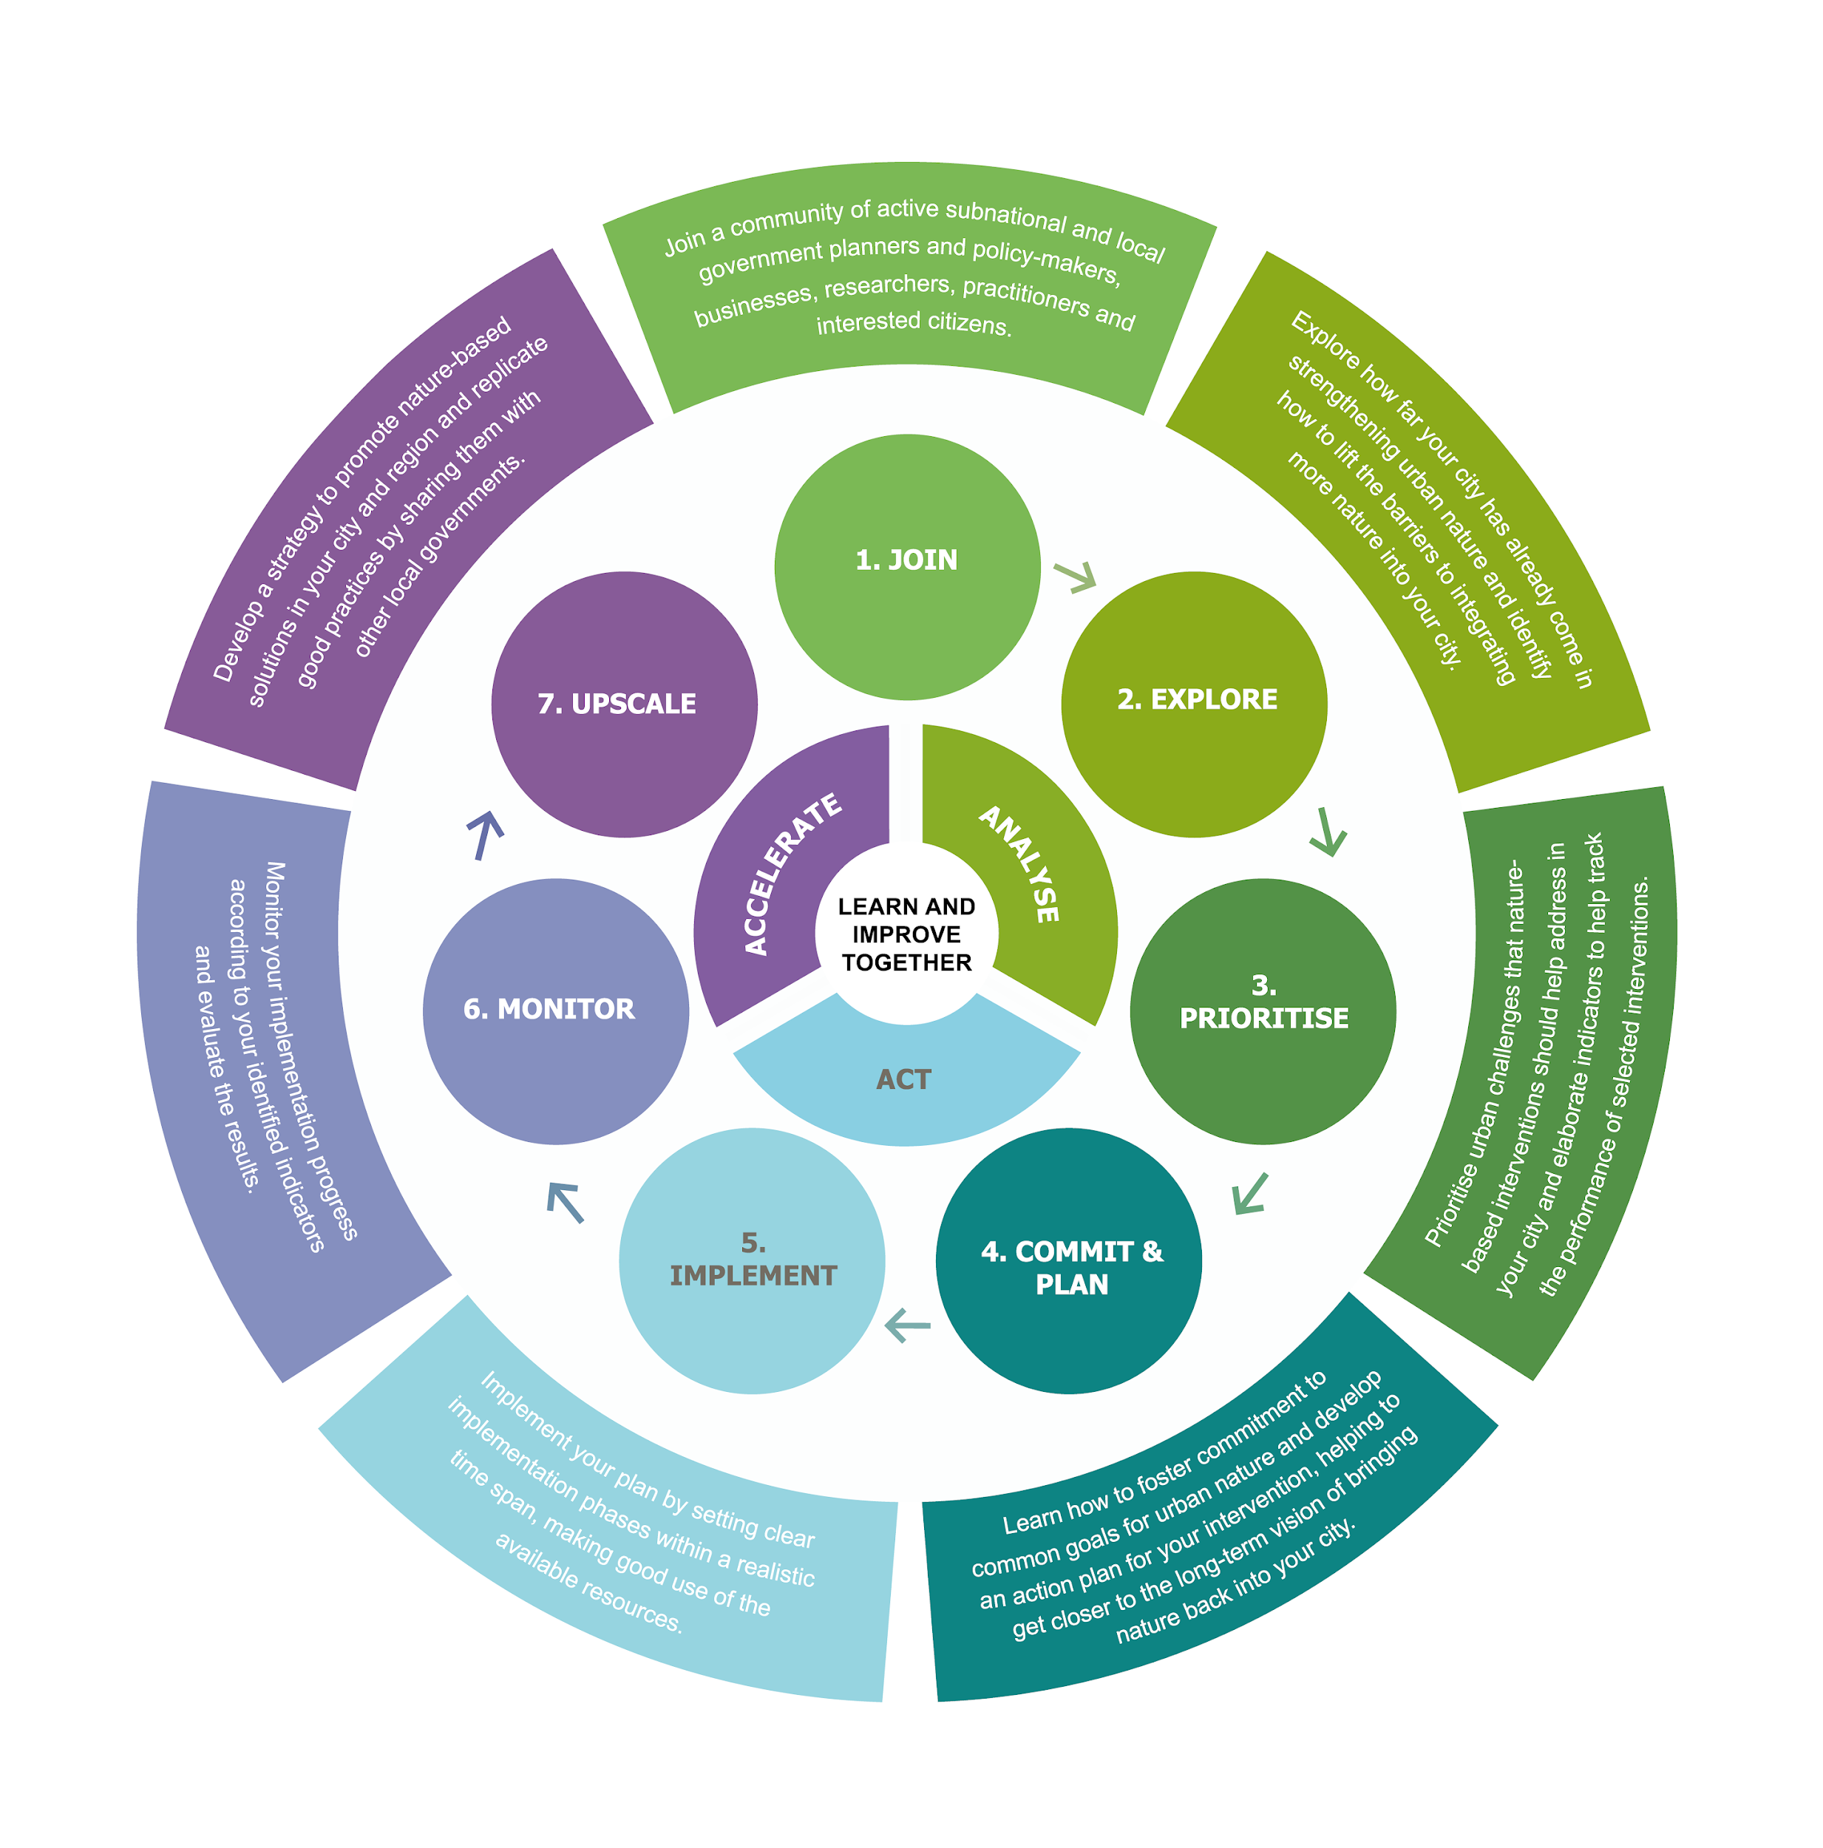
Activity 1
Provide short answers in MentiMeter
What do you understand by Upscaling of NbS?

Slide 4
Scales for NBS
NBS in urban areas are typically small, stakeholder-driven projects tailored to local biophysical, socio- economic, political and cultural conditions. In most cases, they cannot be replicated without various adjustments. Therefore, scaling requires nuanced knowledge of the original context and success factors. Three scaling approaches have been described in literature: ‘scaling out’, ‘scaling up’ and ‘scaling deep’ (Salafsky et al., 2021).
Scaling out – replicates NbS in a similar context with minor adjustments.
Scaling deep – tackles the predominant socio-economic drivers of biodiversity loss and landscape degradation, may include changes in values, policies and insitutions.
SCALING UP – applies where the approach needs to be substantially adapted, e.g. Addressing regulatory barriers at all levels.

Slide 5
Upscaling NbS – How can it be done?
“Instead of piloting and implementing site specific projects, this approach involves thinking about how you might work within the system to operate at a higher and more leveraged scale. For example, instead of doing wetland restoration yourself, you might work to implement a national policy that will incentivise key landowners to restore wetlands in watersheds that they manage. Or you could develop a market-based strategy and partner with major seafood companies to implement sustainable seafood production.
Activities needed to go to scale under this approach include developing higher level strategies as well as raising the necessary resources and building the program team needed to implement these strategies.” (Salafsky et al., 2021)

Slide 6
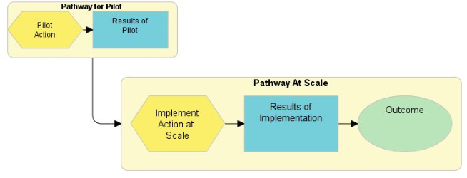
Guidance for taking NbS to Scale
Be explicit in your scaling approach(es)
Build your scaling approach into your Strategy Pathways
Use Systems thinking in designing your pathways
Check your scaling assumptions
Integrate behavioru change into your scaling pathways
Use your strategy pathways to guide your monitoring and evaluation
Salafsky et al., 2021

Slide 7
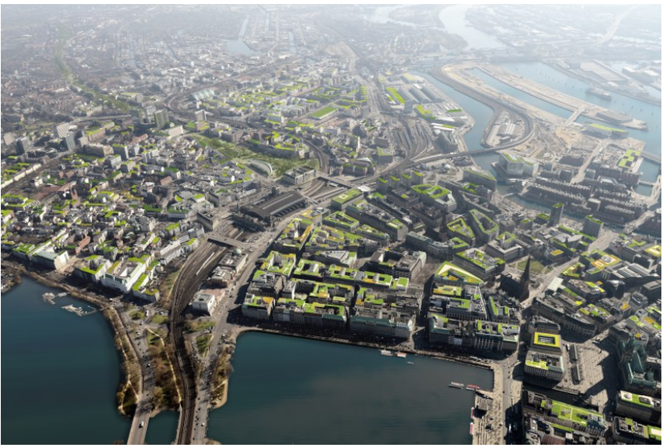
Upscaling NbS – A case study, Hamburg
Hamburg is a pioneer in the development of a comprehensive Green Roof Strategy with the overall goal of developing 100 hectares (ha) of green roof surface in the metropolitan area. This will be implemented on existing and new buildings.
The scaling potential of green roofs depends on awareness about this solution’s economic advantages; willingness to invest and accept the corresponding legal requirements; and the availability of suitable roof surfaces.
Hamburg municipality provides financial support, which partly compensates for the higher installation costs. It also offers reduced stormwater fees, recognising the public benefits of rainwater retention provided by green roofs (Clar and Steurer, 2021).
However, Scaling green roof implementation is physically limited by the availability of adequate surfaces with the correct inclination and suitable construction. This restrains the widespread implementation of green roofs in existing urban areas, even in the case of planning regulations or bylaws
Source: Treibhaus Landschaftsarchitektur and Mathias Friedel

Slide 8
Upscaling NbS – Why is it important?
“For NbS to be effectively implemented at the scale needed to reverse ecosystem degradation trends, they need clear and coordinated principles, on which evidence-based standards and guidelines for practitioners and decision-makers can be developed.” (cohem-shacham et al. 2019)
Moving from demonstration projects to a full-scale deployment of NBS (Fastenrath et al., 2020; Nature-based Solutions Coalition, 2019)
Scaling up NbS solutions may entail mainstreaming them at different spatial, temporal, jurisdictional, institutional, and management levels, simultaneously expanding networks and knowledge (Fastenrath et al., 2020).

Slide 10
IUCN Standards for NbS
The Global Standard for Nature-based Solutions was developed through public consultation with over 800 practitioners and experts from more than 100 countries.
The result is a robust framework that helps increase the impact and scale of Nature-based Solutions.
This framework consists of 8 criteria with 28 associated indicators with guiding questions that help the user assess and improve their solution.
IUCN, 2024

Slide 11
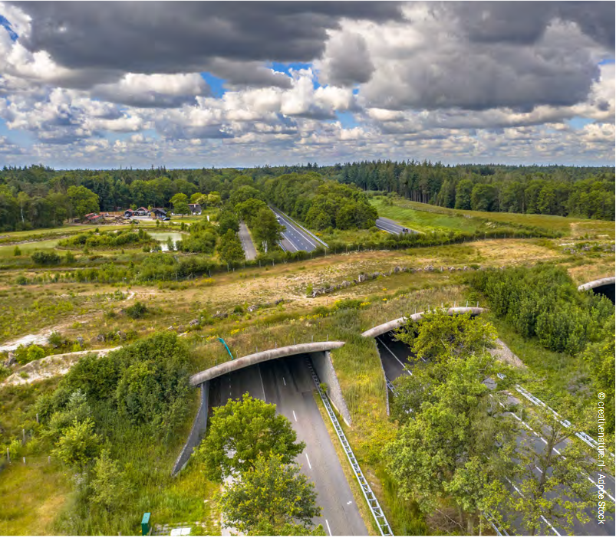
Challenges and Opportunities in Upscaling NbS
Building a common understanding of NbS
Adopting integrated approaches to scale up NbS, combining policy, finance and safeguard measures
Applying appropriate safeguards, standards and guidelines for NbS
Enabling locally-led actions on NbS
Further reading: UNEP 2022

Slide 12
Group work: Upscale NbS
Activity 2
Breakout Group A
What role does Standards play in upscaling NbS?
Breakout Group B
What challenges do the NbS implementors face in upscaling NbS and how can they be overcome?

Slide 13
Final Reflections: Wrap up and key take homes!
Activity 3
Plenary discussion and sharing:-
If you were to take home one key message, what would that be?

Slide 14
Credit for this learning unit content: ICLEI Europe

