Slide 1
UrbanByNature: Going through Step 5 IMPLEMENT
In-person Interactive Lecture
Credit: ICLEI Europe
Content created in 2024

Slide 2
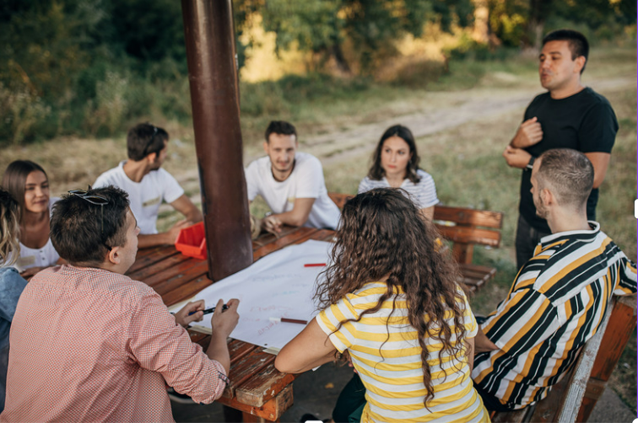
Diverse Voices, Shared Vision:
Understanding Stakeholder Perspectives for NbS Implementation

Slide 3
Learning Outcomes for this Learning Unit
Understand the perspectives and priorities of diverse stakeholders involved in implementing a nature-based solution.
Through a youth empowerment role-playing game, understand the process of NbS implementation by:
- Exploring the complexities of urban sustainability challenges
- Developing collaborative solutions and concrete action plans
- Promoting youth empowerment and meaningful participation in sustainability initiatives

Slide 4
Understanding Stakeholder Perspectives for
Nature-based Solutions Implementation
Collaboration and co-development of knowledge are key elements in the nature-based solutions implementation process (Wickenberg et al. 2021).
Implementing successful nature-based solutions projects requires understanding and addressing the perspectives of diverse stakeholders, each with unique goals, priorities, and concerns.

Slide 5
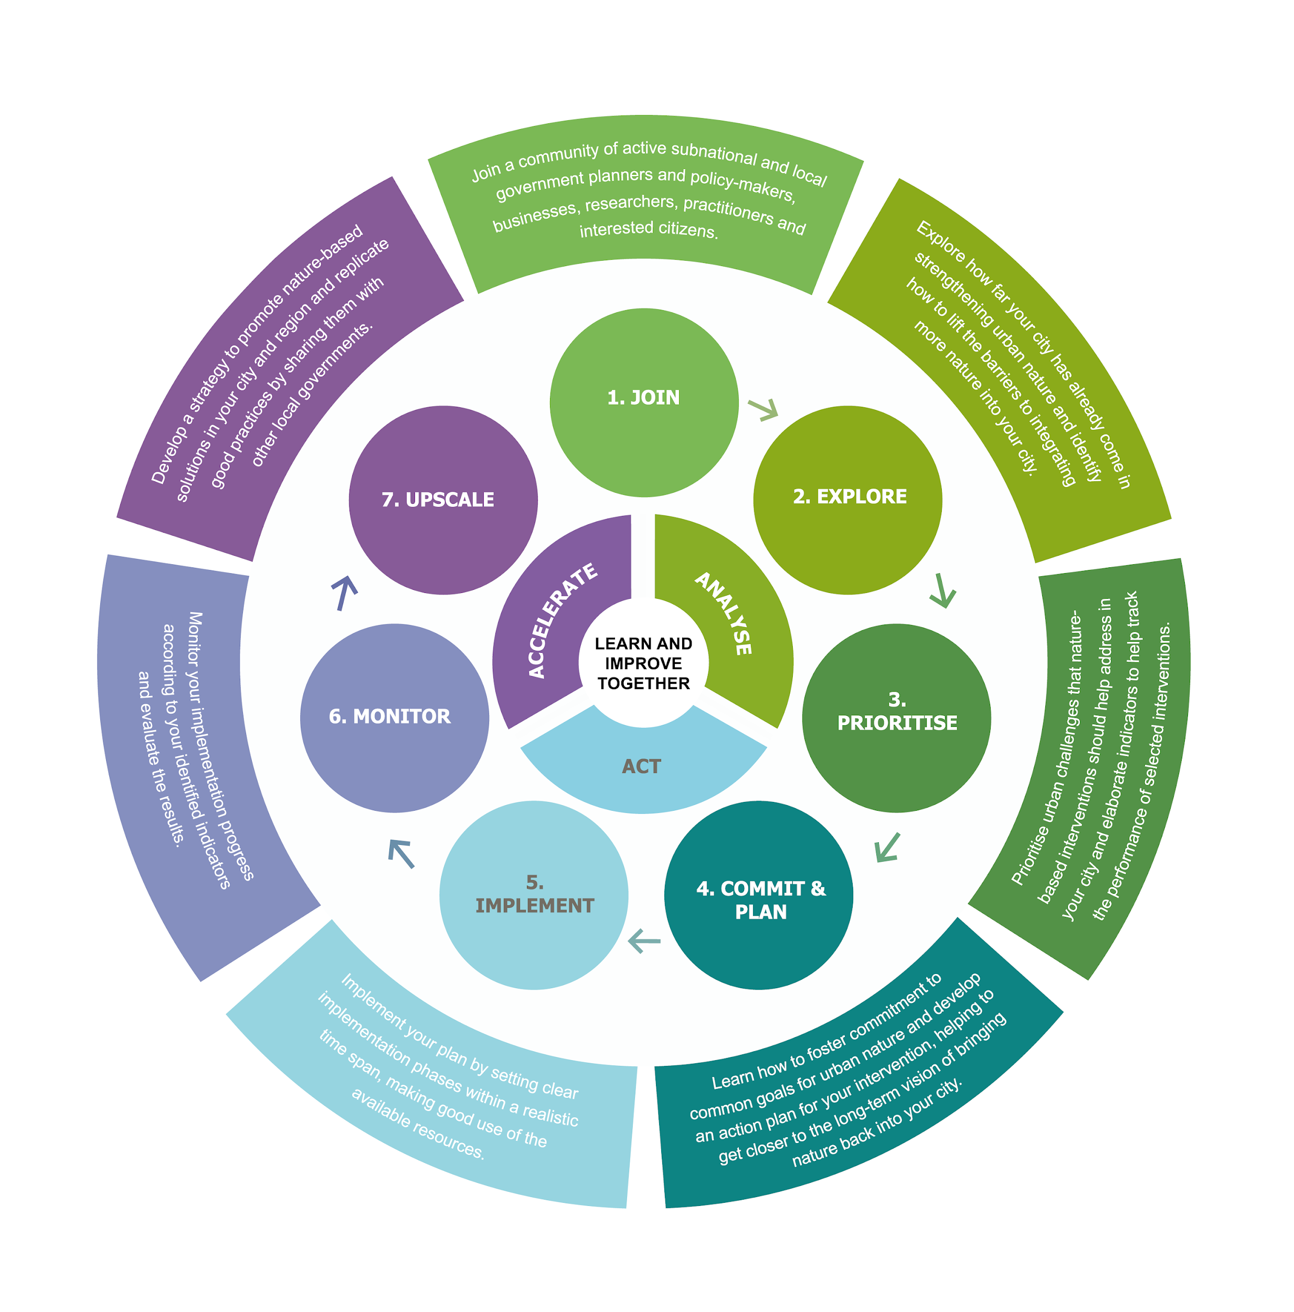
IMPLEMENT

Slide 6
Discussion Prompts:
Can you think of examples of NbS projects where different stakeholder perspectives might clash?
How can we ensure that all voices are heard and respected in the planning and implementation of NbS?
What strategies can help bridge the gap between short-term desires for action and long-term sustainability goals?

Slide 7
Introduction to the Role-Playing Game
The role-playing game centers around a fictional school called Evergreen School in a city with 200,000 residents. This school is facing sustainability challenges after a city council report reveals its poor sustainability performance in areas such as emissions, energy inefficiency, and biodiversity decline. A student-led survey further highlights issues of food waste and a lack of green spaces to address these challenges. The school principal, Mx. Green, initiates a mission to transform Evergreen School into a model of sustainability.

Slide 8
The Mission
In response to these findings, the school principal Mx. Green called an urgent meeting with representatives from all stakeholders, including students, the school management as well as the city council and board of education. The mission is clear: transform Evergreen School into a model of sustainability by addressing energy use, food quality & waste, and biodiversity. However, according to the school motto “Learn, Lead, Sustain”, the approach should not only involve students but also empower them to take ownership and lead initiatives for a lasting impact.

Slide 9
Taking on Roles and Breaking into Groups
The role-playing game simulates discussions and decision-making processes among various stakeholders involved in the school's transformation.
Participants are assigned roles representing:
●Students (aged 14-18) who live in the school´s neighbourhood.
●School management team (administration, technical staff, teachers, and canteen staff) who takes care of the day-to-day operation of the school.
●City council and board of education: the city council is responsible for allocating resources and ensuring schools are well-funded; the board of education implements national and regional education policies.

Slide 10
Break into three groups!
Each of the three focus areas is discussed in a working group, with a mediator moderating discussions and guiding the group toward practical solutions.
Focus of Working Group 1: Energy use
Focus of Working Group 2: Food quality and waste
Focus of Working Group 3: Biodiversity
Each of the 3 Working Groups Contain:
1 moderator
1 student
1 member of the school management team
1 city council or board of education member

Slide 11
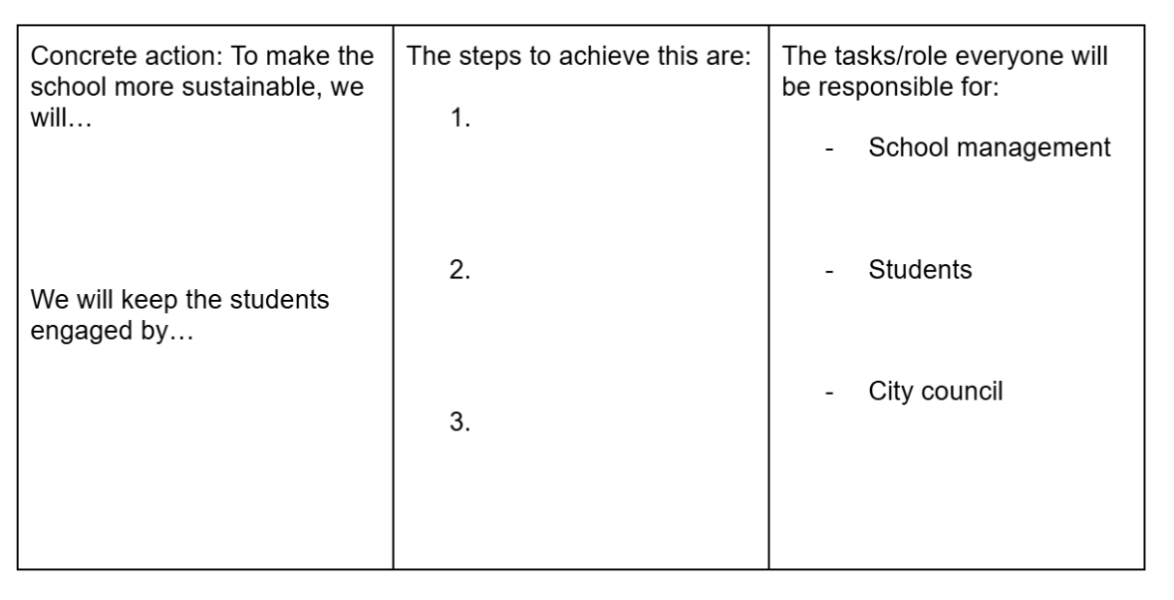
Action Plan Template
Timing and Process
Each participant picks a character sheet randomly and discovers their role. (2´)
Give them time to sit together and briefly discuss their understanding of the role with those who play the same one. (5´)
Facilitate the discussion, as detailed in your character sheet. Make sure that one sustainability action is identified after 10-15´, so the participants can focus on the youth engagement part. (25´)
Ask the participants to collectively fill in the action plan template. (5´)

Slide 12
Character 1:
Student
🎓 Character sheet 🌳🐝
You are…
A 14 to 18 year-old student from Evergreen School, who lives in the school´s neighbourhood.
Depending on your focus group, your mission is to…
Be involved in making Evergreen School more sustainable by addressing the biodiversity and green spaces issues / enhancing the quality of meals or addressing food waste / optimising and reducing the energy use at school. You want to see changes soon!
Perspective
You're excited about projects such as school gardens, green roofs and rainwater harvesting, and see them as a fun way to make school more engaging and connect with nature. You want to start improving the school grounds and students´ wellbeing, while contributing to biodiversity and climate action.
Challenges
Often excluded from decision-making processes
Doubts about your ability to commit long-term or take responsibility for projects
Example arguments for inspiration
These kinds of projects not only make us interested in environmental science, but they also help us understand why it’s important to adapt to changing climate conditions.
Green school projects like school gardens give us a chance to learn and also create relaxing and fun spaces.

Slide 13
Character 2:
School Management Team
🏫 Character sheet 🌳🐝
You are…
A member of the school management team: administration, technical staff or teachers. The technical staff takes care of the maintenance measures, hygiene and security work of the school.
Your mission is to…
Enhance the biodiversity and green spaces / optimise and reduce the energy use (electricity, heating/cooling) / enhance the quality of meals or address food waste i in the school, while ensuring the students´ safety and fulfilling teaching commitments.
Perspective
You are responsible for the management and maintenance of the school's green spaces and infrastructure. You support green initiatives, but must keep an eye on the practical aspects of implementation and maintenance (staff, time, costs, legal issues).
Challenges
Management and maintenance of such projects/areas with limited resources
Safety and liability issues, especially when students are involved
Financing opportunities and training needs
Example arguments for inspiration
Such initiatives promote biodiversity and provide hands-on learning opportunities for students.
We are open to involving students in the maintenance of such projects and entering into long-term partnerships with external experts to ensure sustainable management.
Green projects such as school gardens and green roofs can beautify the school grounds and improve the microclimate.

Slide 14
Character 3:
City Council or Board of Education Member
🏛️ Character sheet 🌳🐝
You are…
A member of the city council or board of education, responsible for establishing policies, allocating resources, and ensuring schools are well-funded, safe, and effectively managed. The board of education implements national/regional education policies.
Your mission is to…
Ensure that the initiatives for more biodiversity and green spaces in / the energy use (electricity, heating/cooling) / the quality of meals or address food waste in the city's schools are financially viable, compliant with regulations, and beneficial to the broader community.
Perspective
You see the re-greening of schoolyards as a valuable opportunity to contribute to the city’s environmental goals and reputation. However, you must balance this with the practical concerns of budget constraints, regulatory compliance, and address the diverse needs of the community.
Challenges
Balancing expertise with young people's input
Addressing diverse perspectives and logistical constraints
Maintaining long-term engagement with youth throughout the entire duration of the project
Example arguments for inspiration
Investing in this project aligns with our city’s commitment to sustainability and environmental education.
We should consider the long-term benefits of this project. By working with experts to navigate environmental regulations, we can create a space that serves as a model for sustainable development in our city.
This project will not only benefit the school but the entire community by enhancing local green spaces and providing educational opportunities.

Slide 15
Character 4:
Mediator
🤹‍♀️ Character sheet 💬
You are…
The mediator. You are a professional with extensive experience in sustainability and urban development, working with ICLEI Europe. Your expertise lies in facilitating multi-stakeholder engagement, guiding complex projects, and ensuring that sustainability initiatives are both effective and inclusive.
Your mission is to…
Facilitate discussions to transform Evergreen School into a model of sustainability by ensuring that the priorities of students (who want quick change), school management (focused on safety and education), and the city council (concerned with financial viability, regulatory compliance and broader community benefit) are all addressed. You especially aim to engage students meaningfully in the process.
See handout for full list of responsibilities

Slide 16
Consider the needs and viewpoints of each group:
Students: Eager to learn, connect with nature, and see tangible results, they often prioritize immediate action and creative solutions.
School Management: Responsible for daily operations, they balance support for sustainability with practical considerations like safety, budget, and maintenance.
City Council/Board of Education: Focused on broader community benefits, regulatory compliance, and financial viability, they often take a longer-term perspective.

Slide 17
Effective communication, collaboration, and compromise are essential to navigating these complexities.
Discussion starters
“Let's start by introducing ourselves and briefly sharing what each of us hopes to achieve in this project.”
“Let's each share one idea to make Evergreen School more sustainable.”
Suggestions for sustainability initiatives
🌳 Depaving the schoolyard
🐝 Creating green spaces: a school garden, green roofs, a pollinator garden…
🌳 Planting trees
🪫 Installing renewable energy solutions: a small wind turbine, solar panels…
💡 Optimising the energy use: installing a heat pump, LED lights, an energy dashboard, improving the insulation…
🍎 Sourcing ingredients from local farmers, creating a farm-to-school programme
🍴 Launch an educational campaign on sustainable eating habits, a composting programme or a zero-waste lunch initiative
🍴 Collecting students´ wishes via a food preference surveys

Slide 18
Effective communication, collaboration, and compromise are essential to navigating these complexities.
Discussion starter:
“Let's each share one idea to engage youth in Evergreen School’s sustainability goals.”
Suggestions for youth engagement methods
Workshops and educational sessions: Foster sustainability knowledge through interactive learning.
Inclusive decision-making: Establish student committees to give students a voice in key decisions.
Hands-on involvement: Engage students in project implementation and maintenance.
Curriculum integration: Incorporate sustainability topics into daily lessons.
External partnerships: Collaborate with NGOs and experts to provide additional resources.
Student working groups: Create small groups to tackle specific project aspects.

Slide 19
Group Discussion and Reflection:
What were some key challenges you encountered during the role-playing game?
What did you learn about how to effectively IMPLEMENT an NbS?
What did you learn about the importance of communication and engaging diverse stakeholders from the early stages?
What strategies did you discuss to help bridge the gap between short-term motivation for action and long-term sustainability goals?
How did you balance the different priorities of each stakeholder?
If you were to take home one key message about this exercise, what would it be?

Slide 20
Credit for this learning unit content: ICLEI Europe

