Slide 1
UrbanByNature: Going through Step 3 and 4 PRIORITISE, COMMIT AND PLAN
In-person lecture and discussions
Credit: ICLEI Europe
Content created in 2024

Slide 2
Learning Outcomes for this Learning Unit
Understand the importance of prioritisation, commitments and planning for NbS in a city using co-creation
Learn about effective steps to plan an NbS – in brief
Learn about the challenges when it comes to committing and planning NbS
Explore the various barriers and bottlenecks when it comes to prioritisation

Slide 3
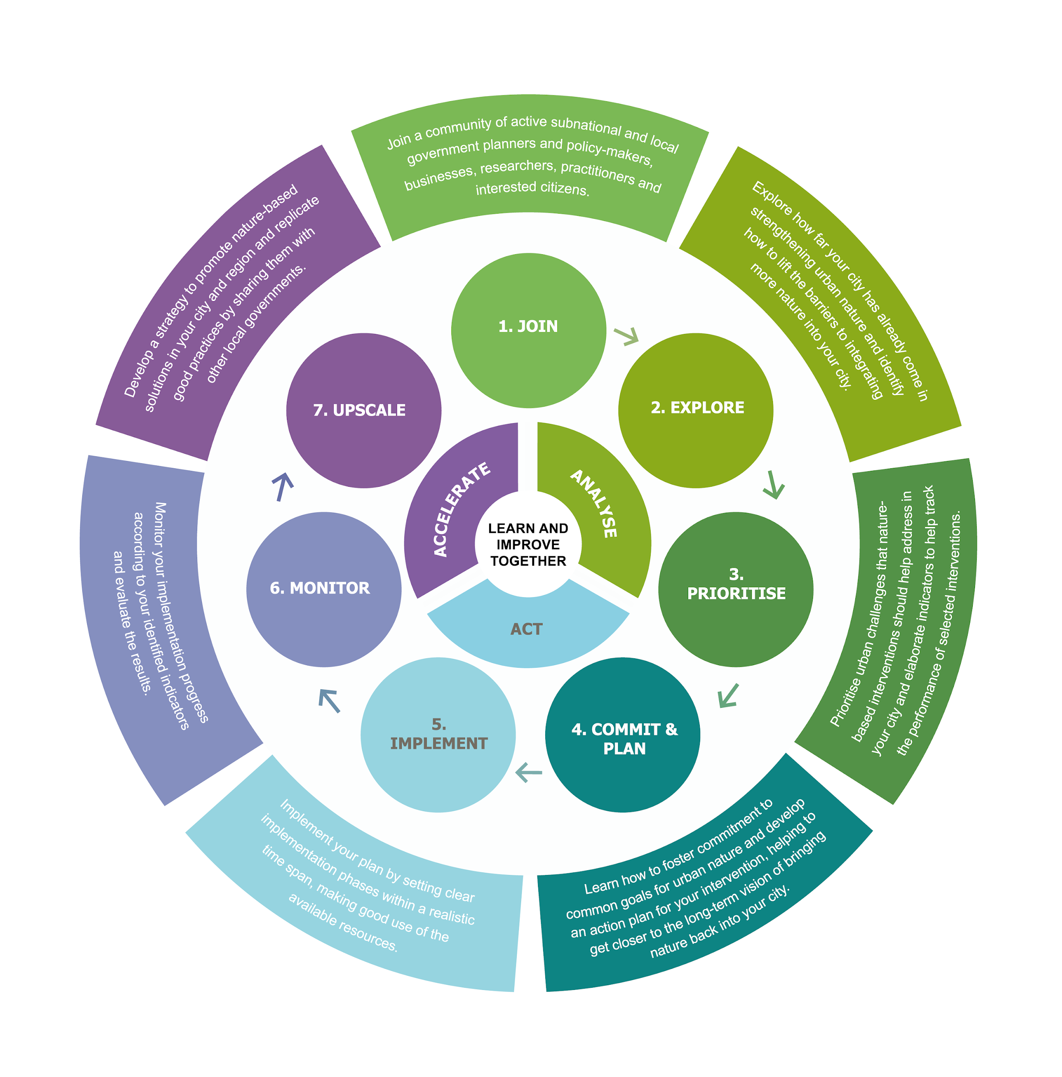
Activity 1
Discuss in pairs
Commit?
Plan?
Prioritise?
What should your city do to
for cost-effective Nature based Solutions that provide multiple benefits?
Think about the next step of UbN to orient yourself. E.g. What would happen if no prioritisation takes place when we come to the actual implementation phase of NbS?

Slide 4
Prioritisation for NBS
Understanding the city needs
Is there sufficient funding?
Are there entreprenuers and private sector involved?
Are there skilled NbS experts in the field to deliver the NbS?
Is there public acceptance for NbS in the neighborhood?
And many more....
Relevance of co-creation and shared governance
To ensure public buy-in and ownership
To support maintenance over time with the support of locals
To make the NbS as user-friendly and specific to needs as possible
Improve social cohesion and provide community building through NbS implementation

Slide 5
NBS co-creation? What is it? (video 2 min)
Steps towards co-creating NbS
Co-diagnostics
Co-design
Co-implementation
Co-evaluation
Upscaling
Reference: NetworkNature

Slide 6
NBS co-creation
Reference: CLEVER Cities
https://clever-guidance.clevercities.eu/storage/app/media/31_What%20does%20it%20mean%20to%20co-create%20nature-based%20solutions_%20FullProduct_V2.pdf

Slide 7
NBS co-creation Principles and Criteria
Inclusive
brings together multiple types of knowledge
Openness
process open to new knowledge, information and actors throughout
Actionable knowledge
knowledge co-produced is immediately planning relevant
Usable knowledge
knowledge co-produced is valuable to multiple participating actors
Legitimacy
brings in legitimate and reliable knowledge in the process
NBS processes contain certain features and principles that tend to be intrinsic to a successful pathway of co-creation:
Iterative process
A learning by doing process
Good and open communication, formal and informal
Locally adapted participatory process
A creative and collaborative effort of a variety of disciplines
Thinking across boundaries
Transdisciplinary and interdisciplinary participation approaches.
Source: https://op.europa.eu/en/publication-detail/-/publication/dd7b9f43-9a33-11ee-b164-01aa75ed71a1/language-en
Reference: Connecting Nature

Slide 8
NBS co-creation? What is it?
Activity 2
Steps towards co-creating NbS
Think of any other steps that might have not been included in the 5 steps mentioned in the video, while they may be important for co-creation?
Write it on a post it and stick it on the flipchart!
Reference: NetworkNature

Slide 9
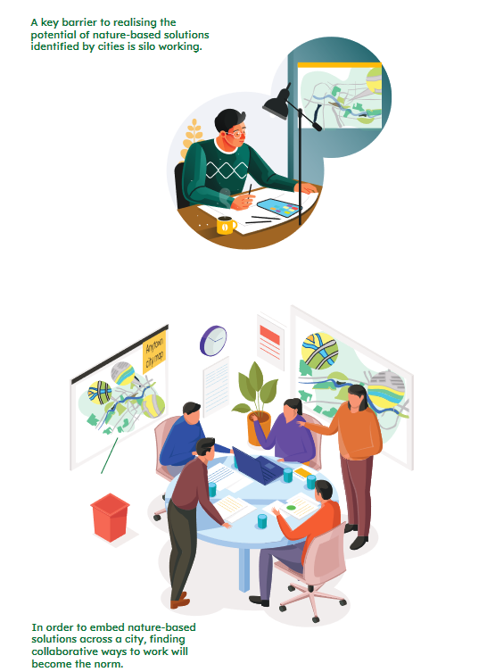
How can co-creation help in Prioritising (PRIORITISE) the right solution?
A good starting point is to identify the connections between what the nature-based solution can deliver and the relevant strategic priorities of the city, the wider area and global targets. (Source: Connecting nature: https://connectingnature.oppla.eu/sites/default/files/uploads/aligningnbswithstrategicprioritiesguideempath50.pdf)
Steps for Prioritising with co-creation!
Taking Stock(Baseline Review)
Mapping relevant departments
Aligning NbS to city specific strategic priorities
Embedding your project in the city’s or national and regional statutory frameworks
Aligning your nature-based solution with UN Sustainable Development Goals

Slide 10
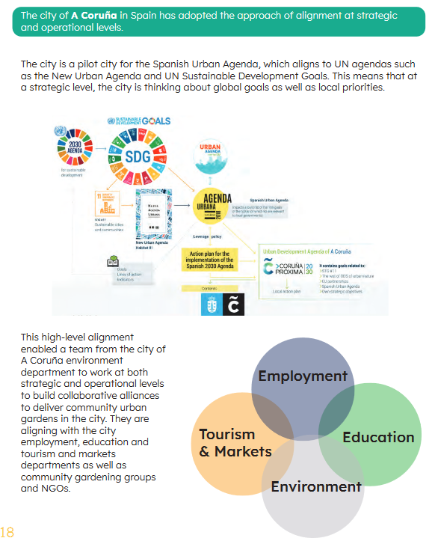
Case Study – A Coruna

Slide 11
What are some challenges with getting commitment (COMMIT) from relevant stakeholders?
Lack of awareness and negative perceptions
Risk aversion and resistance to change
Silo mentality and misalignment of goals
Policy and regulatory barriers
Complexity and time intensive stakeholder engagement processes
Short policy cycles to maintain momentum and interest
No or short window of opportunity to take decisions upto the policy ladder

Slide 12
How to effectively PLAN an NbS?
Context specificity is key! Tailor the NbS to the local context and needs
Communication and engagement from the early stages and keeping the motivation high is essential
Use scientific knowledge and local expertise to inform decisions
To overcome common barriers and enhance the planning process:
Secure political will and long-term commitment by demonstrating the multiple benefits of NbS and aligning them with existing urban development plans
Establish urban living labs with key stakeholder groups to co-identify challenges and suitable NbS
Address risk aversion by providing clear evidence of NbS effectiveness and involving stakeholders in decision-making
Further reading (sources):
https://unalab.eu/en/barriers-co-creation-nbs
https://unalab.eu/sites/default/files/2022-05/PLANNING%20A%20NATURE-BASED%20SOLUTIONS%20PROJECT%20-%20DIGITAL.pdf
https://link.springer.com/article/10.1007/s13280-020-01365-1

Slide 13
Final Reflections: Prioritise, Commit and Plan
Activity 3
Reflect on your NBS learning:
What role does Co-creation play in Prioritise, Commit and Plan and Why?
Why is there a need to overcome the bottlenecks to prioritisation before moving on to commit and Plan?

Slide 14
Final Reflections: Prioritise, Commit and Plan
Contd. Activity 3
Reflect on your NBS learning:
What is needed for a solid commitment and what could hinder the process?
If you were to take home one key message, what would that be?

Slide 15
Credit for this learning unit content: ICLEI Europe

