Slide 1
UbN Steps 1,2 join and explore waste-water treatment NBS
Workshop
Credit: ICLEI Europe
Content created in 2024

Slide 2
After this LU learners will be able to
 | Join & Explore: NBS for water treatment (H2020 NICE Project experiences)
During this workshop, the instructor will provide the presentations from the NICE Project, CETIM, to brief about the project topic and main objectives, LISODE about the main actions carried by them to connect and explore with stakeholders how to develop NICE solutions, and GUT to showcase their experience in conducting these activities in their own context. This will help the learners get a general knowledge on NBS for wastewater treatment, discuss the current governance, regulatory and finance barriers to implement those kind of solutions, and co-create ideas on how to develop cross-collaboration to overcome those barriers in a multi-stakeholder environment at their own individual settings.
Join and explore the topic of NBS for wastewater treatment and its benefits for a more sustainable wastewater management, including wastewater treatment and reuse at the source, as well as increased greening and biodiversity, and engage in a multi-stakeholder discussion for identifying common regulatory, governamental and financial barriers and ways to overcome them for the mainstreaming of cross-collaborative frameworks and co-design of these solutions in the learners individual settings.
Understand what is a water treatment NBS, including the different kinds of wastewater and NBS typologies to treat them
Synergise with different stakeholders groups to identify key challenges for implementing these solutions and ways to overcome them
Connect to key stakehodlers and multi-level institutions that might support in cross-collaboration actions and learn about different methodologies for co-design actions in a co-participatory way
Get familiar with the main EU-relaguratory and policy framework to support the financing and implementation mechanisms of these solutions

Slide 3
Step-by-step guide: workshop
Circulate the learning resources, obtain a clear definition of learner's contextual scope
Time duration:
Teacher: Share resources and form 30 min
Learner: Resources visualisation 1hr 30 min, fill in of the form 30min
Actions:
Teacher action: circulate the resources and a spreadsheet/form to be filled out, requesting learners to assess the learning resources and filled out the form in the upcoming 10 days.
Learner action: visualise the resources, fill in a questionnaire afterwards (to validate the learning outcome), fill in the spreadsheet and send it back to the teacher.

Slide 4
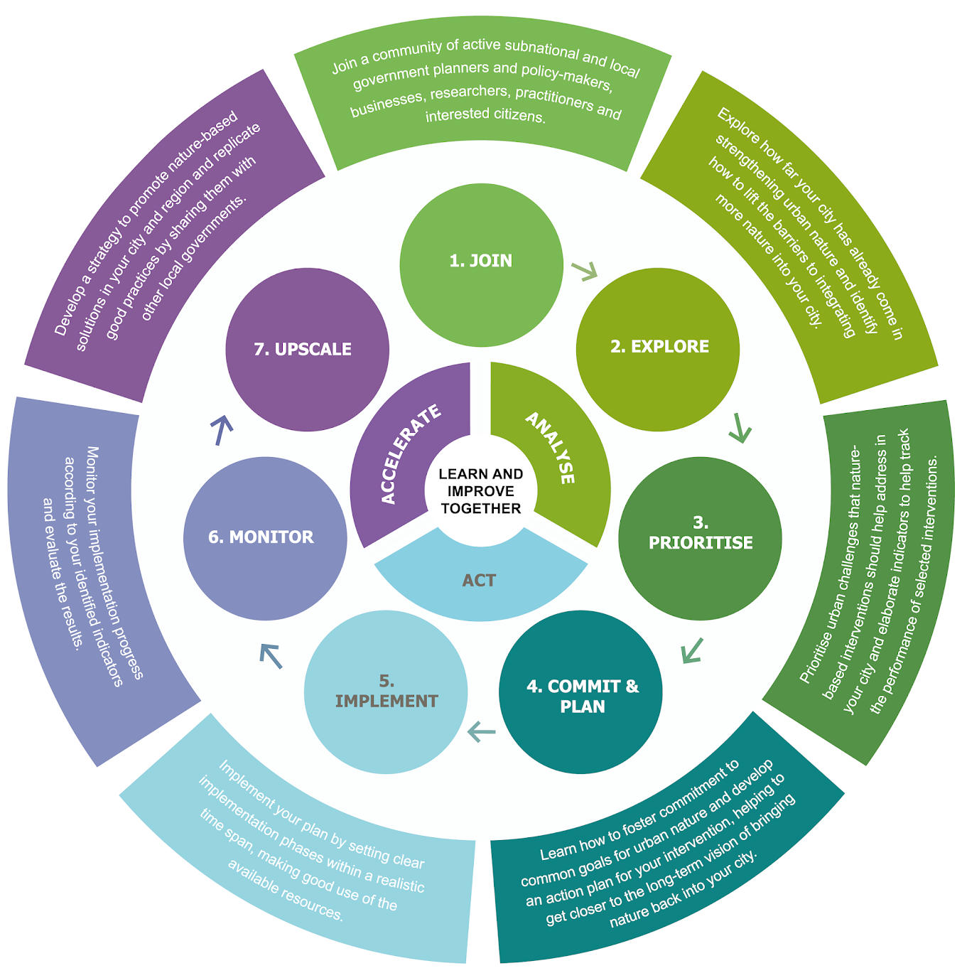
Background: ICLEI’s 5 LU
Based on the steps of the UbN Programme, we aim at facilitating cross-collaboration among stakeholders at different levels for promoting and mainstreaming innovation, restoration, NbS implementation, monitoring and further replication and upscaling.
By joining each ICLEI’s LU you will learn about:
• EU policies and regulatory frameworks main objectives, mission and goals, funding, collaboration in a multi-level and multi-stakeholder environment
• Pathways for innovation in governance, cooperation, at geographical levels or topical frameworks
• Relevance of data analysis, sharing, processing to understand, commit and prioritise sustainable practices
• Innovation in practice, practical examples, design parameters, construction, maintenance and monitoring guidalines
• Replication, upscaling and outscaling of actions to move from research to market and real case implementation

Slide 5
Description of 1st LU Join & Explore
Stakeholder groups
Based on the Steps1,2 of the integrated managemnt approach of the UrbanByNature Capacity-Building Program, LU eis adapted to mentors, professors and transversal stakeholders aiming to train on and support with:
Gathering the 4 categories of stakeholder groups - Mission quadruple helix
citizens, including representatives from NGOs, social group leaders, influencers, volunteering clusters, etc
researchers, scientists, academics, higher education students enrolled in masters, PhD or post-doctoral programmes
private businesses, start-ups, engineering firms, large companies or multi-national private organisations
public administrations, including technicians, administrative staff, local and regional authorities’ representatives
stakeholder engagement and gathering at a local level for raising awareness and cross-collaboration of ideas
innovating in governance, finance
enhancing multi-level stakeholder decision-making, bottom-up/ community-based partnership

Slide 6
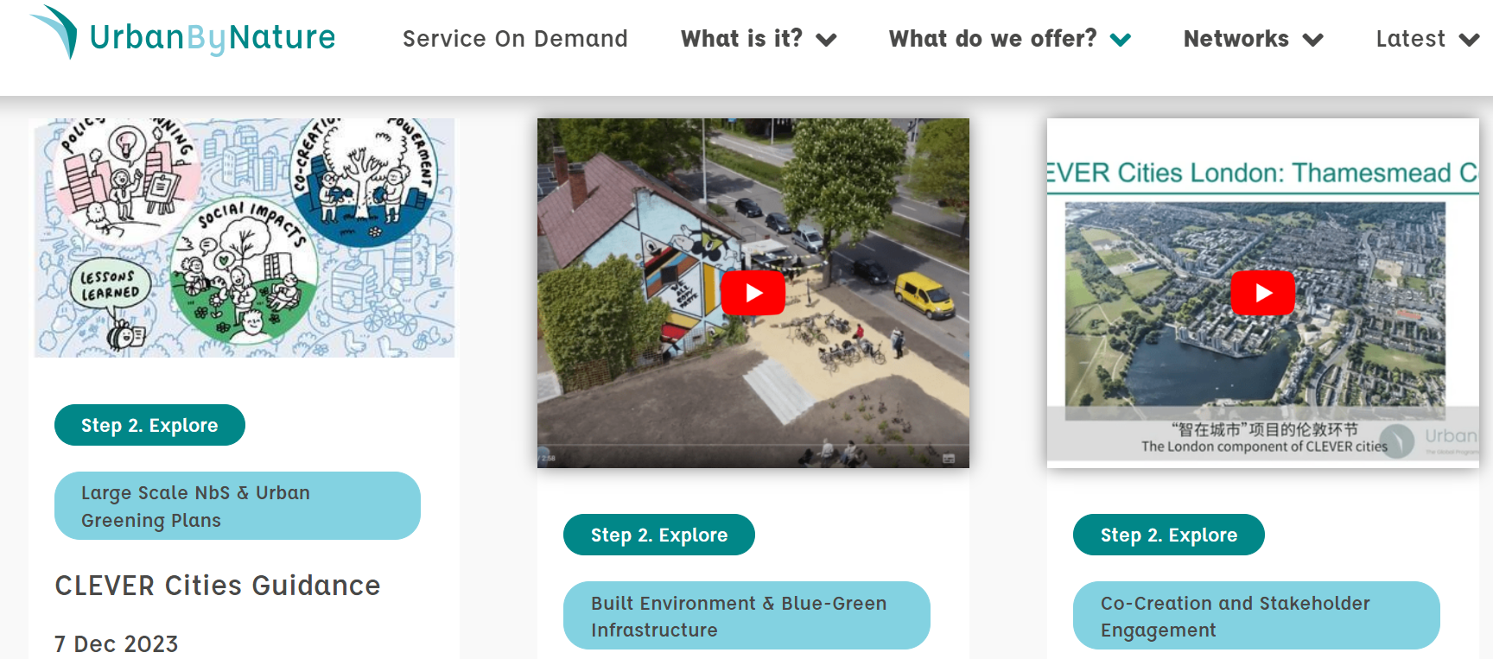
Description of 1st LU Join & Explore
Steps
LU have been clustered by steps assembled as follows: 1,2 join & explore; 3,4 prioritise, commit and plan; 5,6 implement (design & construct) and monitor; and 7 replicate, upscale and outscale. The LUs can be conducted following 3 main streams: umbrellas that embrace sub-topics that cover all the angles of mainstreaming of sustainable development moving from science into practice, market oriented and operationalised implementation.

Slide 7
Description of 1st LU Join & Explore
Protocol
As framework for designing the workshops Steps 1,2
○ Verify the content of presentations fitting to the topic stream and UbN Framework, make use of the public content under the topic stream here. In conjunction to the previous point, discuss with UbN coordinators consent procedure to utilise public material.
○ Program definition: define the agenda of speakers, and questions for the roundtable session after the presentations.
○ Share the outline program with speakers for internal alignment and deadlines for receiving their presentations for review.
○ Review presentations on due time to allow them to introduce possible amendments and record the presentation.
○ Store all recordings in the UbN Database
○ Promote and disseminate information pre and post a webinar through social medial channels and UbN registrants.
Role of Coordinators
o Nurture the work internally with all speakers, setting bilateral meetings, and team brainstorming sessions.
o Coordinate the operational and strategical actions to be taken in accordance with the short, mid and long-term objectives
o Maintain a constant double-check of the content media, posts, website and other dissemination tasks that have to be performed.
○ Together with UbN coordinators, include regular updates with communication through UbN social media posting, social media campaigns and the Newsletters.
● Set the registration form and follow up emails for dissemination, one month, one week, one day and one hour ahead of the event.
TOPIC STREAMS
Green & Blue Infrastructure, Built Environment, Large Scale NbS, Urban Greening Plans
One Health, Environmental Quality, Soils-Water-Air Pollution & Treatment with Ecosystem-Based & NbS Aproaches
Nature Positive Economy, Finance, Investment, Governance & Co-Creation and Engagement

Slide 8
Credit for this learning unit content: {Name/organization/logo}

