Slide 1
Multi-level governance and NBS
Lecture (online)
Credit: PPMI
Content created in 2024

Slide 2
Learning Outcomes for this Learning Unit
Introduce the concept of multi-level governance (MLG) and NBS
Identify multi-level governance challenges for successful NBS
Tips for setting up collaborative MLG NBS processes
Highlight how the MLG settings impact the delivery of NBS projects
Extract insights from lessons learnt from case studies

Slide 3
Introduction to Multi-level governance and nature-based solutions

Slide 4
Definition of Multi-Level Governance (MLG)
Most definitions defined MLG as the way power or authority is distributed between jurisdictions within and beyond states at different levels.
Multi-level in the sense of numerous state and non-state actors located at local sub-national and global supranational levels.
States are no longer the (only) central actors of policy-making in most countries.
The degree of de-centralisation or globalisation characterising MLG structures vary between countries.
Source: Hooghe, Liesbet, Marks, Gary and Arjan H. Schakel (27 April 2023) Multilevel governance. In Comparative Politics, ed. Daniele Caramani. https://www.oxfordpoliticstrove.com/display/10.1093/hepl/9780192846051.001.0001/hepl-9780192846051-chapter-12
Cairney, Paul; Heikkila, Tanya; Wood, Matthew (28 February 2019). Making Policy in a Complex World (1 ed.). Cambridge University Press. doi:10.1017/9781108679053. ISBN 978-1-108-67905-3. S2CID 159046216.
Notes:
Most definitions defined MLG as they way power or authority is distributed between jurisdictions within and beyond states at different levels.
The term was developed by Gary Marks and Liesbet Hooghe in the 90s. The concept aimed to capture and understand political processes related to the emergence of supranational institutions such as the European Union and to facilitate analysis of decentralized decision-making processes, in which sub-national level governments and civil society have come to have increasing influence.
According to MLG theory, states are no longer the monopolizing or even necessarily central actors of policymaking. Instead, the power of government is increasingly shaped by and shared between actors operating at multiple levels.
The way power is shared between levels and how it impacts an actors capability to act differs from state to state.

Slide 5
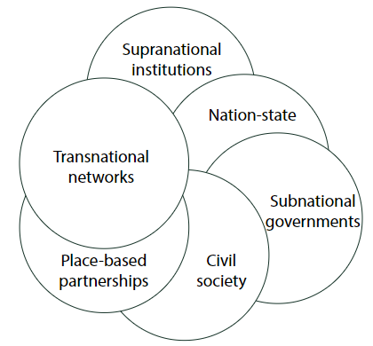
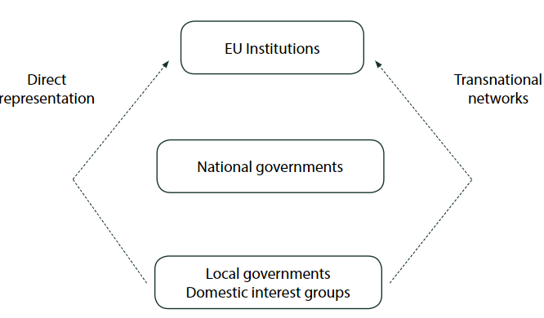
MLG types: nested versus polycentric
Source: Bulkeley, Harriet, Davies, Anna, Evans, Bob, Gibbs, David, Kern Kristine and Kate Theobald (24 June 2010) Environmental Governance and Transnational Municipal Networks in Europe, Journal of Environmental Policy & Planning, 5:3, 235-254, DOI: 10.1080/1523908032000154179
Notes:
MLG can be understood in different ways. Either with the state still being the centre of defining collective goals or with more clear hierarchical structure (‘nested’ – figure on the left) or a more polycentric view (figure on the right).
In the former, local levels governments and domestic interest groups still have some abilities for influence and can create powerful alliances at the global level. Yet, they still primarily depend on national level governance since the national level provides opportunities for going local or global.
In the polycentric view, there are no clear structures and hierarchies, only ‘spheres of authority’ (Rosenau 1997) or ‘complex overlapping networks’ (Bache and Flinders 2004), and state and non-state actors can also have interrelated and simultaneous influence.
These two views are not necessarily mutually exclusive.

Slide 6
Environmental MLG and ecosystem-services governance
Eco services and earth system governance is usually described in a polycentric way, focusing on policy instruments that involve local communities.
Collaborative, co-creating and participatory governance approaches preferred for improved environmental outputs and achieving long-term commitment and inclusion.
Not uncontroversial – links to trends such as deregulation of financial markets and power transfer to private actors (who may have vested interests) → state still a role to play to critically steer the process.
In practice: local level environmental policy administration strengthened across Europe
Katarina Eckerberg & Marko Joas (2004) Multi-level Environmental Governance: a concept under stress?, Local Environment: The International Journal of Justice and Sustainability, 9:5, 405-412, DOI: 10.1080/1354983042000255315
Notes:
Polycentric MLG more commonly preferred in environmental policy circles
Some argue that there should still be a role for the state (e.g., ‘vertical MLG’) so that the nation-state still retains a leading role and can to a critical level steer the development given that one otherwise opens up for too many interests (potentially also harmful to the environmental agenda).

Slide 7
Why taking an MLG approach to NBS (1)
MLG provides opportunities for civil society claims to ‘seep into’ lower levels of governance. Civil society is at the heart of NBS design and actions.
NBS has participation and inclusion as its core. Polycentric MLG is naturally suitable for NBS. NBS provides great opportunities for co-creation.
Partnering up with other authorities and actors can create more secure and stable conditions to attract investment in NBS and make long-term NBS project more financially stable
Coopenergy (2015) A Guide to Multi-Level Governance for Local and Regional Public Authorities. https://www.local2030.org/library/210/A-Guide-to-Multi-level-Governance-For-Local-and-Regional-Public-Authorities.pdf

Slide 8
Why taking an MLG approach to NBS (2)
Public authorities can combine their expertise to benefit the planning process of NBS and ensure coherency between local and regional plans
Develop clear and consistent visions: sharing knowledge and ideas between authorities can enable ambitious and realistic visions to be created
Defining objectives collaboratively ensures that messages are harmonised between stakeholders (avoiding confusion)
Through joint-working different skills, planning techniques and resources can be combined to make limited resources go further, taking advantage of economies of scale, for instance through joint procurement
Coopenergy (2015) A Guide to Multi-Level Governance for Local and Regional Public Authorities. https://www.local2030.org/library/210/A-Guide-to-Multi-level-Governance-For-Local-and-Regional-Public-Authorities.pdf
Notes:
First two points are positives
Next two points are some considerations/concerns

Slide 9
PRACTICAL TIPS AND INSPIRATION

Slide 10
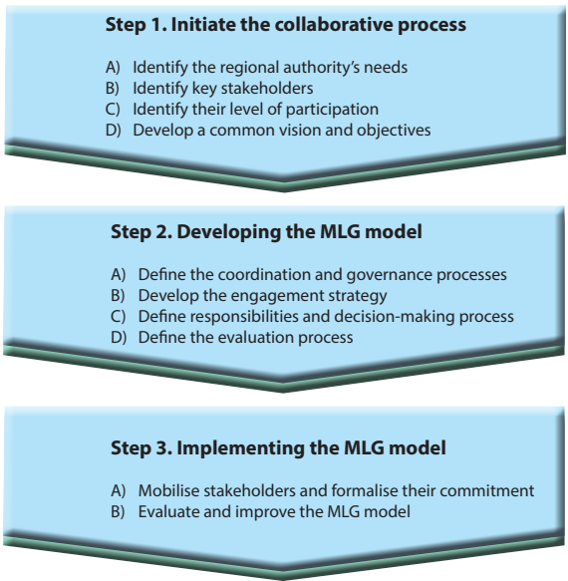
Implementing collaborative MLG for NBS
Highlights: identify stakeholders and their needs, develop a common vision, and way forward for further deliberation, communication, consider timing and context
Coopenergy (2015) A Guide to Multi-Level Governance for Local and Regional Public Authorities. https://www.local2030.org/library/210/A-Guide-to-Multi-level-Governance-For-Local-and-Regional-Public-Authorities.pdf
Notes:
Step 1: this preliminary step serves to identify stakeholders and engage them in the process to develop a common vision, joint objectives, and expected results.
Step 2: during this step, a more detailed analysis of the stakeholder engagement process and governance mechanisms will be carried out, in a joint manner, to define the most appropriate governance structures, decision-making processes, and operational methods to use.
Step 3: in this step a governance system must be established, which requires good communication and the active involvement of all stakeholders throughout the entire process. A participatory evaluation and continuous improvement of the process is implemented.

Slide 11
Consider the MLG settings
 | High Degree of regulatory local autonomy | Low Degree of regulatory local autonomy
Weak Financial support from the state | Unsupported localism | Constrained localism
Strong Financial support from the state | Supported localism | Centralism
The MLG setting urban actors find themselves in enable or hinder policy effectiveness.
Different MLG settings warrant different strategies in promoting NBS and NBS-friendly policies.
Source: Cucca, R. and C. Ranci (2021) Urban Policy in Times of Crisis: The Policy Capacity of European Cities and the Role of Multi-Level Governance Original Manuscript. Urban Affairs Review. 10.1177/10780874211041710.
Notes:
European cities operate within the context of different national governance settings that can act either as a barrier or an enabler to policy effectiveness (Cucca and Ranci 2021). The authors find that the policy capacity of urban governments to deal with the 2008-2009 financial crisis was deeply shaped by cities’ institutional multi-level governance (MLG) settings across two key dimensions: a) the degree of regulatory autonomy granted to the local or regional authority; and b) the financial dependence of the local authority on the state, resulting in four specific MLG settings.
Supported localism: this MLG setting is characterised by the city having wide metropolitan autonomy over setting urban policy rules and goals, as well as strong state financial support. Locally based programmes receive funding from central programmes, often with the opportunity to set specific goals and methodologies, and with high involvement from local stakeholders in planning. Local stakeholders enjoy generous financing and unrestrictive support from the state.
Unsupported localism: here, there is high local autonomy, potentially with a national federalist institutional structure and little or no financial support from the state. In this case, the central constraints are limited, since responsibility for urban competitiveness, welfare and social cohesion has been devolved to the local levels, yet central funding is limited. Urban policy in this situation will depend heavily on the capacity of the local governments to carry out planning and raise funds themselves.
Constrained localism: cities embedded in this structure deal with strict regulation and little autonomy on the one hand, and scarce funding on the other. Urban policy in this case often depends heavily on collaboration with other municipalities in the same metropolitan area, who can join forces in place-based approaches that address very specific vulnerable groups and social challenges.
Centralism: the final MLG setting is defined by strong national interventionism coupled with generous central funding. While local governments are heavily supported, they also have limited functional and institutional autonomy in decision-making.

Slide 12
Good practice example (1)
The Provence Alpes Côte d’Azur region in France has created a guide to assist local governments in integrating sustainable development into their urban planning documents (PLUs). This guide provides tools and practical examples of climate-friendly urban planning strategies. Find out more: http://www.coopenergy.eu/gp/provence-alpes-c%C3%B4te-d%E2%80%99azur-fr-planning-guidelines

Slide 13
Good practice example (2)
Local and regional authorities sign up in the thousands to the Covenant of Mayors (CoM) and ‘Mayors Adapt’, creating climate action plans and building alliances for peer learning. CoM is the main European initiative bringing together local and regional authorities to reach and surpass climate and environmental goals.

Slide 14
Key challenges and take-aways

Slide 15
Key challenges within NBS governance (1)
1. Vertical and horizontal dispersion
Eco-system services beneficiaries and providers are dispersed vertically and at multiple governance levels and across sectors
2. Diverse actors and values
Governance efforts often face challenges in aligning policy instruments across different scales and sectors. Policies that work well for one group (e.g., local communities) may conflict with those designed for others (e.g., national economic goals).
There are certain institutional cultural characteristics and logistics that can act as barriers to smooth collaboration and communication
The governance framework must accommodate participatory, adaptive, and transparent processes to address power imbalances and ensure legitimacy.
Need to balance the interests of stakeholders with differing values, from local communities to global beneficiaries. Differing cultural and ideological perceptions of nature (e.g., intrinsic versus utilitarian values) add complexity to governance negotiations.
Lasse Loft, Carsten Mann, Bernd Hansjürgens (2015) Challenges in ecosystem services governance: Multi-levels, multi-actors, multi-rationalities, Ecosystem Services, Volume 16, Pages 150-157, ISSN 2212-0416, https://doi.org/10.1016/j.ecoser.2015.11.002.

Slide 16
Key challenges within NBS governance (2)
3. Knowledge gaps
Significant gaps remain in understanding ecosystem processes and their societal impacts. This uncertainty complicates policy design.
4. Skills gaps
Many countries, especially in the developing world, face a lack of technical and financial resources to implement effective governance strategies for ES. For example, monitoring and evaluating ES (e.g., carbon sequestration) often require advanced skills and resources that are not always available locally.
Crucial to strengthen the science-policy interface when engaging in NBS.
Implementing inclusive and adaptive governance processes requires stakeholders with the necessary skills to facilitate negotiations, mediate conflicts, and engage diverse actors. Many regions lack trained personnel for such roles.
Lasse Loft, Carsten Mann, Bernd Hansjürgens (2015) Challenges in ecosystem services governance: Multi-levels, multi-actors, multi-rationalities, Ecosystem Services, Volume 16, Pages 150-157, ISSN 2212-0416, https://doi.org/10.1016/j.ecoser.2015.11.002.
Notes:
Source: Moeko Saito-Jensen (2015) Theories and Methods for the Study of Multilevel Environmental Govenrance. Centre for International Forestry Research. https://www.jstor.org/stable/pdf/resrep02152.5.pdf

Slide 17
Conclusion
Implementing NBS undoubtedly requires close collaboration with communities.
MLG is primarily a theory for understanding relations and coordination mechanisms and not itself a recipe for impactful actions in the field of NBS.
In order for MLG in NBS context to be effective, several steps needs to be taken during the MLG process such as clarifying a common vision, roles and responsibilities and making an engagement plan.
Understanding the MLG setting and theories can help local NBS actors design and strategise for more effective NBS, tackling key challenges.
Source: Moeko Saito-Jensen (2015) Theories and Methods for the Study of Multilevel Environmental Govenrance. Centre for International Forestry Research. https://www.jstor.org/stable/pdf/resrep02152.5.pdf

Slide 18
Credit for this learning unit content: PPMI

