Slide 1

Public procurement for NBS
Lecture (online)
Credit: Neil Coles, PPMI
Content created in 2024

Slide 2
Learning Outcomes for this Learning Unit
Introduce and understand the concept of public procurement for NBS
Identify barriers & challenges to public procurement for NBS
Highlight how the challenges impact the delivery of NBS procurement projects
Extract insights form lessons learnt from case studies
Reflect on opportunities to incorporate practices into workplace
Reference materials used : Public Procurement of NBS: Addressing barriers to procurement to urban NBS: Case studies and recommendations. Mačiulytė & Durieux 2020. European Commission.

Slide 3
What is Public Procurement?
Provide three words that describes public procurement from your perspective
Answer in Menti, code: 1234 5678
https://www.menti.com/
Notes:
Icebreaker – use mentimeter https://www.menti.com/ Highlight the menti-wordcloud and discuss outcomes of groups choices- in context with following slide - Definition
3-5 minute exercise.

Slide 4
Definition of Public Procurement
Public procurement (PP) refers to the process by which public authorities, such as government departments or local authorities, purchase work, goods or services from companies.
Source: Public tendering rules ​
Notes:
What is difference between the broader PP process and those specific to NBS – Guidance on innovation procurement : https://ec.europa.eu/docsroom/documents/45975
Public procurement is an important lever for promoting NBS as influences market demand for products and services that support natural solutions that can deliver environmental and health and well-being benefits to business and communities.
Provide feedback on wordchloud- discuss the definition in tis context

Slide 5
Why is Public Procurement important?
Creates a level playing field for businesses across EU via agreed PP Rules
Delivers around €2 trillion/yr to purchase services, works and supplies
Measures are used to boost jobs, growth and investment
Used to innovate, more resource and energy efficient & socially-inclusive
Delivers high quality public services using modern, well-managed and efficient procurement
EU Commission website 2024​
Notes:
Note that over 250 000 EU public authorities spend around 14% of GDP annually
What is difference between the broader PP process and those specific to NBS – Guidance on innovation procurement : https://ec.europa.eu/docsroom/documents/45975

Slide 6
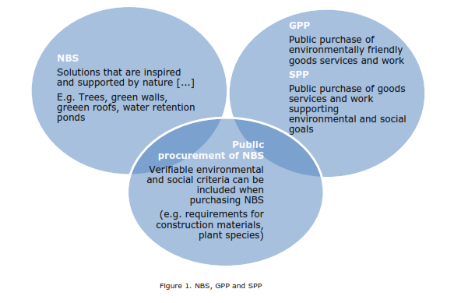
Defining NBS Procurement
PP of NBS refers to the procurement of solutions associated with the definition green public procurement (GPP)
Public authorities seek to procure goods, services and works with a reduced environmental impact throughout their life cycle
Sustainable Public Procurement (SPP) is similar in process, but also accounts for the social impacts.
Source: Green public procurement; Mačiulytė et al, 2020
Notes:
NBS are products or services that can be procured, whilst GPP and SPP denote set of practices that aim to introduce environmental and/or social considerations into specific public purchases (Mačiulytė et al, 2020).
GPP is defined as "a process whereby public authorities seek to procure goods, services and works with a reduced environmental impact throughout their life cycle when compared to goods, services and works with the same primary function that would otherwise be procured.“
GPP is a voluntary instrument and Members States are able to determine the extent to which policies or criteria are applied, it plays a key role in the EU's efforts to boosting a resource-efficient economy.
The basic concept of GPP relies on having clear, verifiable, justifiable, and ambitious environmental criteria for products and services, based on a life-cycle approach and scientific evidence base.
GPP resources available at: https://green-business.ec.europa.eu/green-public-procurement_en

Slide 7
Defining NBS Procurement
The principles of GPP and SPP are supportive of the procurement of NBS
However-widespread confusion between 3 terms harms NBS procurement
Relative novelty of the NBS concept in mainstream urban planning practices
Public procurers might lack the general knowledge of what an NBS is.
Developing a clear understanding of NBS among public procurers is key
Mačiulytė et al, 2020

Slide 8
Barriers to Public Procurement of NBS
Knowledge & Experience
Lack of knowledge and experience with NBS
Key barrier for successful NBS uptake
Site & Context knowledge
NBS projects can be extremely dependent on the local/site specific context
Longer term maintenance costs are difficult to define and price into projects
Limited consensus on the reliable measurement/ quantification of NBS
Procurers often lack information, skills or capacity to evaluate NBS projects
Skills & Capacity
NBS are living solutions, benefits are expected to last much longer.
Complexities make it difficult to account for the full costs and benefits of NBS
Support and training will assist public procurers deal with these challenges
NBS provide benefits to larger areas than grey engineering solutions
Limited information on the associated costs and benefits
Benefits can evolve over different stages and timelines of the project
Notes:
The lack of knowledge and experience with NBS among procurement practitioners has been identified as a key barrier for successful NBS uptake. In particular, there seems to be a lack of a widespread consensus on the reliable measurement and quantification of NBS performance that could provide robust information on the associated costs and benefits. (Mačiulytė et al, 2020)

Slide 9
Challenges to Public Procurement of NBS
1. Lack of NBS Typology
Systemic classification of NBS for procurement remains elusive
Comprehension of the corresponding performance criteria is difficult
2. Difficulty Finding Skilled Suppliers
Difficult to locate suppliers with requisite experience, capacity & skills
Limited use of “common language” and technical expertise
3. Community Engagement on NBS
Communities may have negative interactions with public authorities
Creates view of no action on community view, issues and problems
Creates uncertainty with the type of service or works to be procured
Results in consultation fatigue and a lack of engagement
Impacts submissions from suppliers and valuation of NBS & services
For example, https://oppla.eu/nature-based-solutions-terminology-survey?pk_campaign=Outline
Notes:
Without a systemic classification system of NBS typologies, strengths, weaknesses and application guidelines it fosters uncertainty in determining performance and evaluation criteria.
Creates difficulty in locating suppliers with requisite experience, skill sets and capacity to deliver NBS - reduces competition in the tender process making it difficult to assure quality, competitive pricing and value for money assessments.
Limited use of “common language” and technical expertise to facilitate communication with the suppliers and valuation of NBS & services
Innovation is required to adapt technologies to specific local circumstances, conditions and needs.
Lack of trust and interest between authorities and communities can hinder creation of co-designed NBS projects (Mačiulytė et al, 2020)

Slide 10
Challenges to Public Procurement of NBS
4. Institutional and legal barriers
5. Perceived reputational risk
Procurement officers may lack political and institutional support
6. Limited access to funding
Procurement using taxpayer funds tend toward risk-averse choices
Limited public budgets exert pressures on procurement & value
Reducing risk by predictable process – favour conventional solutions
NBS proposals risk being perceived as high-cost and high-risk
NBS projects are unlikely to be prioritised in a city’s budgets
Procurement of infrastructure projects challenged if it drives up costs
Traditions of spatial planners favours conventional engineering
Maintenance budgets & responsibilities need to be clearly assigned
Mačiulytė et al, 2020
Notes:
Especially true in cities facing strict budget constraints, where NBS projects might not be prioritised and where they have to compete against other infrastructure projects for funding.
Difficulties arise with sustainability and innovation-driven criteria & inclusion in the tendering processes
There are existing cases of NBS where insufficient funds have been allocated for maintenance and/ or the responsibility of maintaining the infrastructure was not clearly assigned between the various city departments.
Poorly maintained NBS impacts performance and acceptance of solutions. The resulting lack of maintenance hinders the functionality and performance of NBS, creating an even more challenging climate for NBS acceptance. Owing to the limited track record of NBS projects so far, public procurement officers might struggle with incorporating sustainability and innovation-driven criteria into the tendering process.
High risk or expensive NBS proposals with limited track records may result in procurement officers being at risk to reputational concerns impacting their willingness to drive NBS projects forward

Slide 11
Example of NBS tender document
Notes:
Frederiksberg is trying out a new style of tendering in which the city and suppliers collaborate to develop new and innovative solutions.
The city is creating stormwater catchments that irrigate urban trees, minimizing the need for manual watering while sparing sewers during heavy rainstorms.
The city wants to pair all-new urban trees with integrated rainwater management, where water is collected in subsurface basins and used to hydrate trees during dry months.
Nine sites are now intended to manage up to 1,295 cubic meters of stormwater, with plans to expand the project around the city.
The city also took advantage of adding stormwater reservoirs beneath the building and nearby roadways, which will protect the area from run-off and reduce combined sewer overflow.
Ref. - https://c2e2.unepccc.org/kms_object/innovative-stormwater-management-approach-takes-advantage-of-synergistic-opportunities/
Photos from Danish company Urban Water Retention (UWR) -https://dagensbyggeri.dk/byggeri-og-anlaeg/frederiksberg-gar-til-kamp-mod-skybrud/

Slide 12
Challenges : Quick Quiz
Menti Questions:
Challenges to using Public Procurement for NBS
(Multiple Choice Q&A)
Notes:
Series of multiple-choice questions (5?) to assess uptake of knowledge and understanding of the procurement process, including actions, barriers and needs.
Approx 10 minutes to compete depending on number of questions. To be developed by teacher. Suggested questions below:
Multiple Choice Q&A
What is public procurement?
Process by which businesses buy products
Process by which local authorities can buy the most expensive services
Process by which public authorities purchase work, goods or services from companies.
Process by which companies can showcase their services
Why is public procurement important?
Creates a level playing field for businesses across the EU
Delivers high quality public services using modern, using a well-managed and efficient procurement process
Measures are used to boost jobs, growth and investment
All of the above
What are some of the barriers to public procurement of NBS?
Lack of knowledge and experience with NBS
Nobody is interested in NBS
Longer term maintenance costs are difficult to define and price into projects
Highly engineered solution are always better
a and b
What are some of the challenges to Public Procurement of NBS?
Lack of NBS typology
Difficult to locate suppliers with requisite experience, capacity & skills
Communities may have negative interactions with public authorities
There may be institutional and legal barriers to purchasing NBS
All of the above
How can the tender process promote adoption of NBS?
By favouring engineering solutions
By excluding measures that support NBS projects
By collaborating with local authorities, suppliers and communities to develop new solutions using NBS
By excluding local contractors and suppliers.

Slide 13
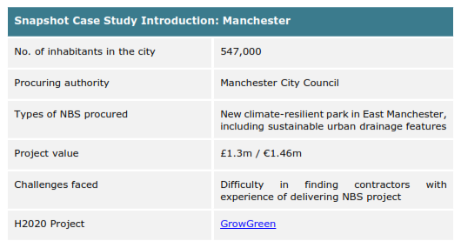
Case Study- Manchester- Public Procurement of NBS
Mačiulytė et al, 2020 . GrowGreen website.
Notes:
The City of Manchester, in the North of England, is regularly affected by heavy rainfall and severe flooding.
Find long-lasting solutions to this problem in the context of climate change was imperative.(Mačiulytė et al, 2020).

Slide 14
Case Study- Manchester- Public Procurement of NBS
Under GrowGreen initiative and guidance it developed a large scale NBS project aiming to address flooding issues
Officers to procure, a new community park including extensive Sustainable Urban Drainage Systems (SuDS) features.
Focus was given to biodiversity-friendly planting, and the community was widely involved in the design process
Mačiulytė et al, 2020 . GrowGreen website.

Slide 15
Case Study - Manchester- Public Procurement of NBS
Procurement was undertaken separately for design and construction activities.
Using an existing framework agreement to procure the design works
City saved time, resources and leveraged existing suppliers relationships
No tenders received due lack of expertise in the storm-water management aspects, lack of availability of staff, security concerns on the site
Mačiulytė et al, 2020 . GrowGreen website.
Notes:
Procuring a building contractor, however, proved to be more challenging. A call for tenders was launched through the North West Construction Hub which is the preferred framework for construction works in the Manchester City Region. Finding suitable and skilled suppliers able to deliver the project was therefore a key challenge for the City.

Slide 16
Case Study Manchester- NBS Procurement
Issue was eventually overcome through local inter-city cooperation
Neighbouring Salford City Council had access to a good pool of landscaping contractors
Utilised an existing procurement frameworks Manchester City was able to post the call for its NBS project tender
Manchester was able to secure a suitable contractor and works were installed.
Mačiulytė et al, 2020 . GrowGreen website.
Notes:
Manchester engaged with its neighbouring municipality - Salford City Council - to discuss their difficulty in identifying suitable suppliers.
Salford allowed Manchester to post it call for tender using their framework agreement, which proved successful as Manchester was able to secure a suitable contractor.

Slide 17
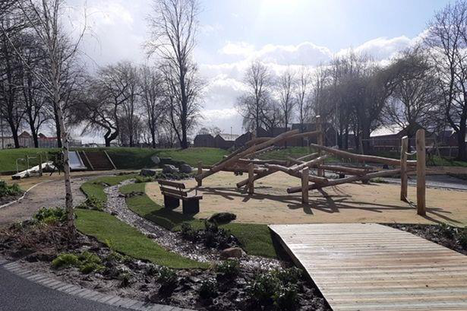
Case Study Manchester- Public Procurement of NBS
New community park including SUDS in West Gorton, Manchester. Photo © Manchester City Council
Notes:
The works were completed in June 2020. More information on the project is available on the GrowGreen website.

Slide 18
Reflect on challenges/actions for Public Procurers
Adopt challenge-based thinking in calls for tender
Consider grouping NBS contracts together
Join an NBS network
Promote cross-departmental exchange
Use pilot projects to build trust in the community
Encourage suppliers to think creatively about community engagement
Mačiulytė et al, 2020 . GrowGreen website.
Notes:
Questions to reflect on from the previous case study. How did the local authority approach the project to encourage deployment of NBS? What was the main issues in developing this project? How did the local authority tackle this issue? What are the lessons learned?

Slide 19
Reflect on Mechanisms to deliver NBS through Public Procurement
Promoting Public Procurement of NBS
Set sustainability targets for suppliers
Include environmental criteria in tenders
Assist suppliers to develop NBS products or services
Encourage collaboration to deliver integrated solutions
Allocate budgets for NBS projects
Adapted from: T. Burola, 2023
Notes:
Public procurement is useful as mechanism to promote NBS that provide multiple benefits for both society and the environment.
This process is an important lever for promoting NBS as influences market demand for products and services that support these solutions.
Requiring suppliers to deliver environmental benefits as part of their contracts, governments can create new markets for NBS providers and encourage innovation of natural solutions and key performance indicators.
PP can use pilot projects to build trust in the community and encourage suppliers to be creative about community engagement.

Slide 20
Public Procurement of NBS - Other examples
Other case studies and information available at:
https://growgreenproject.eu/about/
https://connectingnature.eu/
https://unalab.eu/en
https://clevercities.eu/
https://networknature.eu/networknature/nature-based-solutions
https://nbseduworld.eu/networks

Slide 21
Credit for this learning unit content: PPMI
Notes:
Source materials from Unalab:
European Commission, Directorate-General for Research and Innovation, Mačiulytė, E., Durieux, E., Public procurement of nature-based solutions: addressing barriers to the procurement of urban NBS: case studies and recommendations, Publications Office (2020) Available at: https://data.europa.eu/doi/10.2777/561021

