Slide 1
PITCHING FOR NATURE-BASED ENTERPRISES
Lecture – online / in-person
Credit: Horizon Nua
Content created in 2024

Slide 2
Learning Outcomes for this Learning Unit
Understand the art of pitching your nature-based enterprise for prospective investment.
Develop the content of a pitch for consideration by investors.
Apply the learnings to generate a deck for use in future opportunities to pitch for investment.

Slide 3
What is a Pitch?
Empathetic communication
with intent and
obsessive respect for time

Slide 4
Pitch Types
Business | Job Interview | Dating! | Car purchase

Slide 5
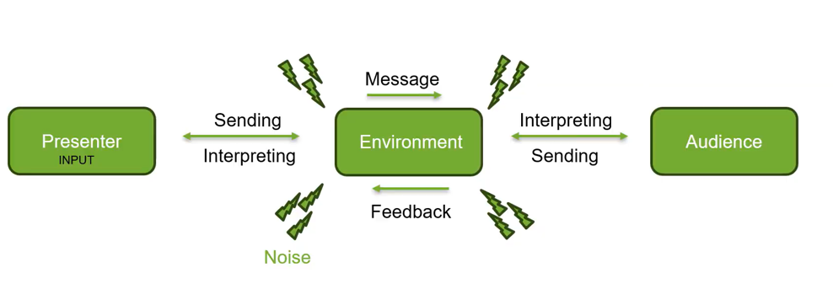
Pitch Theory

Slide 6
“It’s not what you say, it’s what people hear”
Frank Luntz, American political and communications consultant and pollster

Slide 7
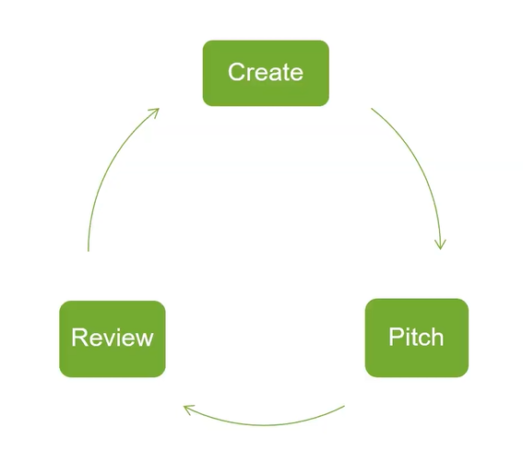
Feedback Loop
Self-Reflection
Peer 2 Peer Feedback
Customer Reaction
Iterative process to build a strong pitch

Slide 8
Finally….Context is key
Different pitches for different scenarios
Investors
Customers
Collaborators

Slide 9
Pitch Content
Be Clear
Be Real
Respect

Slide 10
Pitch Content
7 essential elements for a successful business pitch

Slide 11
No 1
What’s the problem
you solve?

Slide 12
No 2
Who benefits?

Slide 13
No 3
What is the product or service?

Slide 14
No 4
Who is the competition?

Slide 15
No 5
How are you going to make money?

Slide 16
No 6
What’s the ask?
What do you need?

Slide 17
No 7
How will you create value?

Slide 18
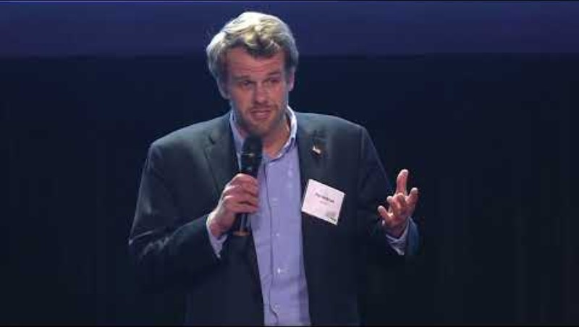
Pair and Share / Group activity:
What did you think of this pitch in terms of style, content and delivery?
Were you clear as to the problem? Was the presenter convincing? Discuss.
ACTIVITY
Source: Youtube, Harvard Business School

Slide 19
Fail to Prepare, Prepare to Fail.
Can you sell yourself as the best person to bring your idea to fruition or to develop your business/product/service? Do you have a strong team?
Anticipate questions and have answers prepared in advance.
Feasibility and viability of your business (organisational, technical, financial)
Extent of novelty, innovativeness and value impact
Logistics (supply, sourcing of raw materials, etc.)
Specific sector (prospects, emerging trends, barriers)
Notes:
Think about who your audience is and what they need to hear to be convinced of the value of your business, product or service. If you’re pitching before a venture capitalist or business angel they not only want to determine the quality of the idea, and weed out any bad ideas, but also grasp a strong sense of who you are.
Can you sell yourself as the best person to bring your idea to fruition or to develop your business/product/service? They are not just investing in the idea, they are investing in you, the entrepreneur. They will want to know that you are someone credible and legitimate, that you are motivated and passionate and will make smart use of the resources that may be afforded to you as a result of investment.
A good indicator of your passion, your work ethic and belief in your own business idea is to highlight your own personal investment (be it personal savings, free labour and time) that you’ve already poured into your business endeavour. Also don’t be afraid to mention your team members - a strong team can more than make up for any shortfalls in your own knowledge, skillset or expertise to deliver your value proposition.
In any business pitching scenario, you can expect to receive a line of questioning together with feedback. There will always be curveball questions but that shouldn’t stop you from anticipating the more commonly asked questions and having some answers prepared in advance.
Feasibility and viability of your business (organisational, technical, financial)
Extent of novelty, innovativeness and value impact (for instance as a nature based enterprise we want to be able to show triple bottom line of economic, social and environmental value)
Logistics (supply, sourcing of raw materials, etc.)
Specific sector (prospects, emerging trends, barriers - regulatory/legal that could inhibit growth)

Slide 20
Building a Pitch Deck
Plan out the framework
Adopt a single theme, font and colour palette
Keep it clear and simple
Have a clear call to action

Slide 21
Framework
Capture the interest
Present the Value Proposition
Pricing Model
What’s the Ask?

Slide 22
Tips and Tricks

Slide 23
Tips and Tricks
The Psychology of Colours

Slide 24
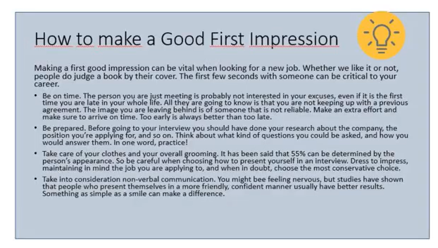
Tips and Tricks
Clear and simple

Slide 25
Tips and Tricks
3 minutes = 390 words
390 words = 27 sentences
Pause for impact
Practice

Slide 26
Resources
You Tube: The Art of Pitching
The Art of the Pitch, Persuasion and Presentation Skills that Win Business; Peter Coughter (2012)
The Pitch Canvas – Entrepreneurial Tool; Best3minutes.com

Slide 27
Individual Activity:
Please prepare a 3 minute pitch to present your idea, product or service.
Pitch it and have the audience provide feedback based on the NBE Pitching Workshop Scorecard.
ACTIVITY

Slide 28
NbE Pitching Workshop Scorecard
Element | Comments / Observations
Was the problem clearly identified? And those impacted by the problem?
Was the solution and competitors clearly explained?
Pricing or Impact ? Value capture?
Was there a clear ask?
Delivery Visuals Timing

Slide 29
Final Reflection: Pitching for Nature-Based Enterprises
Reflect on your learning:
What is your key takeaway from this lesson?
What new information will you share with others?

Slide 30
Credit for this learning unit content: Horizon Nua

