Slide 1
MEASURING IMPACT FOR NATURE-BASED ENTERPRISES PART II: IMPACT MEASUREMENT SYSTEMS
Lecture – online / in-person
Credit: Horizon Nua
Content created in 2024

Slide 2
Learning Outcomes for this Learning Unit
Understand the landscape of impact measurement for nature and biodiversity from CSRD to TNFD.
Appraise the relevance of new reporting requirements for your business – both directly and indirectly.
Learn about guidance and support tools available and apply the knowledge learned to your own context.

Slide 3
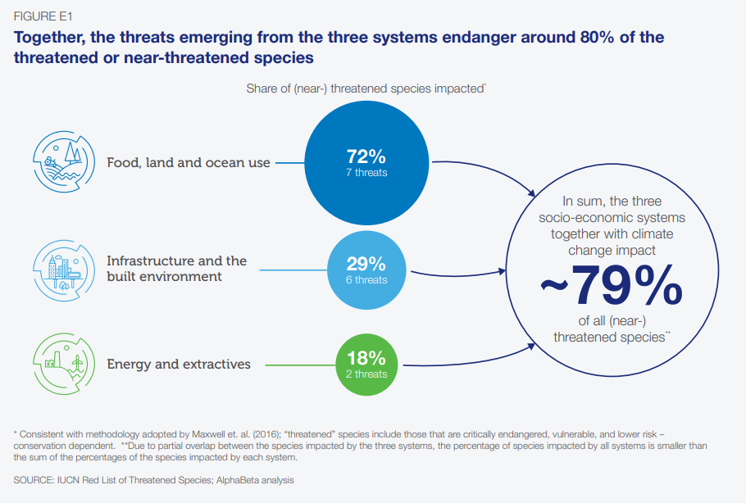
Humans are dependent on nature for survival. But human activity is destroying nature. 3 systems of human activity are endangering around 80% of threatened or near-threatened species. These systems represent over a third of the global economy and provide up to two-thirds of all jobs.
Economic Activity and Nature
Source: WEF (2020)

Slide 4
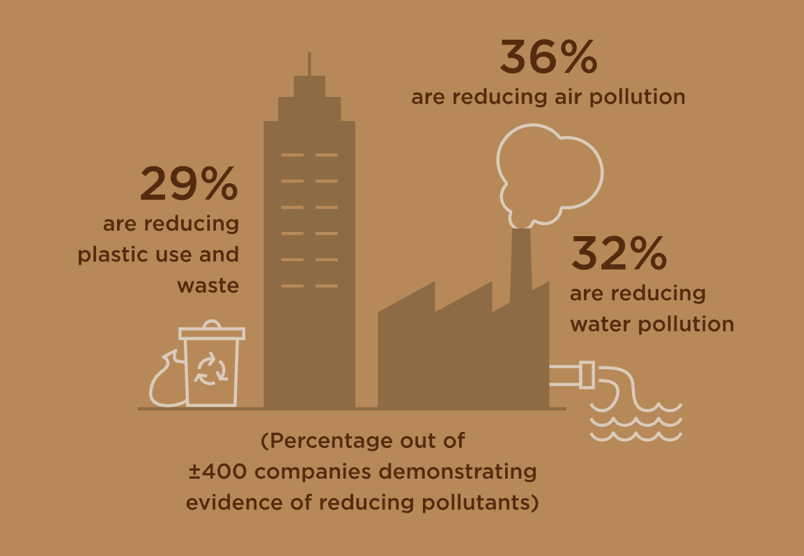
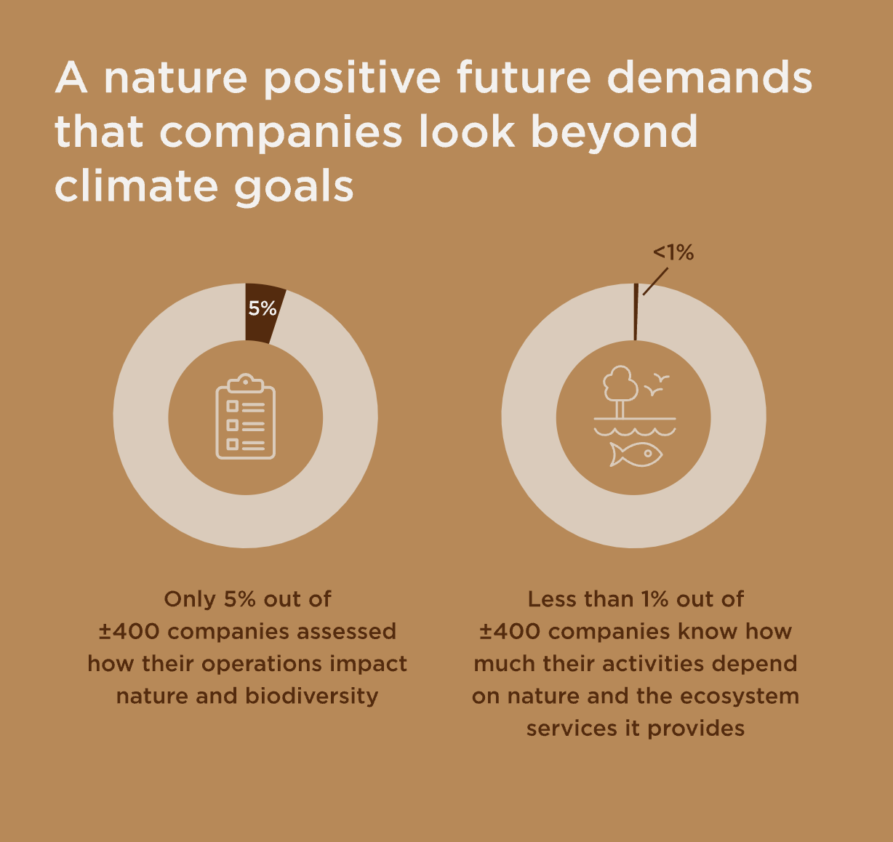
Business and Nature
Net Zero and Pollution are priorities for business
Nature and Biodiversity are not
50% have net zero targets
Source: WBA Nature Benchmark (2024)

Slide 5
Will new sustainability reporting requirements be a gamechanger for business?

Slide 6
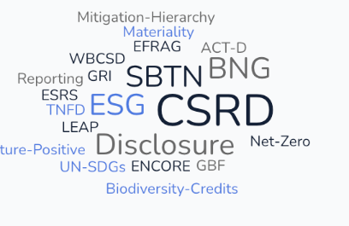
The Reporting Landscape
Increasingly businesses are being asked to report about their impacts on the environment.
This is often part of Environmental, Social and Governance (ESG) reporting.
In Europe, new CSRD regulation means it is mandatory for many companies to report on their impacts.
Double materiality means that they are to report not just on the material impacts for their own business but also on wider societal impacts.

Slide 7
Explainer: Corporate Sustainability Reporting Directive (CSRD)
What is it?
The CSRD, which came into force in 2024, requires all large companies and eventually all companies (except micro-enterprises) to report on social and environmental issues, including the impact of their activities on people and the environment.
The CSRD puts sustainability reporting on an equal footing with financial reporting.
What’s different about CSRD reporting v ESG reporting?
More companies are required to report – most companies with more than 500 employees.
The information reported has to be audited in the same way as financial reporting. This will help to reduce green-washing, a common critique of ESG reporting.
Companies have to report in the same way, using common standards (ESRS). This will allow for better benchmarking of company performance and industry performance.
What does this mean for NBEs?
Most small companies (including most NBEs) will not be required to complete CSRD reporting. Only listed SMEs have to report.
However NBEs may be impacted indirectly e.g. NBEs supplying NBS services to large companies may be asked to comply with large corporate reporting requirements
In December 2024, EFRAG published voluntary ‘CSRD’ reporting standards for non-listed SMEs. These are optional for all SMEs including micro-SMEs (< 10 employees).
EU Finance Podcast (20 minutes)
Episode 13 - The one about sustainability reporting
Discussion point:
How do you think CSRD will impact your business?

Slide 8
A quick look at the new Voluntary Standard for SMEs
Basic Module
Environment
Metrics
GHGs & Energy e.g.
Pollution of air, water and soil (compliance with national legislation)
Biodiversity (closeness to sensitive areas) & Land use (a) total use of land (in hectares); (b) total sealed area; (c) total nature-oriented area on-site; and (d) total nature-oriented area off-site
Water withdrawal & consumption
Resource use, circular economy and waste management
Social
Metrics
Workforce – general, health & safety, remuneration & training
Governance metrics
Comprehensive Module
Basic Module + Strategy (Business model & Sustainability), Policies & Practices, more detailed environmental & social metrics including human rights

Slide 9
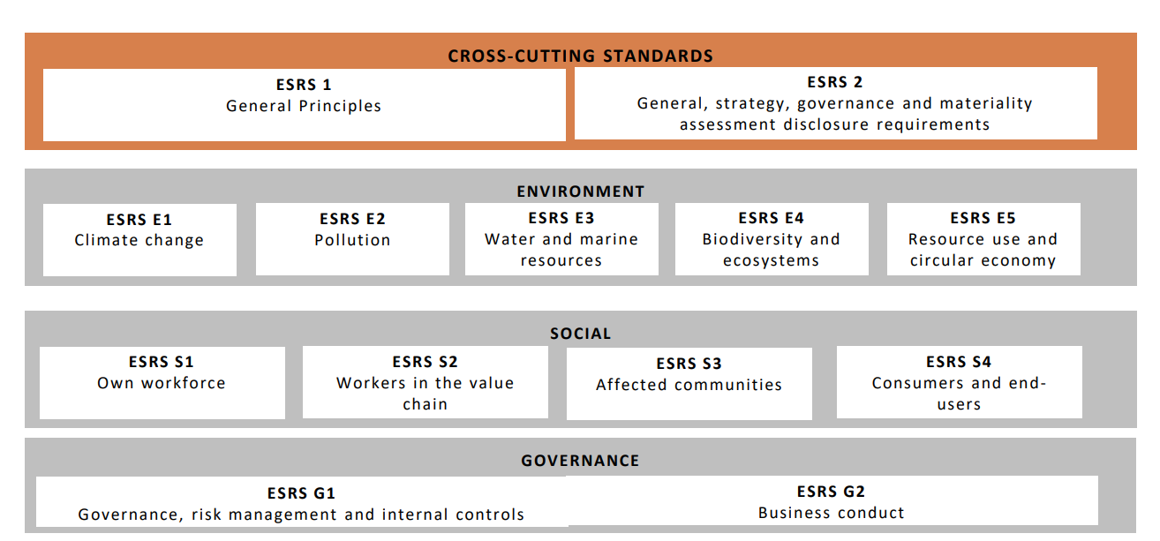
Other relevant ESRS standards for NbEs?

Slide 10
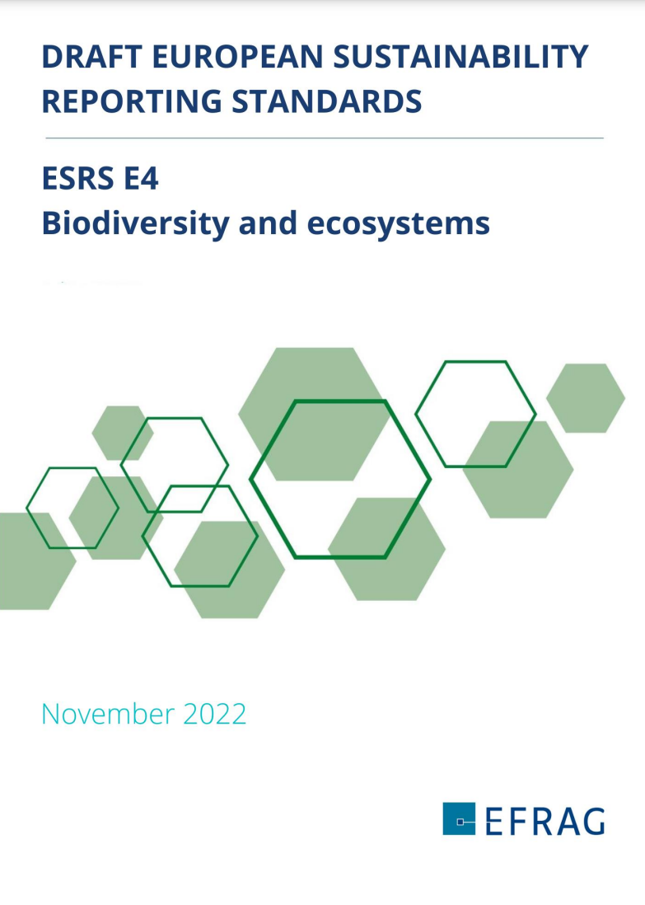
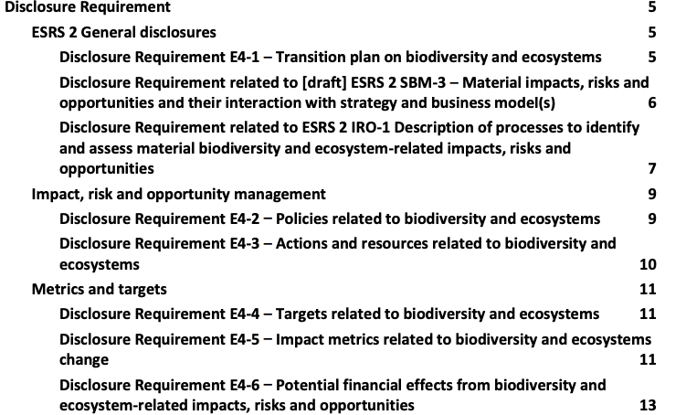

Slide 11
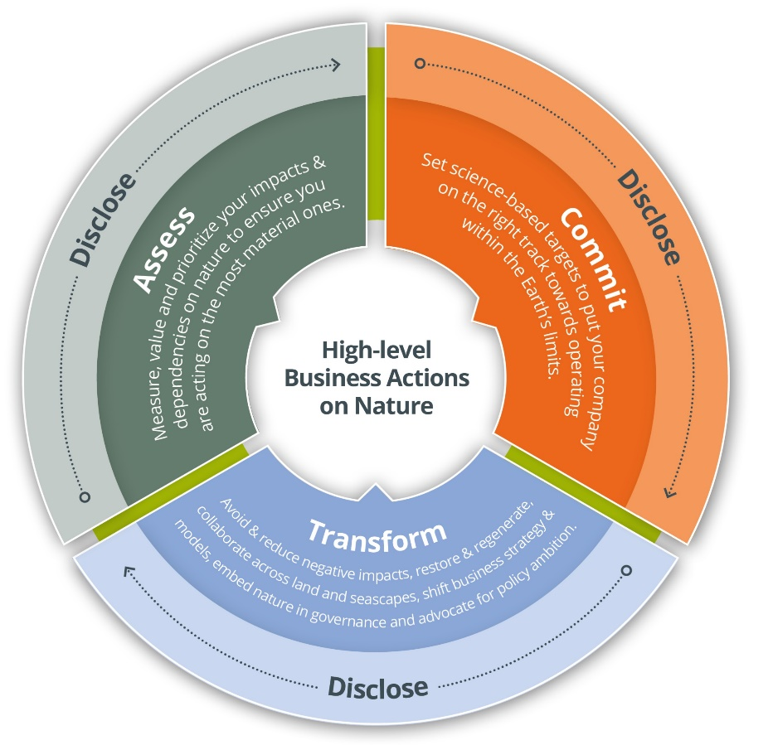
Locate your interface with nature;
Evaluate your dependencies and impacts on nature;
Assess your nature-related risks and opportunities;
Prepare to respond to, and report on, material nature-related issues
The
LEAP
Approach
Supported by and aligned with:
Useful guidance & tools
for businesses who need,
or choose, to report on nature
ACT-D
Many others…

Slide 12
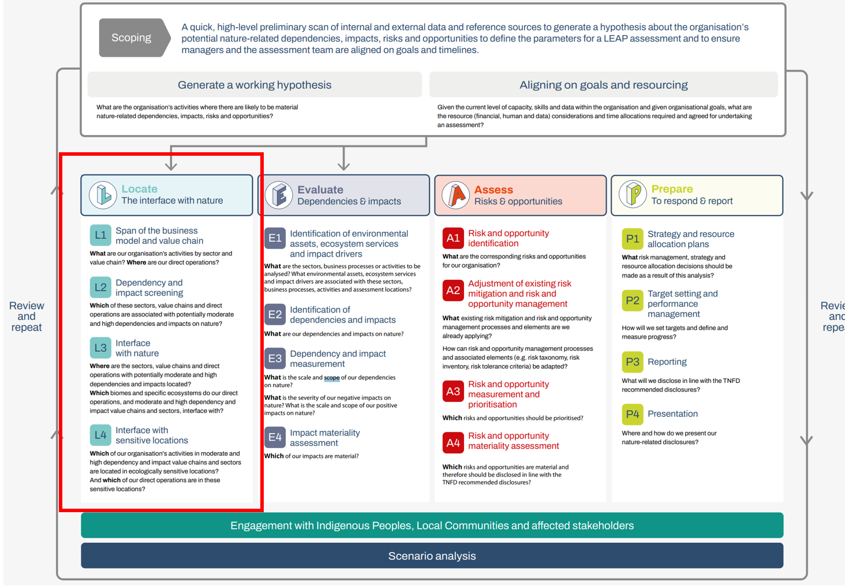
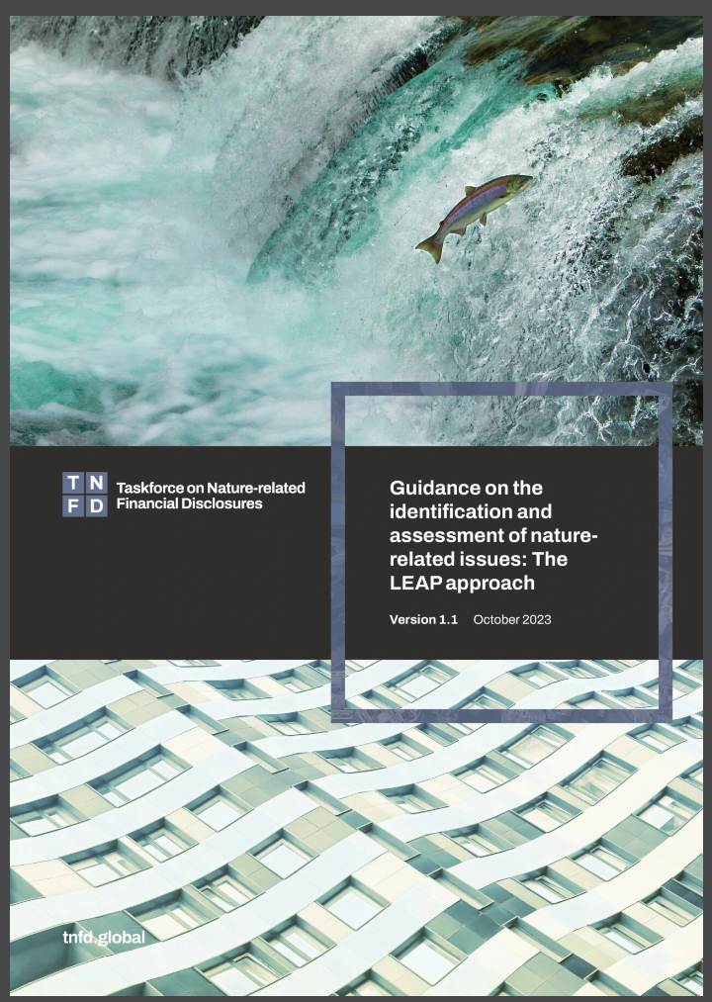
Source: TNFD https://tnfd.global/publication/additional-guidance-on-assessment-of-nature-related-issues-the-leap-approach

Slide 13
BUSINESSES CAN USE ACT-D (HIGH-LEVEL ACTIONS ON NATURE)
To coordinate business efforts and to have a consistent approach to accelerate nature action, leading organizations developed the high-level business actions on nature, known as the ACT-D
ASSESS: Measure, value and prioritize your impacts and dependencies to ensure you are acting on the most material ones.
COMMIT: Set transparent, time-bound, specific, science-based targets to put your company on the right track towards operating within the Earth’s limits
TRANSFORM: Contribute to systems transformation by avoiding and reducing negative impacts, restoring, and regenerating, collaborating across land, seascapes and river basins, shifting business strategy and models, advocating for policy ambition and embedding your strategy within your corporate governance
DISCLOSE: Publicly report material nature-related information throughout your journey
Available at: www.businessfornature.org/high-level-business-actions-on-nature
Supported by and aligned with:
and more…
Notes:
To coordinate business efforts and to have a consistent approach to accelerate nature action, leading organizations developed the high-level business actions on nature, also known as ACT-D
The first action is to assess: Measure, value and prioritize your impacts and dependencies to ensure you are acting on the most material ones. Companies might use the guidance of the TNFD to understand how to conduct this assessment.
Businesses also need to commit by setting transparent, time-bound, specific, science-based targets to put their company on the right track towards operating within the Earth’s limits. The science-based targets network has developed guidance to support companies in setting targets on nature.
But action on nature is not just about measuring and setting targets, ultimately, companies need to transform – they need to contribute to systems transformation by avoiding and reducing negative impacts, restoring, and regenerating, collaboration across land, seascapes and river basins, shifting business strategy and models, advocating for policy ambition and embedding your strategy within your corporate governance.
And finally, disclose. Companies need to publicly report material nature-related information throughout their journey.

Slide 14
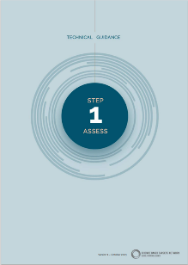
ASSESS
Resources include:
Measure, value and prioritize your impacts and dependencies to ensure you are acting on the most material ones.
#1 Conduct an initial materiality assessment to prioritize efforts
#2 Measure and evaluate impacts and dependencies on nature
#3 Assess risks and opportunities
#4 Consider climate and people within your nature assessment
LEAP Approach (TNFD)
Technical Guidance – Assess (SBTN)
Natural Capital Protocol (Capitals Coalition)
Source: Nature Strategy Handbook It’s Now for Nature https://nowfornature.org/
Notes:
Let’s dive in now on every steps of the High-level Business Action on Nature, starting by Assess.
We will first look at the theory behind it, and then at an example from the business world.

Slide 15
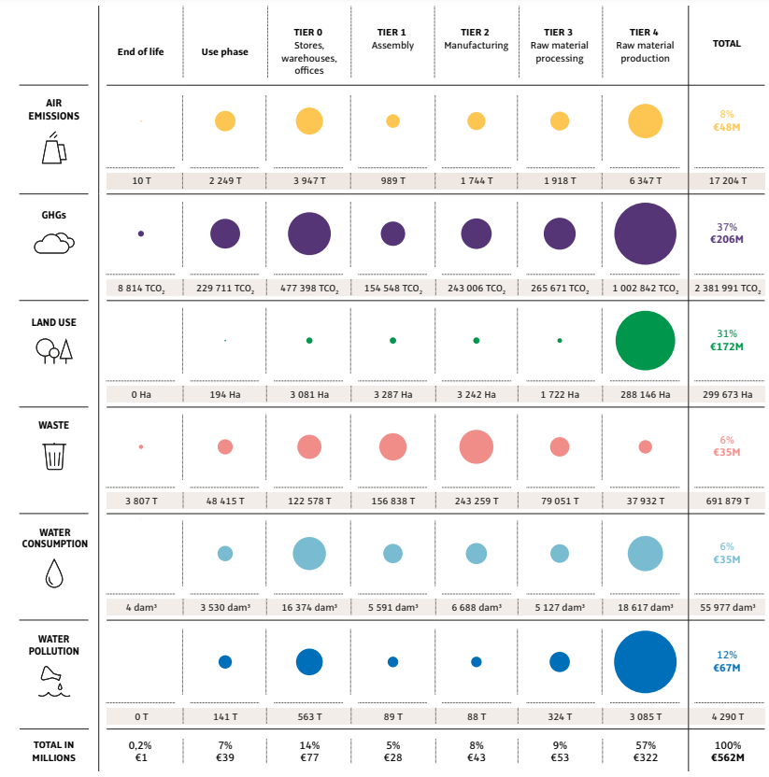
Assess | Commit | Transform | Disclose
ASSESS: IN PRACTICE
Materiality Assessment Example: Kering
Using this table, Kering clearly show what they've assessed to be their largest environmental impacts.
Tier 4, the raw material production phase, is where their greatest environmental impacts occur.
Resources: refer to Business for Nature ACT-D for more information (SBTN, TNFD’s LEAP process, ENCORE and more)

Slide 16
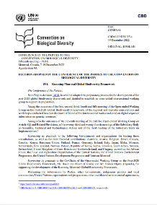
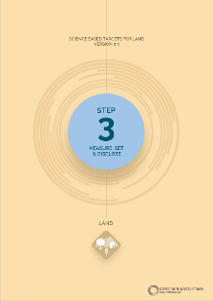
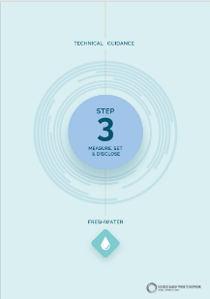
COMMIT
Resources include:
Set transparent, time-bound, specific, science-based targets to put your company on the right track towards operating within the Earth’s limits
#5 Define your goals and ambition
#6 Set targets
Kunming-Montreal Global Biodiversity Framework
Technical Guidance – Measure, Set, Disclose (SBTN)
Source: Nature Strategy Handbook It’s Now for Nature https://nowfornature.org/

Slide 17
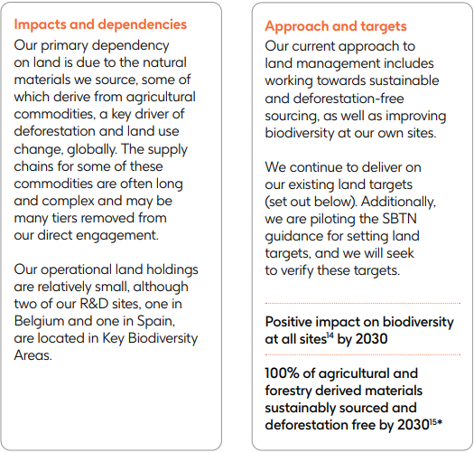
COMMIT: IN PRACTICE
Assess | Commit | Transform | Disclose
SMART Targets example: GSK
GSK have set a global plan for contributing to a nature positive world.
Their targets are broken down by their four focus areas:
Freshwater
Land
Oceans
Atmosphere
Their land targets correlate to their primary impacts and dependencies and one of them is linked with the remuneration of their senior leaders.
Resources: align goals with The Biodiversity Plan, leverage SBTN’s technical guidance and the Science Based Targets initiative (SBTi)

Slide 18
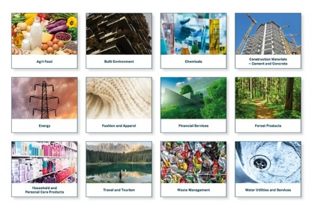
TRANSFORM
Resources include:
Contribute to systems transformation by avoiding and reducing negative impacts, restoring, and regenerating, collaboration across land, seascapes and river basins, shifting business strategy and models, advocating for policy ambition and embedding your strategy within your corporate governance
Sector Actions (WEF, WBCSD, BfN)
#7 Avoid & Reduce
#8 Restore & Regenerate
#9 Shift Business Strategy and Models
#10 Collaborate with your value chain
#11 Advocate for ambitious policies and initiatives
#12 Embed nature within corporate governance
Stakeholder Engagement Guidance (SBTN)
Responsible Policy Engagement Guide (BfN)
Source: Nature Strategy Handbook It’s Now for Nature https://nowfornature.org/

Slide 19
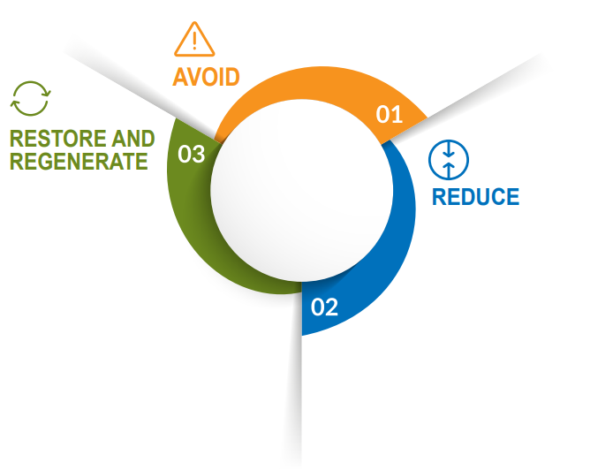
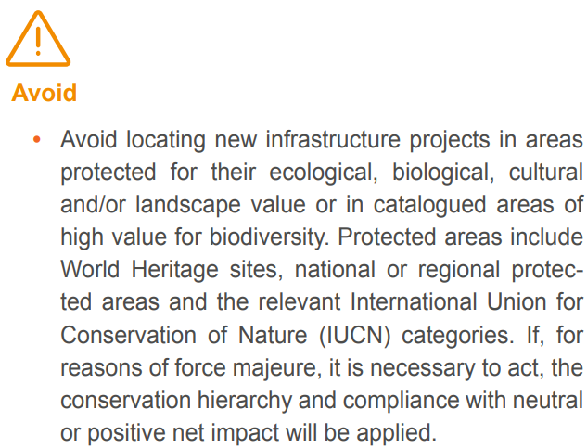
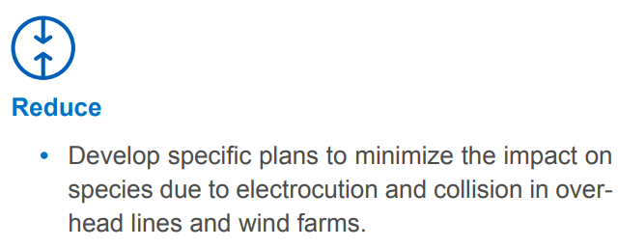
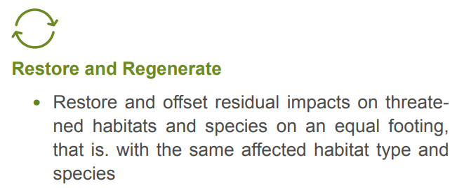
TRANSFORM: IN PRACTICE
Assess | Commit | Transform | Disclose
Mitigation hierarchy application example: Iberdrola (renewable energy)
Iberdrola have applied the mitigation hierarchy in setting out their transformative actions.
This is alongside broader value chain and governance actions.
Resources: The Action Framework (AR3T hierarchy), NBS benefits explorer, IUCN Global Standard for Nature-based Solutions, WBCSD’s Roadmap to Nature Positive and Sector Actions developed by BfN, WEF and WBCSD

Slide 20
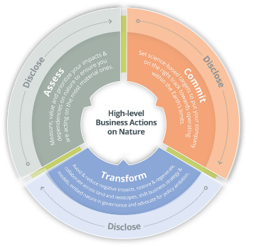
ADVOCATE FOR AMBITIOUS POLICIES
Nature-positive policies are key to accelerating business action. Businesses have a key role to support governments and advocate for ambitious policies, legislation and regulation.
Why and how to advocate for nature?
Five actions outlined in the Responsible Policy Engagement guide
Commit to support ambitious policy
1
Align trade associations
2
Allocate advocacy spending
3
Speak out publicly
4
Disclose advocacy activity
5
Source: https://www.businessfornature.org/
Notes:
Another key element of Transform is to advocate for ambitious policies and initiatives.
We must continue to give courage and comfort to policymakers that leading businesses fully support ambitious policies and regulations for nature and reiterate the critical role business and finance plays in GBF 2030 targets and 2050 goals.
This can convince governments to implement well-designed policies and mandatory requirements, that in turn can accelerate action and enable companies to deliver on their own nature strategies, creating a positive feedback loop between businesses and policymakers
Business for Nature has prepared a guide for Responsible Policy Engagement which outlines why and how to advocate for nature, using five key steps (Commit to support ambitious policy, Align trade associations, Allocate advocacy spending, Speak out publicly and Disclose advocacy activity).
Businesses can refer to Business for Nature’s policy recommendations (TO BE RELEASED IN MAY) to explore what policies they can ask governments to adopt, and there are a variety of opportunities to speak publicly too, either through the Business for Nature coalition or by joining other initiaties such as the Business Coalition for a Global Plastics Treaty.

Slide 21
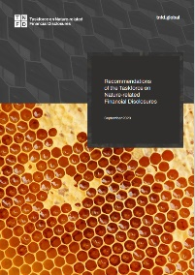
DISCLOSE
Assess | Commit | Transform | Disclose
Resources include:
Publicly report material nature-related information throughout your journey
#13 Seek out independent validation and verification to enhance credibility of actions
#14 Align reporting with major reporting standards
Recommendations of the TNFD
Reporting and disclosure guidance (CDP)
Source: Nature Strategy Handbook It’s Now for Nature https://nowfornature.org/

Slide 22
Presenting ‘Materiality’ is of critical importance

Slide 23
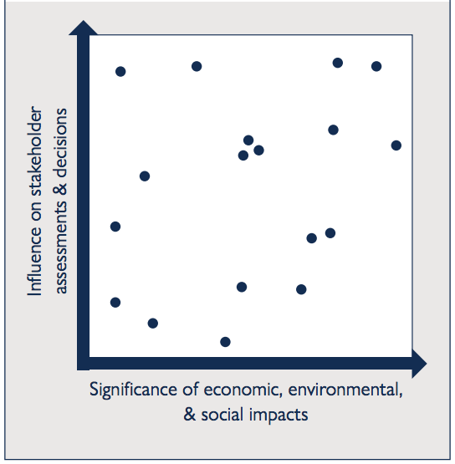
Materiality Matrix: GRI Updated Guidance
Think about visual representation of information e.g. in a Materiality Matrix showing double materiality:
Internally: impact of nature and biodiversity on the company e.g. financial materiality
Externally: impact of the company on nature and biodiversity in the wider world e.g. stakeholder materiality

Slide 24
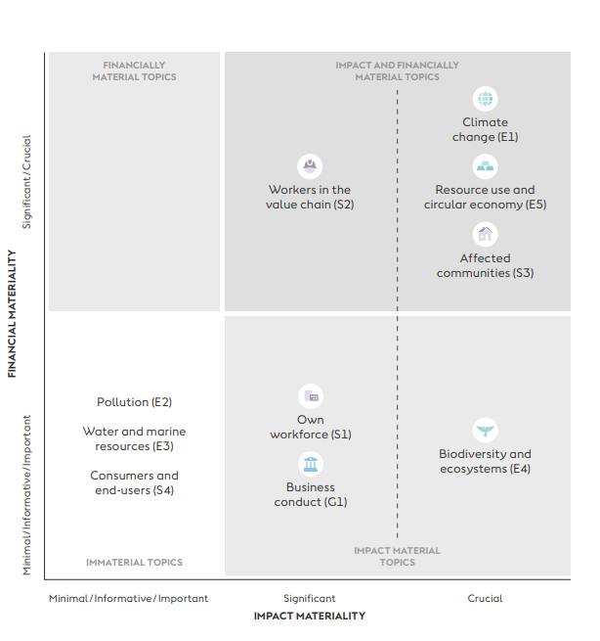
Example 1: Energy Utility
Renewable Energy

Slide 25
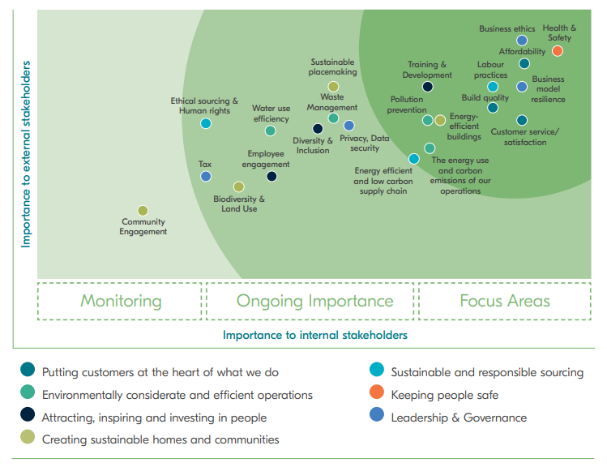
Example 2: Construction
Construction

Slide 26
Pair and Share / Group activity:
Prepare a Materiality Matrix for your business.
Consider the importance of nature and biodiversity impacts for:
Direct company stakeholders (employees, investors, partners)
Indirect stakeholders (wider community and society)
Direct
ACTIVITY
Indirect

Slide 27
Final Reflection: Measuring Impact for Nature-based Enterprises
Reflect on your learning:
What is your key takeaway from this lesson?
What new information will you share with others?

Slide 28
Sources of Further Reading
World Economic Forum (2020). New Nature Economy Report II: The Future of Nature and Business. Accessed from: https://www.weforum.org/publications/new-nature-economy-report-ii-the-future-of-nature-and-business/
World Benchmarking Alliance (2024). Nature Benchmark 2022-2024. Accessed from: https://www.worldbenchmarkingalliance.org/publication/nature/
EFRAG (2024). Voluntary Sustainability Reporting Standard for non-listed SMEs. Accessed from: https://www.efrag.org/sites/default/files/sites/webpublishing/SiteAssets/VSME%20Standard.pdf
TNFD (2024). Guidance on the identification and assessment of nature-related issues: the LEAP approach. Accessed from: https://tnfd.global/publication/additional-guidance-on-assessment-of-nature-related-issues-the-leap-approach/
Business for Nature (n.d.). High-level business actions on nature. Accessed from: https://www.businessfornature.org/high-level-business-actions-on-nature
Now for Nature (2023). Nature Strategy Handbook. Accessed from: https://nowfornature.org/read-the-handbook/

Slide 29
Credit for this learning unit content: Business for Biodiversity Ireland (Emer Ní Dhúill) and Horizon Nua (Siobhán McQuaid)

