Slide 1
MEASURING IMPACT FOR NATURE-BASED ENTERPRISES PART I: TERMINOLOGY AND STRATEGY
Lecture – online / in-person
Credit: Horizon Nua
Content created in 2024

Slide 2
Learning Outcomes for this Learning Unit
Understand the importance of measuring impact for NbEs, the challenges faced and the underlying terminology.
Explore the different steps of a framework for measuring impact, learn about different impact indicators related to different measurement objectives and stakeholder needs.
Analyse and apply the learning to develop an impact measurement strategy for your business.

Slide 3
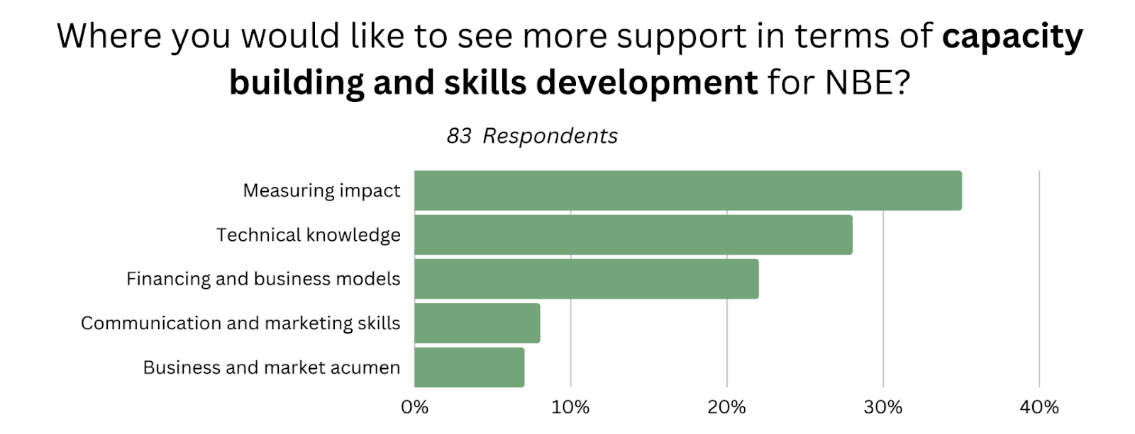
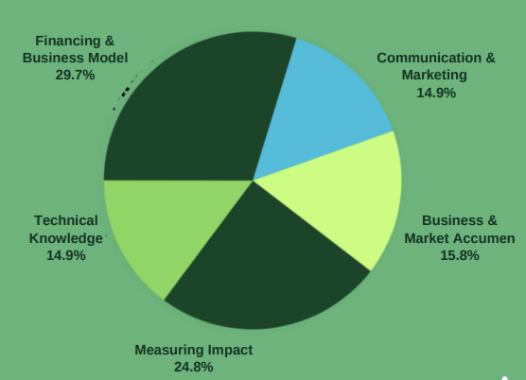
Measuring impact is a priority for NbEs
Source: Nature Futures Online Survey 2023
Source: I4N Survey 2024 (n=124)

Slide 4
Why is measuring impact so important for NbEs?
Measurement of impact may be required to secure financing e.g. subscription revenue related to impact
Clients may require impact information to make investment decisions e.g. verifiable outcomes
Credible impact measurement may be important for stakeholders and staff to show the achievement of company mission e.g. demonstrable impact from activities on nature and biodiversity such as increase in species, wetlands etc;
Reporting on impact is an increasing regulatory requirement e.g. new EC requirements on ESG reporting (CSRD)
Online Poll
How important is measuring impact for your business?
Scale 1-10 with 10 being highest
Why is measuring impact so important? Open response….
How would you rate your current mechanism for measuring impact?
Scale 1-10 with being Excellent
What are the challenges you face in measuring impact?
Open response…

Slide 5
NbE face specific challenges to measuring impact:
Difficult: Measuring nature and biodiversity can be time-consuming and expensive;
Confusing: Many different approaches to measuring impact – creates confusion for companies, clients and financing institutions;
Lack of knowledge: Lack of in-house skill-set and/or resources to deliver credible impact measurement.

Slide 6
Back to basics

Slide 7
What is impact?
“the action of one object coming forcibly into contact with another”
Oxford English Dictionary
‘a marked effect or influence’
Oxford English Dictionary

Slide 8
Measuring impact isn’t always easy…understanding key terms
Outputs - outcomes - impact
Monetary and non-monetary benefits
Measuring tangibles and intangibles
Considering trade-offs and unintended consequences

Slide 9
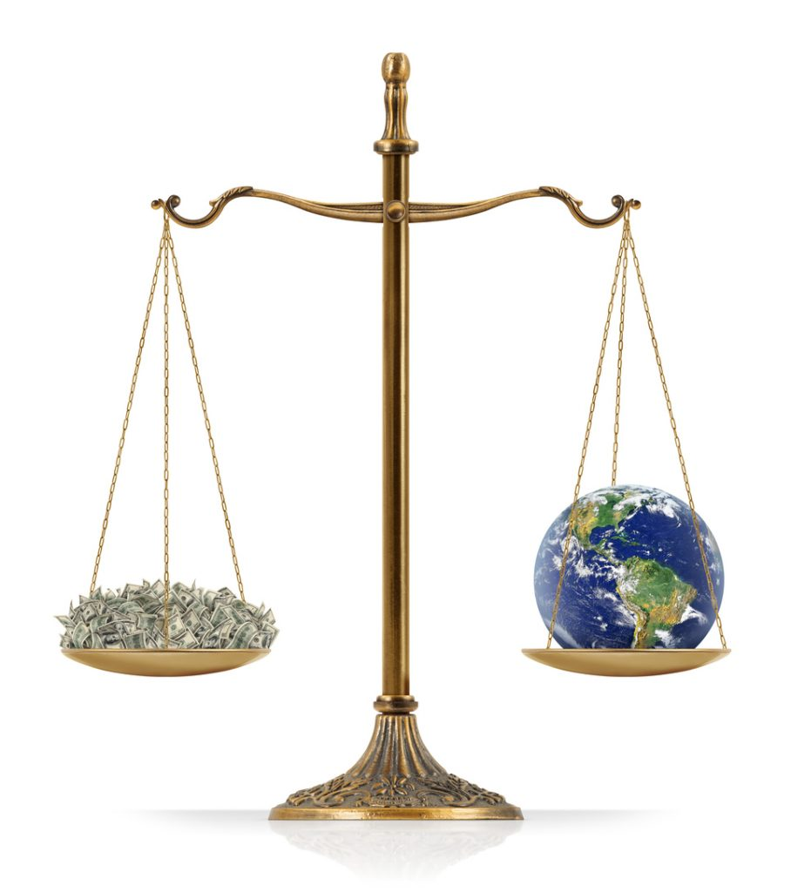
Impact Indicators (KPIs)
Monetary Indicators e.g. revenue generated
Pros: easy to understand, easy to compare
Cons: difficult to monetise some indicators
V
Non-monetary e.g. increase in biodiversity
Pros: more accurate and related to mission of most NbEs
Cons: lack of consistency, difficulty comparing ‘like with like’

Slide 10
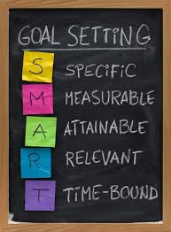
Impact Indicators (KPIs) should be SMART
Monetary Indicators pretty straightforward e.g. annual financial reporting.
Non-monetary Indicators more tricky.
E.g. environmental benefits for an airport:
Reduction in water usage per passenger from 26.3 to 15.3 in 2019 (SMART indicator)
20% Improvement in Air Quality indicators
40% Increase in biodiversity (species) in airport grounds

Slide 11
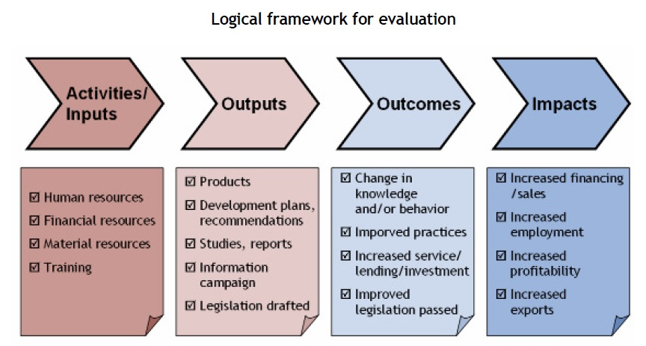
Common confusion between Outputs v Outcomes v Impact
Source:
https://ppd.cipe.org/tools/ppd-handbook/d-monitoring-and-evaluation-framework-for-ppd/d-6-evaluation-of-regulatory-and-economic-outcomes-and-impact-of-ppds/

Slide 12
Impact comes last!
Discussion point:
What is the key impact from your business?
Immediate output from activities
Problems solved
Change in knowledge / behaviour
The change that you want to see in the world
Source: Adapted from https://amaniinstitute.org/setting-social-impact-monitoring-evaluation-success/

Slide 13
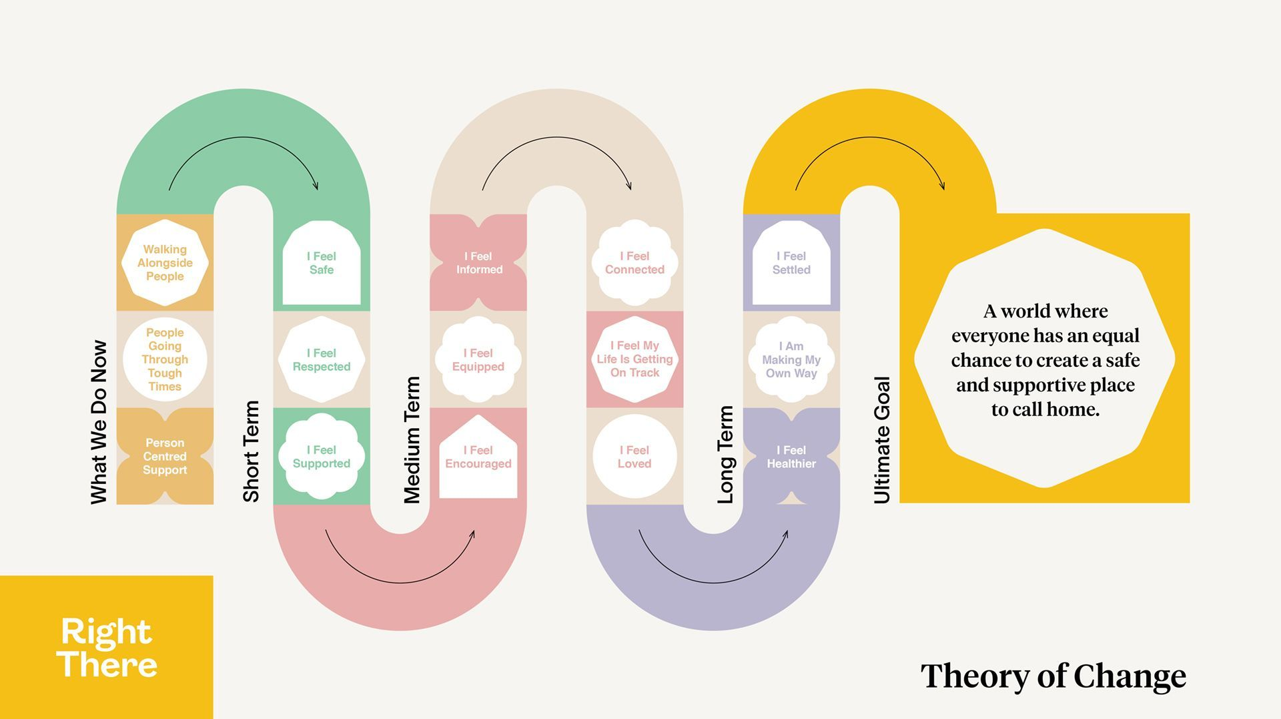
Useful tool: Theory of Change…start with the end goal and work back
Source: https://rightthere.org/about-our-theory-of-change/#

Slide 14
Theory of Change
Step 1 Clarify end goal
Unlike other approaches, with a Theory of Change we want to start at the vision we would like to see. We take the distant goal and we work from there to where we are currently. When setting this end goal, try and use numbers and targets where possible.
A good way to think about this end goal is to imagine what the newspaper headline might read like after you have reached that goal.
Step 2 Stakeholder Map
Be clear on who needs to be on the journey, who is affected by your organisation and who might have an interest in the organisation succeeding. Try and write them out and identify all parties.
Step 3 Backwards Map
As we are starting at the end and work to where we are now, you will start to map backwards all of the changes that need to happen. e.g. for this to happen, what needs to happen before that. This will look much like a critical path in reverse.
Source: https://socialenterprisetoolkit.ie/chapter-8-social-impact/

Slide 15
Theory of Change (cont.)
Step 4 Reflect on assumptions
Don’t take anything for granted! Make sure you are being realistic and open with your assumptions. Try and find evidence for your position rather than from your hopes or beliefs. Read widely and don’t be afraid to change if a better solution is found.
Step 5 Clarify actions
Now that you have started to identify the path that you should take, who is going to do what to make things happen. Put names and times and dates on your programme to begin to action the plan.
Step 6 Clarify outcome measures
Start to concisely phrase your theory of change. What are your inputs, processes, outputs, outcomes and impact as a result of your mapping? For example, by using the best staff with the resources you need, you can deliver a service, that service can help a specific number of people with a particular need and those people are changed as a result of your service.
Outcomes
Once you have thought about your outcomes, you can start to identify short, medium and long term outcomes. It would be helpful to use time periods as a way to easier identify the impact your organisation will have.
Source: https://socialenterprisetoolkit.ie/chapter-8-social-impact/

Slide 16
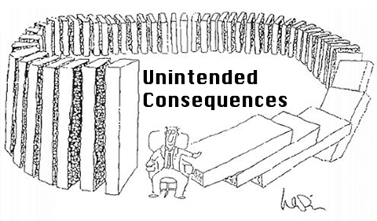
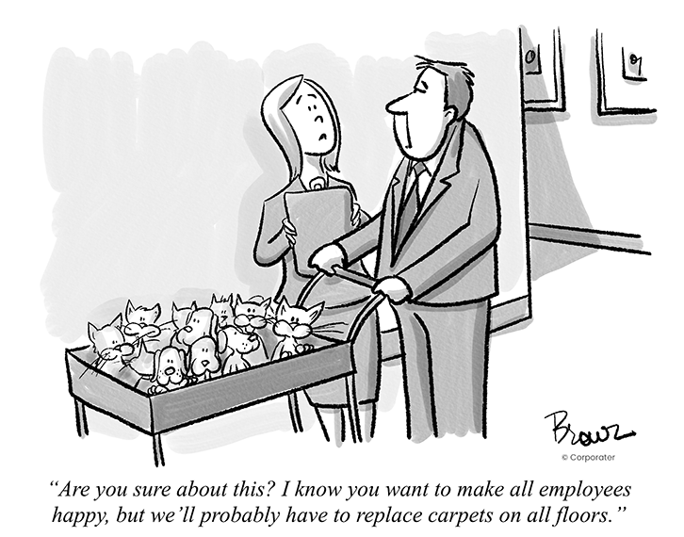
Consider - trade-offs and unintended consequences

Slide 17
Developing your own Impact Measurement Strategy

Slide 18
5 step framework for impact measurement
Set objectives: what is your rationale for measuring impact? In the short term and long term.
Analyse stakeholders: what impact information do different stakeholders need? Consider both internal and external stakeholders.
Measuring results: what are the best ways to measure the impact you want? Keep it simple!
Verifying and valuing impact: are you capturing meaningful impact information? Are you capturing real value? Double-check against your objectives. Update as relevant.
Monitoring and reporting: Put in place a timely and transparent process of feedback back to stakeholders. Consider regulatory requirements e.g. CSRD
1. Setting Objectives
5. Monitoring & Reporting
2. Analysing Stakeholders
4. Verifying & Measuring Impact
3. Measuring Results
Source: Adapted from Impact Europe (2024)

Slide 19
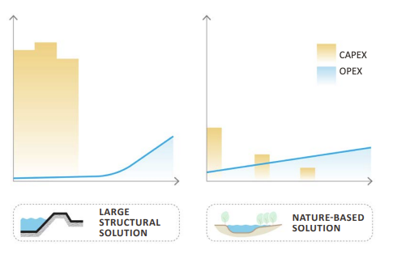
Objective for Measuring Impact
Example 1: Securing New Business
In Europe, more than 80% of NbS are funded by the public sector e.g. Sustainable Urban Drainage Systems, Nature Restoration etc
Stakeholder needs & measurement data required: In the public sector (and sometimes in the private sector), cost-benefit analysis (CBA) is a common tool used to make investment decisions. CBAs compare the capital expenditure (CAPEX) and operating expenses (OPEX) of different solutions with the potential benefits. E.g. investment in NbS v conventional ‘grey’ infrastructure solutions.
Nature-based enterprises delivering nature-based solutions need to be able to provide data on capital and operating expenses over time as well as data on impacts (benefits over time). Benefits may be social as well as environmental.
New EU reporting (CSRD) means most large companies now have to report on social and environmental impact. They may request NbEs to provide input into this reporting (see Impact Part II).
Source: Wishart et al. 2021, cited in https://openknowledge.worldbank.org/entities/publication/9ed5cb4b-78dc-42a4-b914-23d71cef24a2
‹#›

Slide 20
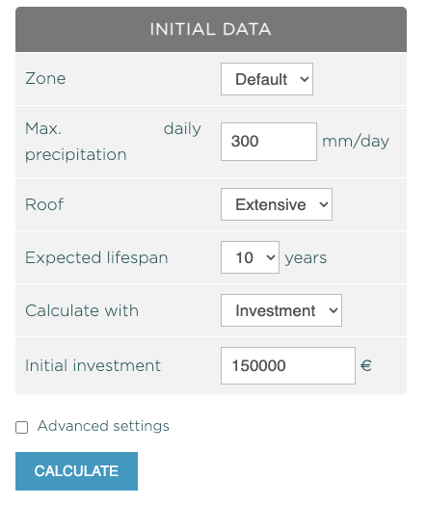
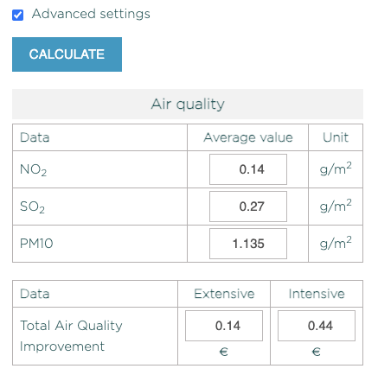
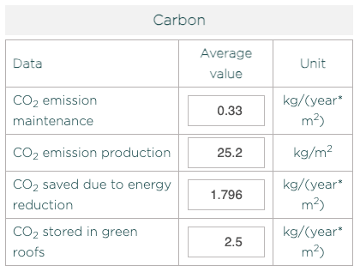
https://growgreenproject.eu/nbs-benefit-calculator/#:~:text=This%20prototype%20tool%20attempts%20to,quantified%20automatically%20by%20the%20calculator.
Can you capture this level of impact data for your business activities?
‹#›
‹#›

Slide 21
Objective for Measuring Impact
Example 2: Secure Financing
Stakeholder needs and measurement requirements: Investors in your business, including public sector funding agencies and/or grant awarding bodies, want to know what return on investment they will see.
Private sector investors, including impact investors, often want to see monetary return on investment (RoI). Non-monetary impact indicators may be of varying levels of importance.
In Europe, the EU Sustainable Finance Taxonomy may influence investment decisions in particular by financial institutions and banks.
Public sector investors, including grant awarding bodies, may be interested in monetary RoI but they may also be interested in Social Return on Investment (SRoI).
While most large companies in the EU have reporting requirements (CSRD).

Slide 22
EU Sustainable Finance Taxonomy Q&A
What is it? The EU Taxonomy helps to reduce green-washing by directing investments toward activities that are aligned with the EU goal for just transition to a net zero, nature positive economy by 2050.
How does it work? It is a classification system that defines criteria for economic activities that are aligned with EU sustainability goals. Protection and restoration of biodiversity and ecosystems is one of the six objectives of the Taxonomy. Conservation including restoration of habitats, ecosystems and species is an economic activity aligned with the Taxonomy. Investment in any other activity aligned with the Taxonomy, for example in circular economy, must show they Do No Significant Harm (DNSH) to Biodiversity and Ecosystems.
How is it operationalised in investment decisions?
Since 2023, large companies have to report on how their investments are aligned with the taxonomy. While investments meeting the Taxonomy criteria are still low (only 20% of investments were aligned in 2023), reporting shows an increase in taxonomy related investments each year. The highest investments are by utility companies.
Financial institutions are using the Taxonomy. In 2023, 90% of green bonds issued by EU public actors referenced the EU Taxonomy to illustrate their commitment of using the raised funds for green projects.
Banks are also using the EU Taxonomy in their lending strategies and to assess companies’ investment plans.
What does this mean for investment in Nature-Based Enterprises? Nature-based enterprises are well placed to secure investment from banks and financial institutions if they can show their activities and outcomes (impact) are aligned with the EU Taxonomy criteria.
Source: https://finance.ec.europa.eu/sustainable-finance/tools-and-standards/eu-taxonomy-sustainable-activities_en and https://invest4nature.eu/2023/04/13/how-eu-taxonomy-supports-investments-in-nature/

Slide 23
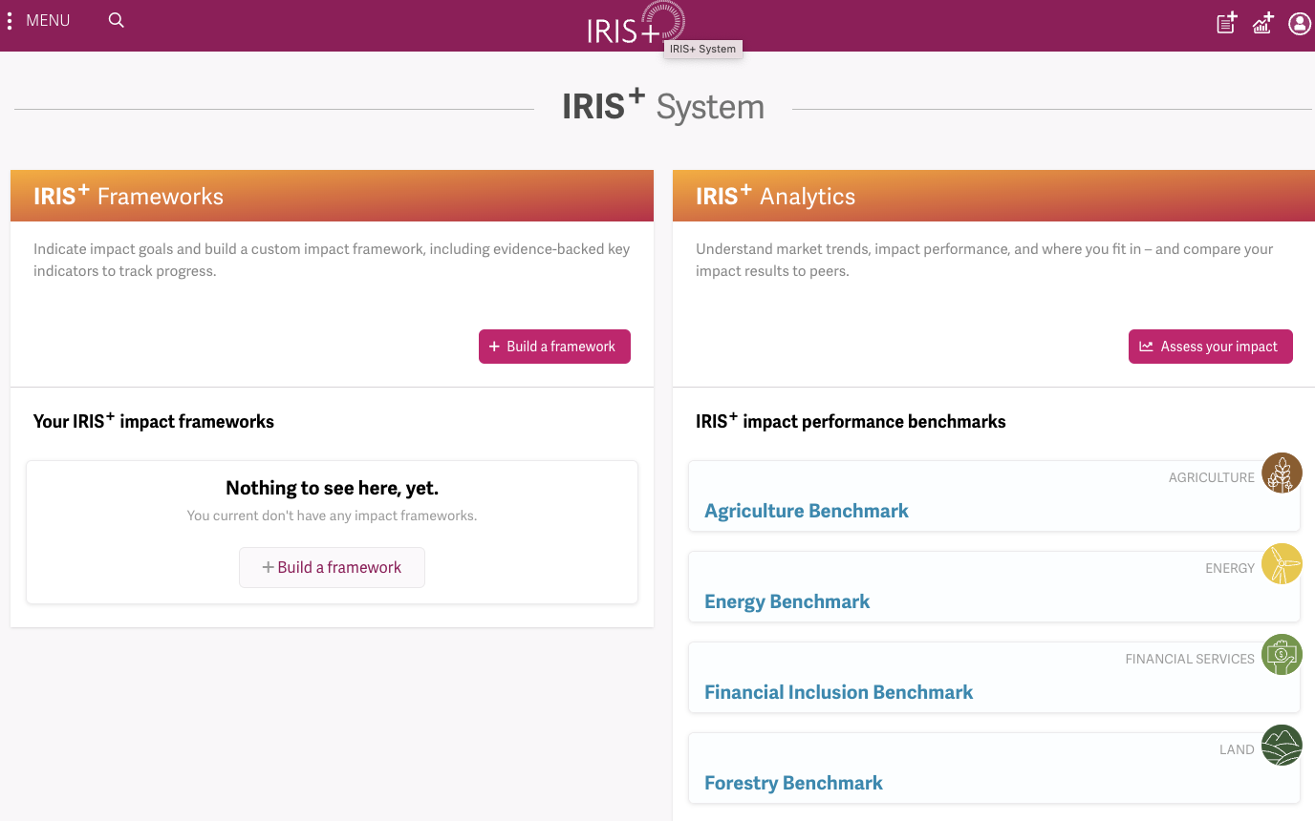
Useful tool: IRIS+
IRIS+ is a widely accepted impact accounting system that impact investors use to measure, manage, and optimize their impact. With over 40,000 registered users, half of all impact investors and the majority of fund managers, banks use IRIS metrics.
You can develop your own framework for impact assessment or look at the performance benchmarks investors use for your sector.
Source: https://iris.thegiin.org/plus/home/

Slide 24
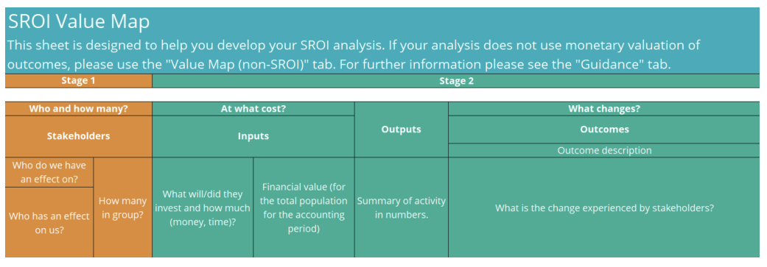
Useful tool: Social Return on Investment (SROI)
Social Return on Investment (SROI) is another commonly known framework “for measuring and accounting for (a) broader concept of value; it seeks to reduce inequality and environmental degradation and improve wellbeing by incorporating social, environmental and economic costs and benefits” Guide to SROI (2012) pp.8.
Multiple useful tools and guidelines are available on the Institute for Social Value website.
Source: https://socialvalueuk.org/resources/sroi-value-map/

Slide 25
Objective for measuring impact
Example 3: Measuring progress towards achieving Mission
Many NbEs are mission driven organisations. Achieving this mission is the raison d’etre of the organisation and therefore measuring progress or contribution towards the mission is an intrinsic, motivational requirement for owners, staff and partners.
Stakeholder needs and measurement requirements: If mission achievement is the primary rationale for measuring impact, then an organisation has more freedom to identify which elements of the mission are most important and what indicators should be used to measure progress. These may be similar to previous financial or social indicators or related to more environmental indicators such as Biodiversity Net Gain (BNG).
A Theory of Change is a useful tool for identifying how goals related to the organisational mission can be translated into impact indicators relating to outcomes and activities.

Slide 26
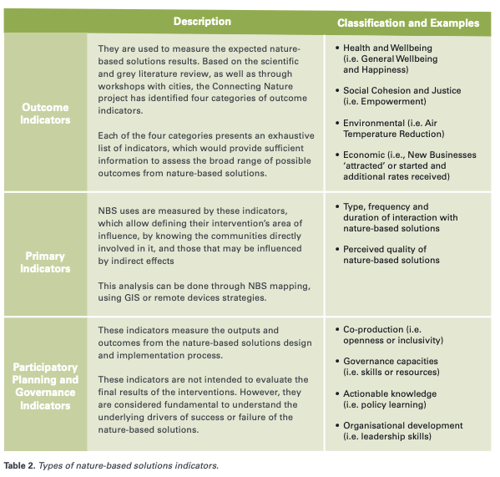
Broad range of NbS Indicators relating to economic, environmental, social and health objectives.
For an exhaustive overview of NBS indicators, see
European Commission: Directorate-General for Research and Innovation, Evaluating the impact of nature-based solutions – A handbook for practitioners, Publications Office of the European Union, 2021, https://data.europa.eu/doi/10.2777/244577
Source: Dumitru et al (2022) Impact Assessment Handbook, Connecting Nature, pp 9

Slide 27
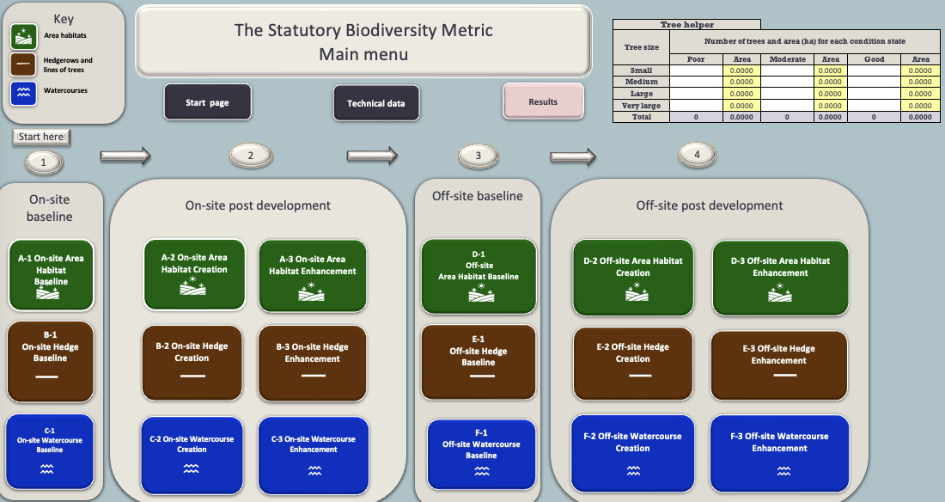
Tool: Biodiversity Net Gain (BNG)
Measuring Biodiversity Net Gain (BNG) is mandatory for new developments in the UK.
Developers must deliver a BNG of 10% more or better quality natural habitat than there was before development.
The UK Government provides many useful guidelines and tools for measuring BNG. These tools have provided inspiration and guidance for many other countries
Source https://www.gov.uk/government/collections/biodiversity-net-gain

Slide 28
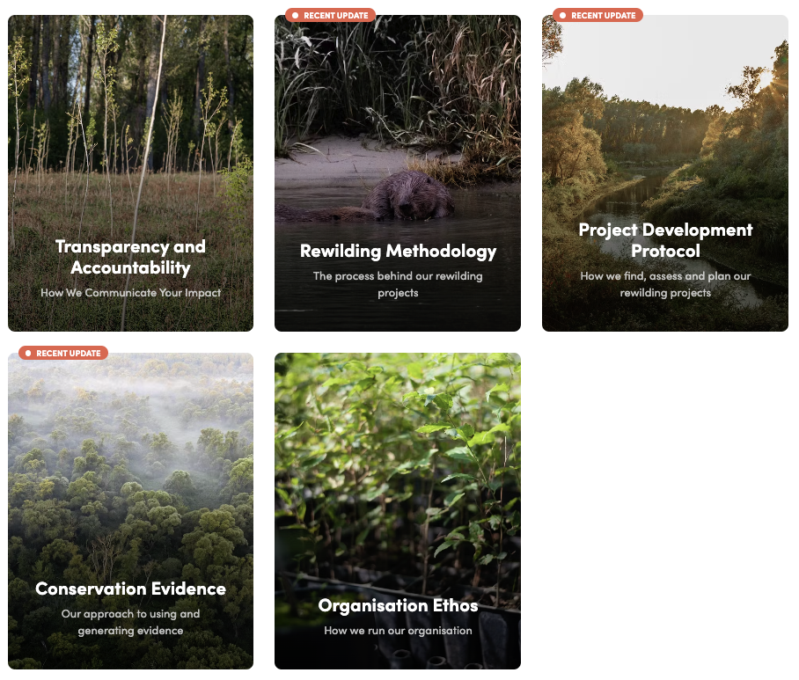
Case study:
Purpose
To restore wild ecosystems, support wildlife and biodiversity and help fight climate change.
Approach to impact
Impact on the ground is funded through paying members. In order to be as transparent as possible Mossy Earth openly publish their methodologies for measuring impact and their results on their website.
Source: https://www.mossy.earth/methodologies/trust-transparency

Slide 29
Summary: For impact measurement to be effective, it must be:
Relevant: related to, and arise from the outcomes it is measuring;
Helpful: in meeting the needs of stakeholders’, both internal and external;
Simple: both in how the measurement is made, and in how it is presented;
Natural: arising from the normal flow of activity to outcome;
Certain: both in how it is derived, and in how it is presented;
Understood and accepted: by all relevant stakeholders;
Transparent and well-explained: so that the method by which the measurement is made, and how that relates to the services and outcomes concerned are clear;
Founded on evidence: so that it can be tested, validated, and form the grounds for continuous improvement
Source: European Commission Social Impact Measurement (2014) pp 33

Slide 30
Pair and Share / Group activity:
Why are you measuring impact – what is your objective / driving rationale?
Who are the most important stakeholders?
What kind of measurement data do your stakeholders need?
1. Setting Objectives
5. Monitoring & Reporting
2. Analysing Stakeholders
ACTIVITY
4. Verifying & Measuring Impact
3. Measuring Results
Source: Adapted from Impact Europe (2024)

Slide 31
Final Reflection: Rationale and Factors to Consider
Reflect on your learning:
What is your key takeaway from this lesson?
What new information will you share with others?

Slide 32
Sources of Further Reading
CIPE (n.d.). Logical framework for evaluation. Accessed from: https://ppd.cipe.org/tools/ppd-handbook/d-monitoring-and-evaluation-framework-for-ppd/d-6-evaluation-of-regulatory-and-economic-outcomes-and-impact-of-ppds/
Amani Institute (2022). Setting your social impact monitoring and evaluation for success. Accessed from: https://amaniinstitute.org/setting-social-impact-monitoring-evaluation-success/
Right There (n.d.). Accessed from: https://rightthere.org/about-our-theory-of-change/#
Social enterprise toolkit (n.d.). Chapter 8 Social Impact. Accessed from: https://socialenterprisetoolkit.ie/chapter-8-social-impact/
Impact Europe (2024). How to do impact measurement and management. Accessed from:https://www.impacteurope.net/sites/www.evpa.ngo/files/publications/how-to-do-impact-measurement-and-management-2024.pdf
Institute for Social Value (n.d.). SROI Value Map. Accessed from: https://socialvalueuk.org/resources/sroi-value-map
European Commission: Directorate-General for Research and Innovation, Evaluating the impact of nature-based solutions – A handbook for practitioners, Publications Office of the European Union, 2021, https://data.europa.eu/doi/10.2777/244577
Gov.uk (n.d.). Biodiversity Net Gain. Accessed from: https://www.gov.uk/government/collections/biodiversity-net-gain
European Commission (2014). Proposed Approaches to Social Impact Measurement. Accessed from: https://social-economy-gateway.ec.europa.eu/document/download/c1bd2c6d-f51c-43d8-b74b-b02ead31b01b_en?filename=proposed%20approaches%20to%20social%20impact%20measurement%20in-KE0414665ENN_0.pdf

Slide 33
Credit for this learning unit content: Horizon Nua

