Slide 1
Understanding Nature Based Solutions An Introduction
Lecture (online)
Trinity College Dublin
Content created in 2024
Notes:
Objective: The deck introduces the concepts of NBbS, their impacts, how local governments can get involved, and includes business and community perspectives.

Slide 2
NBS Definition – EU
NBS are “Solutions that are inspired and supported by nature, which are cost-effective, simultaneously provide environmental, social and economic benefits and help build resilience.”
Such solutions bring more, and more diverse, nature and natural features and processes into cities, landscapes and seascapes, through locally adapted, resource-efficient and systemic interventions.
Reference: European Commission
Notes:
Think of an example

Slide 3
What are NBS? (video 2 min)
Elements of NBS:
Biodiversity
Resilience and mitigation of climate change effects
Environmental, societal and economic benefits
Cost-efficiency
Co-creation
Beyond technical solutions for climate change, consider nature solutions
Reference: NetworkNature

Slide 4
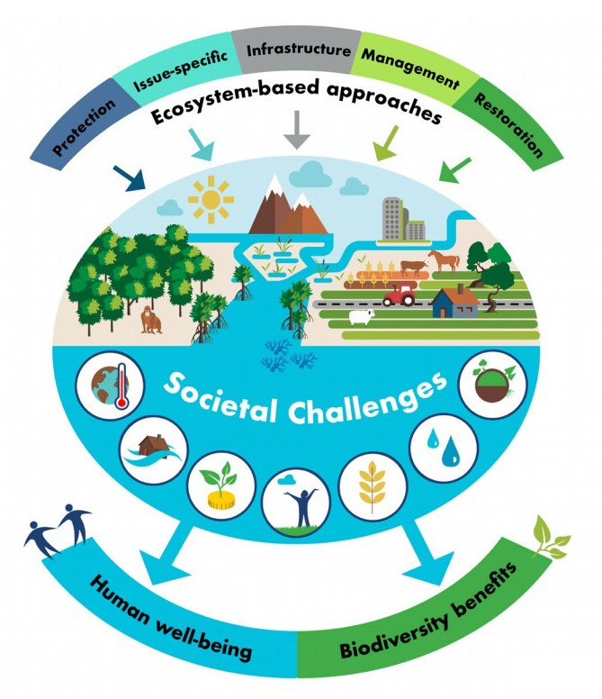
Benefits of NBS
Environmental, Social, and Economic Impacts
1. Environmental Benefits:
Climate change mitigation and adaptation.
Flood reduction and water quality improvement.
2. Social Benefits:
Healthier communities with improved access to green spaces.
Social cohesion and community engagement in NbS projects.
3. Economic Benefits:
Cost savings in stormwater management, flood prevention, and energy use.
Job creation in green sectors, such as urban gardening and landscape design.
Biodiversity restoration through green infrastructure.
Notes:
Must take the Triple Bottom Line into account
Reference and photo credit: International Union for the Conservation of Nature

Slide 5
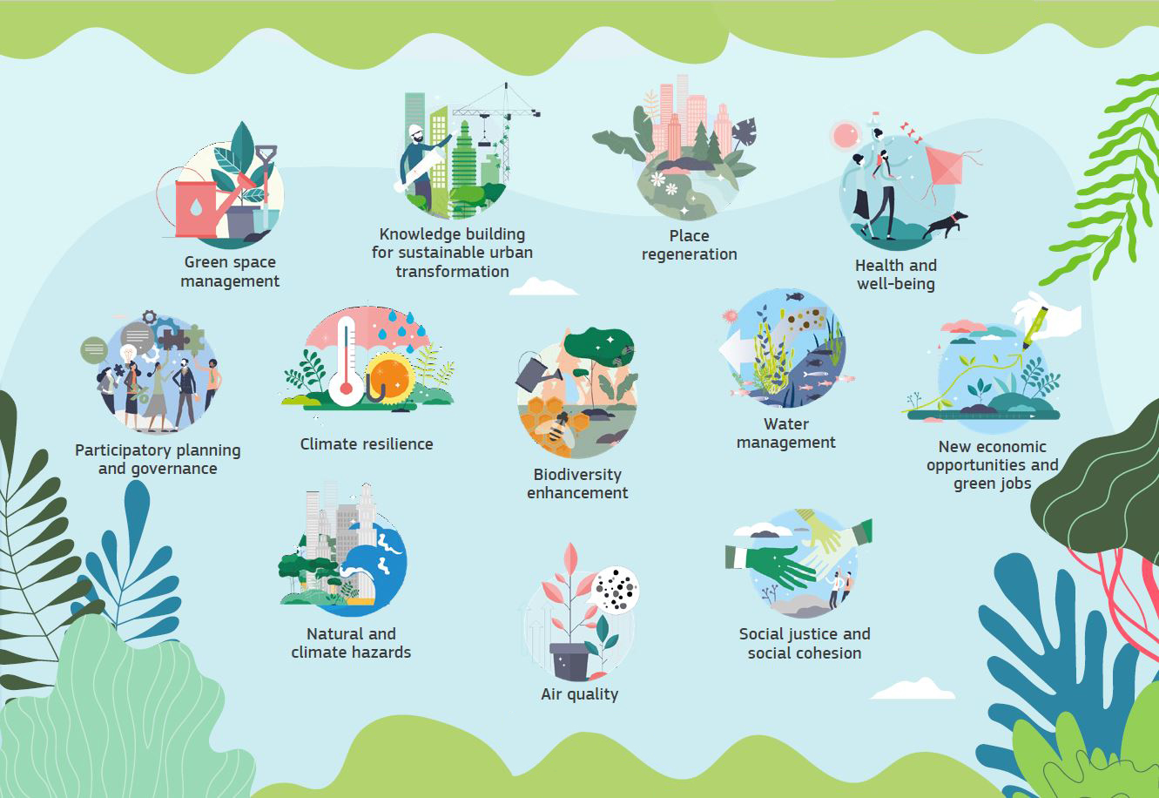
Summary of the Benefits of NBS: tackling the climate and biodiversity crisis
Reference: European Commission. 2021 Evaluating the impact of nature-based solutions

Slide 6
How to recognise an NBS?
1
2
3
4
5
Does it use nature/natural processes?
Does it provide/improve social benefits?
Does it provide/improve economic benefits?
Does it provide/improve environmental benefits?
Does it have a net-benefit on biodiversity?
Connop, S. “Nature-Based Solutions Explained.” Connecting Nature.
Notes:
5 questions to help students identify if a solution/intervention should be considered an NBS
Highlight examples as necessary: pocket parks, green walls/roofs, constructed wetlands etc

Slide 7
In-Class Exercise 1:
TAKE
FIVE
Objective: Apply NBS concepts to design a solution for a specific urban challenge.
Instructions:
Choose an urban challenge (e.g., flooding, heat islands, or pollution).
Propose an NBS solution (e.g., green roofs, rain gardens, or urban forests).
Discuss potential policy and community involvement strategies.
Notes:
Take 5 minutes to brainstorm in groups, following by a 5 minutes group discussion on the ideas produced
Learning Outcome: Understand the practical aspects of designing and implementing nature-based solutions at the local level.
Materials: teacher can summarise answers and/or include a summary slide on the projector to capture the discussion

Slide 8
NBS and the SDGs
NBS are contributing to Sustainable Development Goals (SDGs)
Key SDGs Linked to NBS:
SDG 6: Clean Water and Sanitation (e.g., SUDS for water management).
SDG 11: Sustainable Cities and Communities (e.g., urban green spaces).
SDG 13: Climate Action (e.g., forest restoration for carbon sequestration).
SDG 15: Life on Land (e.g., biodiversity conservation through NBS).
SDG 3: Good Health and Well-being (e.g., green spaces for public health).
Notes:
The 17 Sustainable Development Goals (SDGs), which are an urgent call for action by all countries - developed and developing - in a global partnership
UN Sustainable Development Goals, website: https://sdgs.un.org/goals

Slide 9
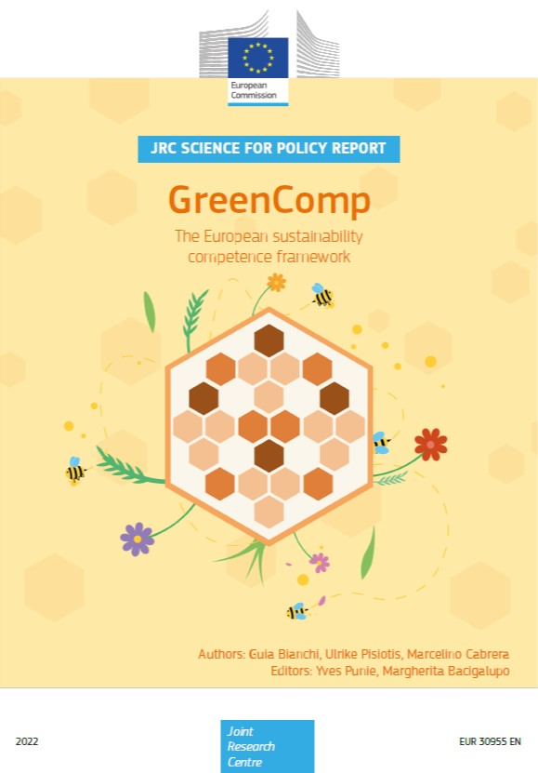
GreenComp: The European Sustainability Competence Framework
Promoting sustainability concepts via lifelong education and training exercises
Four competence areas:
1- Embodying values: a) valuing sustainability, b) supporting fairness,
c) promoting nature;
2- Embracing complexity in sustainability: a) systems thinking, b) critical
thinking, c) problem framing
3- Envisioning sustainable futures: a) futures literacy, b) adaptability,
c) exploratory thinking
4- Acting for sustainability: a) political agency, b) collective action, and
c) individual initiatives (Bianchi et al, 2022)
Reference: GreenComp 2022

Slide 10
GreenComp: Skills to address environmental challenges
Understanding sustainable development principles
Assessing environmental impacts
Implementing eco-friendly practices
Promoting circular economy models
Utilising renewable energy sources
Developing innovative solutions
A wide range of skills to address environmental challenges.
The framework aims to ensure that individuals and businesses have the necessary competences to actively participate in and support the transition towards a greener and more sustainable future.
Source: Utkarsh et al 2023 Learning from NBS EduSystems inspiring initiatives

Slide 11
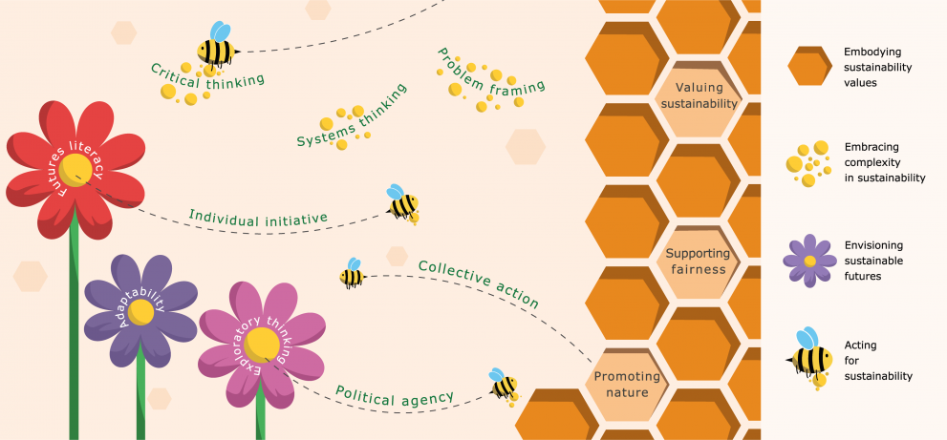
Components of GreenComp
Reference: GreenComp 2022

Slide 12
Nature Based Entrepreneurship
Opportunities for Businesses to Implement NBS
Eco-Entrepreneurship: New business models in green construction, urban farming, and green infrastructure solutions.
Corporate Responsibility: Companies investing in NBS projects to reduce their environmental footprint and contribute to SDGs.
Example: Private developers partnering with local authorities to implement green infrastructure in new housing projects.
For a list of Nature Based Enterprises check out the ‘Connecting Nature Enterprise Platform’
Notes:
For a list of Nature Based Enterprises check out the ‘Connecting Nature Enterprise Platform’: https://www.horizonnua.eu/cnep

Slide 13
Local Government & NBS
The Role of Public Administration in Implementing NBS
Policy Development: Creating policies and incentives to promote NBS
Zoning and Urban Planning: Integrating green infrastructure and permeable surfaces into development codes.
Community Engagement: Involving local groups in planning and implementation through public consultations and workshops.
Two local government partners from NBS EduWORLD who are promoting NBS in Ireland and Portugal
Notes:
Offaly County Council, Ireland: https://www.offaly.ie/
Almada, Portugal: https://www.cm-almada.pt/

Slide 14
Local Government & NBS
How Local Communities Can Engage in NBS Projects
Co-designing NBS solutions with the community.
Volunteer Programs: Local groups can participate in tree planting, maintenance of green spaces, and monitoring NBS projects.
Community-Led Monitoring: Using citizen science to track the effectiveness of NBS in urban environments.
Notes:
Local Government Actions:
Mandating green roofs and rain gardens in new developments.
Revitalizing public parks with sustainable landscaping.
Incorporating SUDS (Sustainable Urban Drainage Systems) to reduce urban flooding

Slide 15
Potential of NBS and ‘Green Gentrification’
Greening efforts NBS integration may result in exacerbated social exclusion:
increased rents
inflated property taxes
displacement of residents
Building trust, ownership, and support among all those directly or indirectly affected by these solutions - regardless of income, gender, and race - and benefitting society at large.
Reference: Network Nature: Knowledge Brief 3

Slide 16
In-Class Exercise 2:
TAKE
FIVE
Objective: Understand the role of public-private partnerships in implementing NBS.
Instructions:
Design a model for a public-private partnership that involves local governments, private companies, and local communities.
Discuss potential funding sources, roles, and responsibilities.
Notes:
Take 5 minutes to brainstorm in groups, following by a 5 minutes group discussion on the ideas produced
Learning Outcome: Learn how collaboration can help scale up NBS projects and increase their effectiveness.
Materials: teacher can summarise answers and/or include a summary slide on the projector to capture the discussion

Slide 17
Monitoring & Evaluating Impacts
Tracking the Success of NBS Projects
Monitoring Tools: Use of smart sensors, IoT devices, and data analytics to track NBS performance (e.g., water quality, temperature, and biodiversity).
Evaluation Metrics: Assess environmental, social, and economic outcomes, including carbon sequestration, flood risk reduction, and public health improvements.
Example: The Green4CITIES project uses smart technology to monitor the impact of green infrastructure in urban settings.
Notes:
Example projects

Slide 18
Conclusion
NBS as a Pathway to Sustainable, Resilient Cities
Nature-Based Solutions (NBS) are crucial for creating sustainable, resilient, and healthy urban environments.
Local governments play a pivotal role in enabling the integration of NBS into urban planning, policymaking, and community engagement.
Collaboration between governments, local community groups, and private sectors is essential for ensuring the success and long-term impact of NBS.
Notes:
Explore the 50 Learning Units to find educational material in any of the learning areas
The learning units are free to use and edit
Please give credit to the NBS EduWORLD project where learning unit content is used

Slide 19
Credit for this learning unit content: Trinity College Dublin

