Slide 1
Challenges in Financing and Supporting NBS
Online lecture
Credit: Trinity Business School, Trinity College Dublin
Content created in 2024

Slide 2
Learning Outcomes for this Learning Unit
Examine NBS projects and their finance model to understand their importance in achieving EU and global carbon-neutrality and other sustainability targets.
Analyse EU Emissions Trading System (ETS) and evaluate Phase IV (2021 - 2030)
Critically evaluate private green financing and other support schemes, such as budgetary transfers, insurance, taxes, PPP (Public-Private Partnership)
Consider the challenges in applying NBS should stakeholders express opposing views and vested interests.

Slide 3
Defining Nature-Based Solutions (NBS)
Energy and resource-efficient solutions
locally adapted
use the power of nature with commendable sophistication
“simultaneously provide environmental, social and economic benefits by bringing more nature and natural features and processes into cities, landscapes and seascapes”
(European Commission, 2015)
NBS should be more effective and resource saving than traditional approaches.

Slide 4
Elements of Nature-Based Solutions (NBS)
NBS
Enhancing sustainable urbanisation
Restoring degraded ecosystems
Developing climate change adaptation and mitigation
Improving risk management and resilience
Adapted from: (European Commission, 2015)​

Slide 5
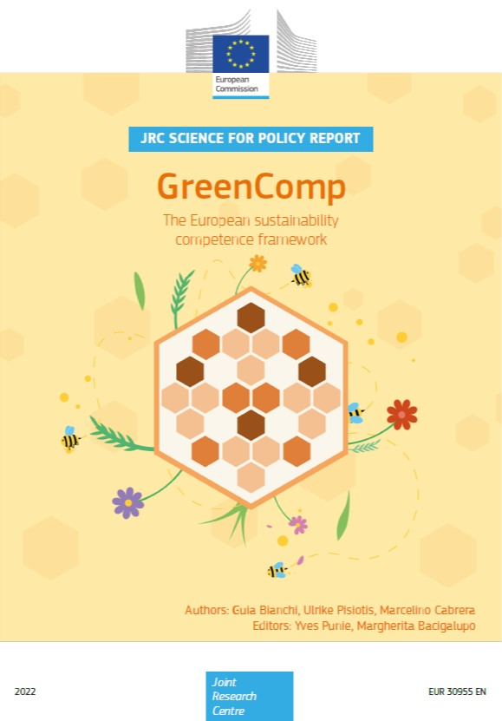
GreenComp: The European Sustainability Competence Framework
Promoting sustainability concepts via lifelong education and training exercises
Four competence areas:
1- Embodying values: a) valuing sustainability, b) supporting fairness,
c) promoting nature;
2- Embracing complexity in sustainability: a) systems thinking, b) critical
thinking, c) problem framing
3- Envisioning sustainable futures: a) futures literacy, b) adaptability,
c) exploratory thinking
4- Acting for sustainability: a) political agency, b) collective action, and
c) individual initiatives (Bianchi et al, 2022)
Photo Credit and Reference: Bianchi et al. GreenComp (2022) Link

Slide 6
EU Emissions Trading Systems (ETS)
Established in 2005 as a cap-and-trade system
companies are allowed to emit some carbon dioxide,
trade in trade allowances (EUA), representing the carbon credits
Each EUA equals one tone of carbon dioxide
Each company needs to purchase if the CO₂ emission is beyond the determined cap level.
Industries in ETS within EEA:
electricity and heat generation
production of iron, aluminium, metals, cement, lime, glass, ceramics, pulp, paper, cardboard, acids and bulk organic chemicals, oil refineries, steel works and commercial aviation.
European Commission – EU ETS Web page Link

Slide 7
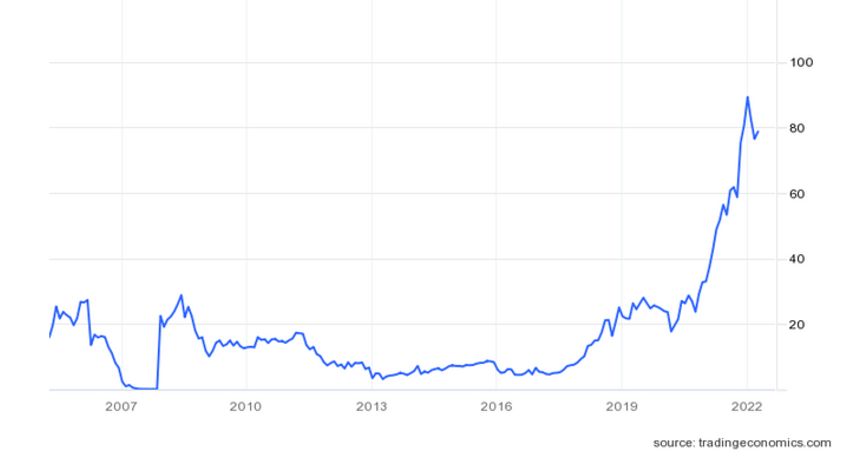
The price carbon permits
The price of carbon permits was mainly in the range between €5 and €25 pre tonne.
In February, 2023, the reported price reached €100.
In 2022, high gas prices and a move to high-carbon coal caused in increase in CO₂ emissions,(Climate Trade, 2022) which in turn impacted the demand for permits.
In 2023, the delay in permit issuance caused a price spike.
Reference and Photo credit: Trading Economics - Link

Slide 8
EU’s Carbon Border Adjustment Mechanism (CBAM)
Aims to reduce the carbon emission outside of EU member states, by determining a fair prices of carbon dioxide emitted during the manufacturing process.
On 1st October, 2023 the CBAM entered the transition phase that will last until 2025.
Starting 2026, if goods are covered by CBAM, EU importers must register themselves and purchase CBAM certificates.
CBAM certificate prices determined by average weekly auction prices of EU ETS allowances.
importers must inform authorities of the carbon emission levels in imports and then submit the corresponding number of certificates per year (European Commission, 2024)

Slide 9
Nature-Based Solutions - examples
Urban areas: parks, city forests, street trees, green roofs, ponds
Agriculture: soil and water management, crop diversification, agroforestry, paludiculture
Water Management: river restoration, buffers, eco-hydrological forest management
Forests and forestry: restoration, protection and connection, sustainability, forest and tree inclusion in the landscape
Coastal areas: restoration and rehabilitation, barrier islands, beach development
Protecting areas: reforestation, timber use for water retention, microbial use in growing vegetation. (European Commission 2015)

Slide 10
Financing Solutions - NBS
Economic incentives:
reduction of concrete areas = lower utility fees.
credit for urban development and subsidies/payments are positive factors.
Economic disincentives:
Conversion fees for highly valuable land should discourage the use for other purposes.
150 biodiversity-linked taxes and one of the effective examples is a pesticide tax.
Insurance:
Insurance companies rewarding risk-reducing behaviour (e.g. reductions in premiums and deductibles)
flood resilience evaluation rewarded with lower premium
Recognising the value of ecosystems.
Mesoamerican reef scheme, (60 km of coastal area) protected by purchasing parametric insurance triggered by damaging wind speeds and by collecting taxes from tourism. (European Environment Agency, 2021)

Slide 11
Financing Solutions
Green loans and bonds:
finance green projects, i.e. those that are environmentally beneficial. (European Environment Agency, 2021)
Natural Capital Financing Facility:
established by the European Investment Bank and European Commission in 2016
supports biodiversity and foster ecosystem adaptation (anticipating and mitigating the damage of adverse changes, while also taking advantage of opportunities) to the climate change.
Loan size of up to €15 million, with a grace period of up to three years.
Financing examples:
restoration of coastal seagrass
regeneration of disused brownfield sites
restoration of grassland habitat
river restoration for pro-biodiversity businesses. (NCFF, 2016)

Slide 12
Challenges
Citizen can hinder the implementation of projects via
Outright contestations
Inaction
Lack of civic engagement
Lack of consideration for legal provisions
Some outcomes are positive, but unintended
When seeking feedback, citizen are less interested in green agenda and more in increased convenience
self-selection of citizens with negative attitudes during consultations (Wamsler et al., 2020)

Slide 13
Calculating NBS and Green Infrastructure Projects
Example to consider financial value of NBS:
Stormwater Management Calculator link
Evaluate benefits of green infrastructure to prevent urban flooding.
https://gib-foundation.org/wp-content/uploads/2019/12/ThinkNature_Handbook_20190913.pdf

Slide 14
Developing a NBS Business Case
Example to consider financial value of NBS:
Stormwater Management Calculator link
Evaluate benefits of green infrastructure to prevent urban flooding.
Somarakis et al 2019 - Think Nature NBS Handbook

Slide 15
Challenges – how can this be mitigated?
Citizens do not prefer the planting of more street trees, because of bird droppings.
Sea wall may be preferred by owners of houses closest to the sea. However, for others the wall may obstruct the view of the sea.
Green sea wall sometimes cannot be erected because the citizens were building on municipal land and then even sold properties with the municipal land being misappropriated.
Promoting environmental agendas against taller buildings could be strategically more focused on getting extra time to increase resistance to the project. However, taller buildings save space, as opposed to sprawling one-family houses, and it is environmentally more sustainable.
Lack of greenery is a general impression among citizens, but when it comes to implementation, the specifics are not accepted by citizens.

Slide 16
Credit for this learning unit content: Aleksandar Sevic,
Trinity Business School – Trinity College Dublin

