Slide 1
Socio Economic Impacts of NBS
Lecture (online)
Learning Unit 14
Credit: Trinity College Dublin
Content created in 2024
Notes:
This presentation details the socio-economic impacts of Nature-Based Solutions (NBS), focusing on how they can be measured, explaining the triple bottom line, and exploring the importance of complex systems where nature underpins the economy. The information is based on data gathered from EU-funded NBS projects
There are two class exercises designed for group work – please allow 10-15 minutes for these
This presentation is designed for a third-level audience
Key Learning Outcomes:
Students will understand the socio-economic impacts of Nature-Based Solutions and how to measure them.
They will gain insight into the triple bottom line (TBL) approach and its application in urban planning.
Students will engage in critical thinking about the benefits and drawbacks of NbS and public perceptions.
They will develop the ability to assess and design sustainable urban solutions that balance environmental, social, and economic factors.

Slide 2
Introduction
The Socio-Economic Impacts of Nature-Based Solutions (NBS)
Exploring how NBS contribute to the triple bottom line (environmental, social, and economic outcomes).
The role of EU-funded projects in measuring and showcasing these impacts.
Understanding impact through a SWOT analysis

Slide 3
NBS Definition – EU
“Solutions that are inspired and supported by nature, which are cost-effective, simultaneously provide environmental, social and economic benefits and help build resilience.”
Such solutions bring more, and more diverse, nature and natural features and processes into cities, landscapes and seascapes, through locally adapted, resource-efficient and systemic interventions.
Reference: European Commission
Notes:
Think of an example

Slide 4
Measuring Impacts
How Do We Measure the Socio-Economic Benefits of NBS?
Environmental Metrics: Reduction in CO2 emissions, increased biodiversity, improved water quality.
Social Metrics: Health and well-being improvements, community engagement, social cohesion.
Economic Metrics: Cost-benefit analysis, job creation, property value enhancement, long-term savings.
Notes:
Examples: Green roofs, urban forests, sustainable agriculture, and restored wetlands.

Slide 5
Triple Bottom Line (TBL)
Understanding the TBL
People: Social equity, health benefits, and quality of life improvements.
Planet: Environmental sustainability through enhanced biodiversity, pollution control, and resource conservation.
Profit: Economic sustainability, including cost savings, job creation, and resilience to economic shocks.
The TBL ensures that NBS are evaluated comprehensively, considering the full range of impacts.

Slide 6
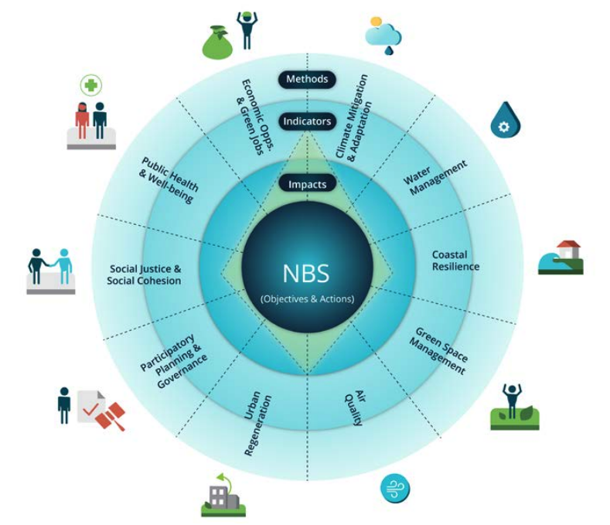
Measuring NBS Impact
EKLIPSE Framework
10 Climate resilience challenges considered in the impact assessment framework
Notes:
Eklipse Report: https://www.iflaeurope.eu/assets/docs/EKLIPSE_Report1-NBS_FINAL_Complete-02022017_LowRes_4Web.pdf
EKLIPSE NBS Impact Assessment Framework: The NBS impact assessment framework (slides 9 and 10) builds on and supports several other closely related concepts, including the ecosystem approach, ecosystem-based adaptation and mitigation, green and blue infrastructure and ecosystem services (European Commission, 2015). The European Commission, through MAES (Mapping and Assessment of Ecosystems and their Services), is assisting Member States in the process of mapping and assessment of ecosystems and their services, as well as assessing the economic value of such services, and incorporating these values into EU and national accounting and reporting systems (European Commission, 2013). T

Slide 7
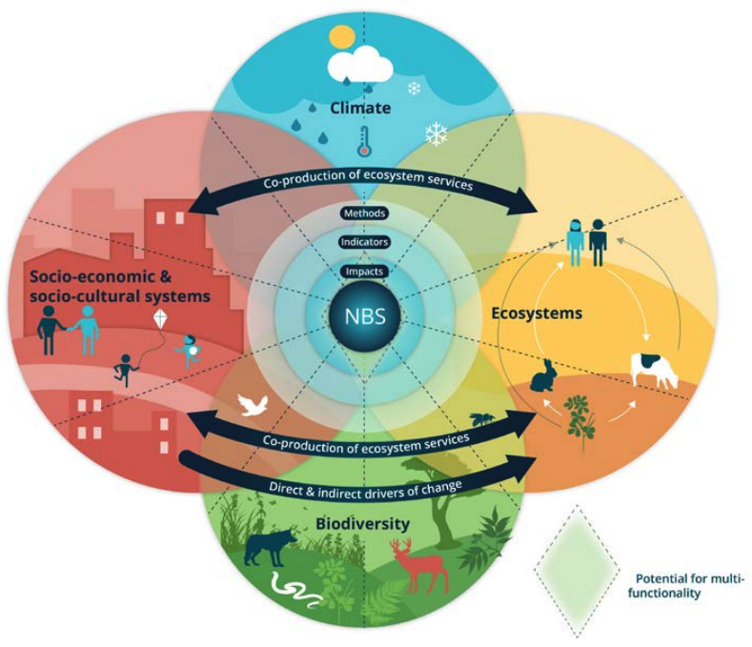
Measuring NBS Impact
EKLIPSE Framework
Notes:
Eklipse Report: https://www.iflaeurope.eu/assets/docs/EKLIPSE_Report1-NBS_FINAL_Complete-02022017_LowRes_4Web.pdf

Slide 8
Complexity & NBS
Complex Systems Thinking
Cities and ecosystems are complex systems with interrelated components that function together.
Nature underpins the economy by providing essential services (e.g., clean air, water, climate regulation).
NBS are integrated solutions that enhance both natural systems and human systems (economic, social, and cultural).
Notes:
Green4CITIES: https://www.green4cities.com/en/

Slide 9
Research on Measuring Impact
EU-Funded NBS Projects Measuring Socio-Economic Impacts
Green4CITIES: Focuses on green urban infrastructure, its role in improving biodiversity, and the socio-economic impacts of green spaces LIFE UrbanGreen: Measures the long-term socio-economic benefits of NBS in cities, such as cost savings in flood management
Natura2000: Focuses on preserving biodiversity and its economic value in land management, agriculture, and tourism sectors.
Eklipse: helps governments, institutions, businesses, and NGOs make better-informed decisions when it comes to biodiversity and ecosystem services in Europe.
Notes:
Note this list Is not exhaustive, the network nature website is a useful resource for finding alternative sources:
https://networknature.eu/ridb?field_ridb_societal_challenges_tid=3485&field_ridb_approach_tid=All&field_ridb_environment_tid=All&field_ridb_programme_tid=All&field_ridb_nbs_type_tid=All&combine=

Slide 10
Social Impact
The Social Benefits of NBS
Improved Health and Well-being: Access to green spaces reduces stress, improves mental health, and increases physical activity.
Social Cohesion: NBS create spaces for community interaction, enhancing social bonds and collective action.
Cultural and Aesthetic Value: Green spaces improve the aesthetic quality of urban areas, attracting tourists and enhancing the local community's identity.

Slide 11
Economic Impact
Understanding the Economic Value of NBS
Job Creation: NBS can create green jobs in sectors like landscaping, environmental monitoring, and urban planning.
Cost Savings: Sustainable stormwater management through NBS can reduce costs associated with flood damage and water treatment.
Increased Property Values: Well-maintained green spaces can increase property values and attract investment.
Notes:
Economic Impact: The implementation of green roofs and green spaces has been shown to increase property values. A study in Barcelona found that properties near green spaces had an average value increase of up to 12% (Yanez et al., 2023)
Reference:
European Commission, NaturaCity website: https://naturacity.co.id/en/projects/

Slide 12
Environmental Impact
How NBS Contribute to Environmental Sustainability
Carbon Sequestration: NBS like reforestation and wetland restoration absorb CO2, helping mitigate climate change.
Biodiversity Enhancement: Creating green corridors and restoring ecosystems increases biodiversity and supports ecosystem services.
Pollution Reduction: NBS such as green roofs and permeable pavements help reduce urban pollution levels.
CO₂

Slide 13
In-Class Exercise 1:
TAKE
FIVE
In-Class Group Exercise: Analysing the Impact of a Local NBS Project
Objective: Students will assess the socio-economic impacts of an existing NBS project (e.g., urban green space, wetland restoration) in a European city.
Tasks:
Identify the environmental, social, and economic benefits of the project.
Discuss the challenges in measuring these impacts and how to overcome them.
Present the findings to the class, including recommendations for improving the project’s impact.
Notes:
Learning Outcome: Students will understand how to assess the multi-dimensional impacts of NBS on urban environments, focusing on measuring socio-economic outcomes.
Materials: teacher can summarise answers and/or include a summary slide on the projector to capture the discussion

Slide 14
Public Representation
How Public Perception Affects the Success of NBS
Public perception is a crucial factor in the implementation and maintenance of NBS.
Barriers: Public scepticism, lack of awareness, or resistance to change.
Solutions: Education campaigns, community involvement in planning, and clear communication of benefits.
Example: ReGREEN project in Rome, which included community engagement to build public support for urban greening initiatives.

Slide 15
SWOT Analysis
1
STRENGTHS
Sustainability and Climate Resilience: NBS provide long-term sustainable solutions to climate-related urban challenges, such as flooding, urban heat islands, and biodiversity loss.
Cost-Effectiveness in the Long-Term: NBS are often more cost-effective than traditional "grey" infrastructure in managing urban water, reducing energy costs, and mitigating climate impacts.
Health and Well-being Benefits: NBS improve public health by providing accessible green spaces, enhancing mental well-being, and promoting physical activity.
Biodiversity Enhancement: NBS can restore urban ecosystems, improve habitats, and support the restoration of local biodiversity in cities.
NBS and their impacts
Notes:
The following slides give an overview of the main Strengths, Weaknesses, Opportunities, Threats of NBS and their impacts

Slide 16
2
WEAKNESSES
High Initial Costs: Establishing NBS can require significant upfront investment for green spaces, urban forests, or green roofs. Example: Urban wetlands restoration requires high initial funding and expertise.
Land Constraints: Limited space in dense urban areas for large-scale green infrastructure. Example: High-density areas like Paris face challenges in integrating green spaces.
Complex Management: NBS require continuous monitoring, maintenance, and coordination across urban departments. Example: Maintenance of green roofs and urban parks can be resource-intensive.
Public Resistance: Some communities may resist changes, especially in areas with limited knowledge of NBS benefits. Example: In some cities, the installation of green infrastructure is met with scepticism due to loss of parking or changes to established spaces.
NBS and their impacts
SWOT Analysis

Slide 17
3
OPPORTUNITIES
EU Funding: Multiple EU-funded programs (e.g., Horizon Europe, LIFE Program) support NBS projects focused on sustainability, biodiversity, and climate adaptation. Example: CIVITAS funds green mobility and infrastructure projects.
Public-Private Partnerships: Collaboration between governments, businesses, and local communities to implement and maintain NBS. Example: ReGREEEN fosters collaboration between multiple sectors to implement urban greening.
Technology Integration: Use of IoT, AI, and big data to monitor and optimize NBS for efficiency and effectiveness. Example: Smart sensors for green roof systems optimize energy use and stormwater management.
Increased Public Awareness: Growing recognition of the environmental and health benefits of NBS encourages investment and political will. Example: LIFE-IP UrbanGreening projects increased awareness of the social and environmental benefits of urban green infrastructure.
NBS and their impacts
SWOT Analysis

Slide 18
4
THREATS
Climate Change and Uncertainty: Changing climate conditions may challenge the effectiveness of NBS, particularly if not designed to handle extreme weather. Example: In cities like Brussels, urban flooding could reduce NBS effectiveness if extreme weather events are not accounted for.
Competing Urban Priorities: Urban governments may prioritize infrastructure development or housing over green spaces due to budget constraints. Example: Madrid has limited space for large-scale green infrastructure amidst growing population demands.
Funding and Resource Limitations: Even with EU funding, securing consistent investment for long-term NBS projects can be challenging. Example: Projects like Sustainable Drainage Systems (SuDS) require continuous funding for maintenance.
Public Perception and Resistance: Lack of awareness or reluctance to change can slow down the adoption of NbS. Example: In some urban areas, public resistance to the loss of traditional spaces (e.g., parking) for green projects can hinder NBS implementation.
NBS and their impacts
SWOT Analysis

Slide 19
In-Class Exercise 2:
TAKE
FIVE
In-Class Group Exercise: Triple Bottom Line Analysis
Objective: Students will work in groups to evaluate the triple bottom line (TBL) of a proposed NBS project.
Tasks:
Discuss the social, economic, and environmental benefits of implementing a specific NBS (e.g., green infrastructure, tree planting, urban farming).
Create a proposal that balances all three aspects of TBL, offering potential solutions to improve the project’s overall impact.
Present the analysis to the class.
Notes:
Learning Outcome: Students will understand how to assess the multi-dimensional impacts of NBS on urban environments, focusing on measuring socio-economic outcomes.
Materials: teacher can summarise answers and/or include a summary slide on the projector to capture the discussion

Slide 20
Holistic Assessment
Social
Environment
Economic
Why a Holistic Approach is Essential for NBS
NBS should be evaluated holistically, considering long-term sustainability, community engagement, and economic viability.
The triple bottom line (TBL) approach ensures that all dimensions of the solution are considered before, during, and after implementation.
Complex systems thinking allows cities to identify interdependencies between ecological, social, and economic systems.

Slide 21
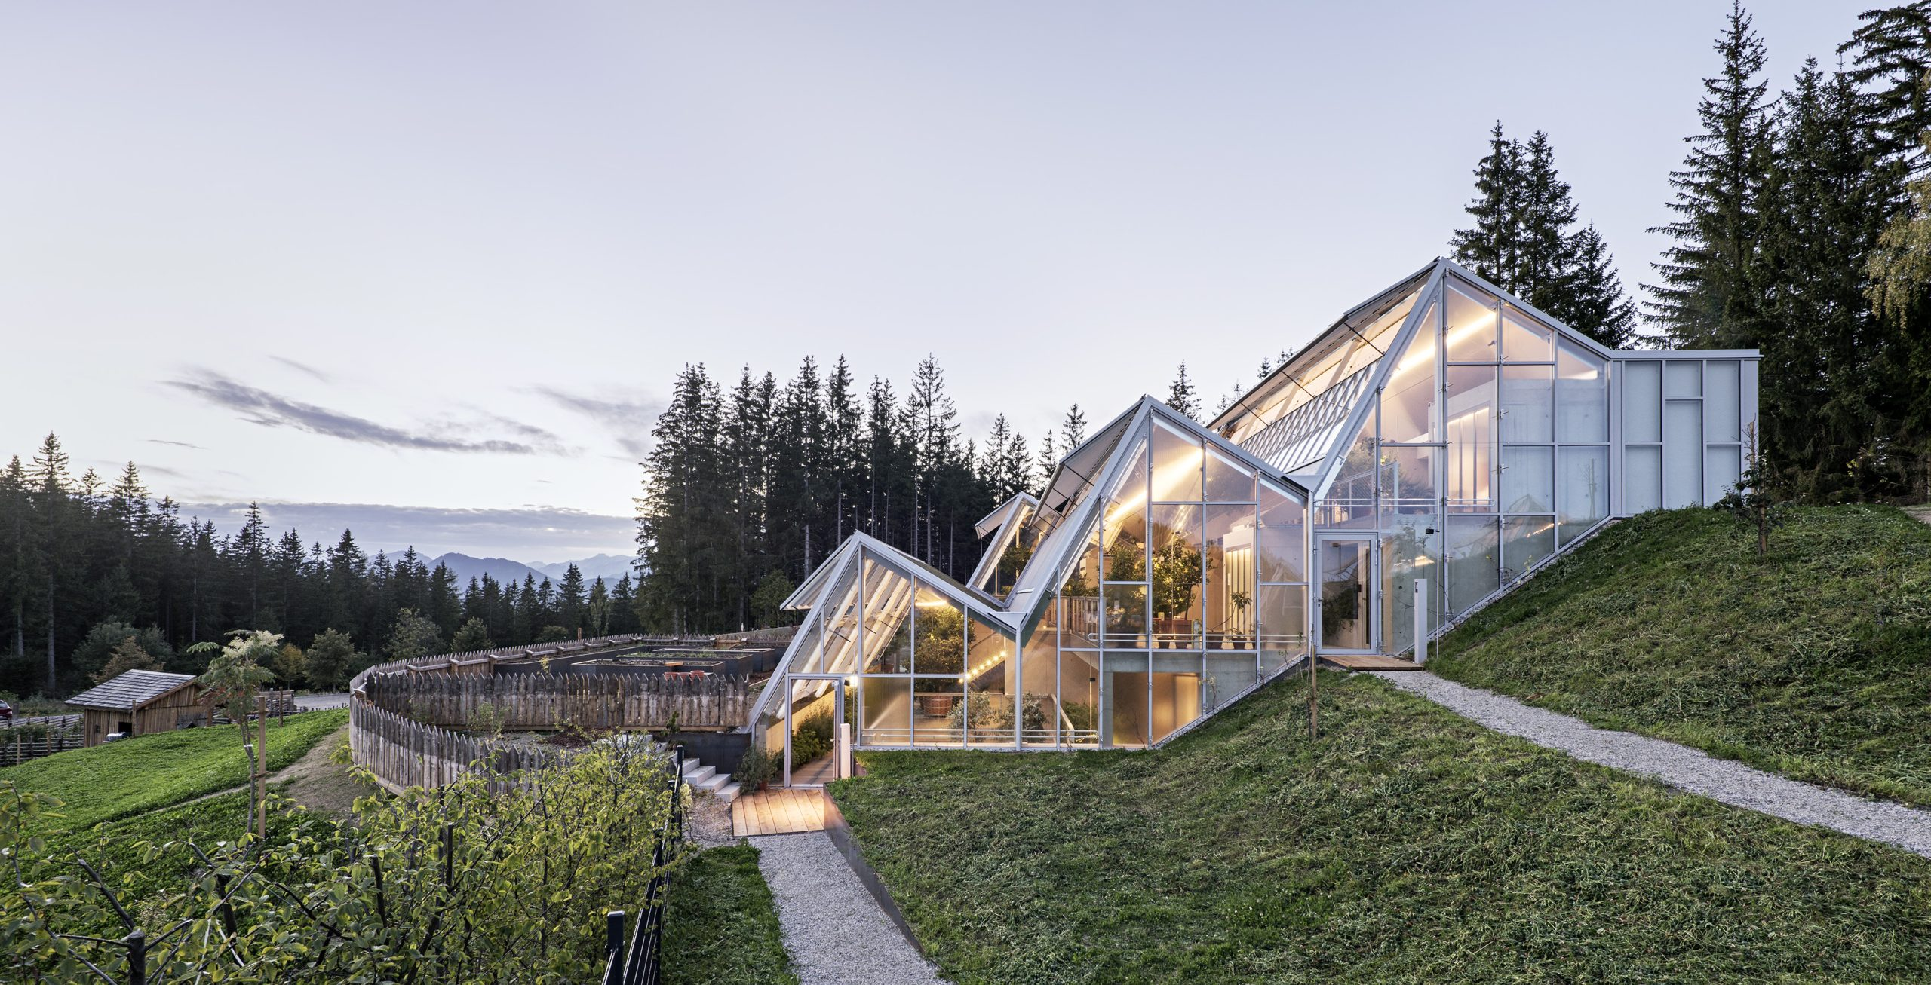
Case Example: The Green4CITIES Project
How Green4CITIES Measures the Socio-Economic Impacts of NBS
Example: Green4CITIES integrates green urban infrastructure and measures its impact on biodiversity, public health, and economic development.
The project assesses the cost-effectiveness of various NBS, such as urban forests and green walls, to provide benefits such as cooling, stormwater management, and social inclusion.
Notes:
Photo Credit: Green4CITIES

Slide 22
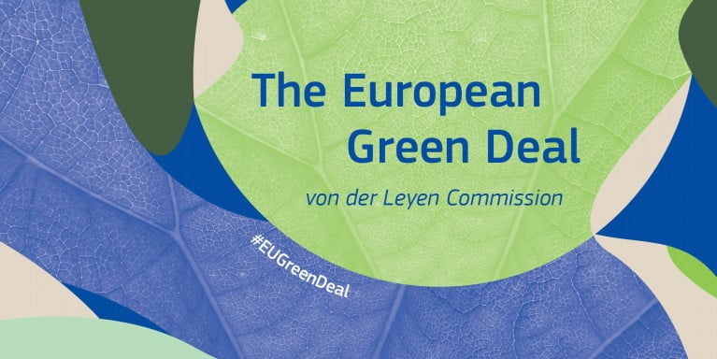
Policy Support for NBS
Policies Supporting the Development and Implementation of NBS
EU Green Deal: Supports NBS as part of the transition to a carbon-neutral economy.
Nature Restoration Law: Aims to restore degraded ecosystems and integrate NBS in urban planning.
Horizon Europe: Provides funding for research and innovation in NBS, including social, environmental, and economic assessments.

Slide 23
The Future of NBS and Sustainable Cities
Envisioning a Future with NBS at the Core of Urban Development
The growing importance of NBS in smart cities and climate-resilient urban planning.
The future will see greater integration of NBS, socio-economic impact assessments, and smart technologies to create sustainable, resilient cities.
Cross-sector collaboration will be key to maximizing the benefits of NBS.

Slide 24
Conclusion
NBS as Catalysts for Sustainable Urban Development
Nature-Based Solutions provide environmental, social, and economic benefits that are critical for the future of cities.
By embracing the triple bottom line, cities can create resilient, sustainable urban environments that enhance quality of life and foster long-term economic growth.
The socio-economic impacts of NBS should be carefully measured to ensure they deliver the maximum benefit for cities and their inhabitants.

Slide 25
Credit for this content:
Centre for Social Innovation, Trinity College Dublin

